Slide 1
Run 22 RHIC Machine/Experiments Meeting
October 26, 2021
Agenda:
Welcome and Overall schedule for the FY 22 RHIC run - W. Christie
C-AD/RHIC schedule from now to the start of the run - P. Sampson
STAR status, schedule, and goals for the run - J.H. Lee
CeC status, schedule, and goals for the run - V. Litvinenko
RHIC status, schedule, and commissioning plans - V. Schoefer
All Other Business (AOB)

Slide 2
Program Advisory Committee (PAC) recommendations on the 2022 RHIC Run
2.2 Discussion and Recommendations for RHIC Run 22
The Run 22 BUR of a transversely polarized pp run at 510 GeV with the STAR Forward Upgrade represents a unique opportunity to address important issues in spin physics and will allow exploration of the regimes of low and high-x physics with unprecedented precision. New results anticipated for Run 22 with the Forward Upgrade can have important impacts on the planning for EIC, as well as on the interpretation of EIC data. The PAC strongly endorses the STAR Run 22 BUR.
.
.
.
If Run 22 were to be reduced from 20 to 18 weeks that would result in at least a 15% reduction of the integrated luminosity and have a very detrimental effect on the prospects of achieving all the physics goals. Given that the CeC beam time would additionally reduce the STAR run by 2.6 weeks, this would have further negative effects on the physics programme. C-AD is strongly encouraged to optimize RHIC operations to fulfill the goals of both CeC and STAR.
What is shown here are the first and eighth paragraphs from the PAC report concerning the 2022 RHIC run. The other paragraphs of the section deal with physics, as opposed to operations topics.

Slide 3
Rough Look at Long Term Schedule
2021 |  |  |  |  |  |  |  |  |  |  |  | 2022 |  |  |  |  |  |  |  |  |  |  |  | 2023
J | F | M | A | M | J | J | A | S | O | N | D | J | F | M | A | M | J | J | A | S | O | N | D | J | F
SD1
2021 Run (24 wks) 1/25 – 7/12
SD2 (18 wks) 7/12 – 11/15
2022 Run (20 wks) 11/15 – 4/4
sPHENIX1 (16) 4/4 – 7/25
sPHENIX2 (17 wk) 7/25 – 11/23
sPHENIX3 (67 D) 11/24 – 1/30
2023
Run
N.B. Whereas STAR was asked to submit a BUR for the 2021 run for 24 and 28 Cryo weeks, the baseline schedule above assumes 24 weeks for the 2021 run.
N.B. This Schedule was the result of meetings that were held in late summer of 2020 to discuss the longer-term schedule. So far it has held up very well.

Slide 4
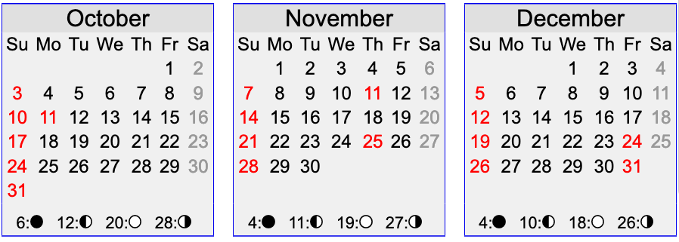
A calendar for the remainder of Calendar 2021
Today’s date
Scheduled start of Helium cooldown

Slide 5
All Other Business (AOB)
AOB

