Slide 1
Run 2022
Scheduling Physicist: Andrei Poblaguev
e-mail: poblaguev@bnl.gov
Office Phone: 631-344-7508

Slide 2
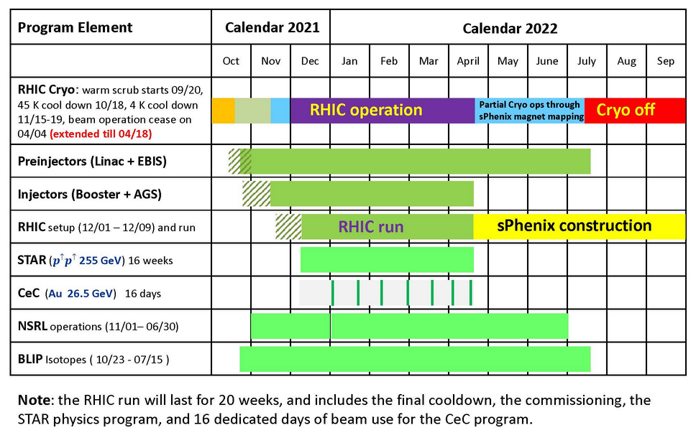
Run22 Schedule
*
*RHIC Operation was granted a 2 week run extension, ending on 4/18 instead of the original end date of 4/4

Slide 3
Run22 Schedule Timeline
Blue cooldown begins: 11/28/2021
Yellow cooldown begins: 11/30/2021
Blue 4K reached: 11/29/2021
First circulating bunch (Au) in Blue: 12/03/2022
Yellow 4K reached: 12/02/2021
First circulating bunch in Yellow (Au): 12/05/2022
CeC PoP Start: 11/24/2021
Physics Start for Polarized Protons: 12/22/2022
End Physics Operations: 04/18/2022
Begin Cryo Warmup: 04/18/2022
RHIC Activities End: 04/18/2022
Cryo Warmup Complete: 05/03/2022

Slide 4
Mode Timeline
Mode 1A: polarized p on polarized p at 254.2 GeV particle energy
Beam Operation: 12/03/2021 - 04/18/2022 [136 days, 128 days for physics]
(interleaved with Mode 2A)
Mode 2A: ¹⁹⁷Au⁷⁹⁺ in Yellow ring for CeC PoP at 26.5 GeV/nucleon particle energy
Beam Operation: 11/24/2021 - 04/18/2022 [145 days, 8 days for experiment] (interleaved with Mode 1A)

Slide 5
Run Coordinators
Vincent Schoefer [RHIC Operations]
e-mail: schoefer@bnl.gov
Office Phone: (631) 344-8453
Modes of Operation: 1A, 2A
Vladimir Litvinenko [CeC Operations]
e-mail: vl@bnl.gov
Office Phone: (631) 344-2570
Modes of Operation: 2A
Igor Pinayev [CeC Operations]
e-mail: pinayev@bnl.gov
Office Phone: (631) 344-5706
Modes of Operation: 2A

Slide 6
Run Overview

Slide 7
Major accomplishments and events
OPPIS LEBT modified (Einzel lenses replaced by quadrupoles) for higher transmission
Multiple start-up issues: AGS cold snake short to ground, Booster vacuum restoration, Siemens rheostat repair, AGS high leakage current during high-pot, AGS cable tray damage in conduit under road, AGS dipole coil replacement, vacuum leak in Yellow IR7 triplet, stuck vacuum valve in BtA - replaced with spool piece, cryo control upgrade completion delayed full 4K cool-down by 13 days (time used to setup CeC electron beam), BNL site-wide power outage of 86 sec on 12/02/2021 - about 1 day recovery (found a helical magnet in Blue snake bi9 damaged after recovery)
prepared new bunch split and merge scheme to reduce peak current at AGS injection and thereby emittance: additional bunch split on intermediate energy level in Booster and recombination at AGS before extraction (not used with Westinghouse MG)
40 Ohm injection kickers (used for low energy runs) inadvertently installed for Run-22 resulting in a kick too weak by 10-15%, switched to nominal 25 Ohm resistors for Blue and Yellow on 4/4/2022
helical dipole 2 of Blue snake bi9 found to be open (possibly damage in power outage), need to run with configuration like in Run-3 (Yellow snake with same problem): 2 inner helical dipoles turned off, 2 outer helical dipoles a full strength with field reversed - provides a partial snake with 90% spin rotation
after power dip on 12/13/21 found helical magnet 4 in Blue snake bi9 also damaged, reconfigured again to use helical magnets 1 and 3 for a partial snake (can be done from outside)
work on 7b-qd1 quench detection system requires 5x longer energy ramp for 3 days (12/25-27/2021)
changed store energy from γ = 271.635 (Gγ = 487.0) to γ = 270.938 (Gγ = 485.75) to have nearly vertical spin direction in all locations with bo9 partial snake - in particular pC polarimeters and STAR, beginning with fill no. 32934 (01/02/2022)
Siemens MG set damage on 01/12/2021, switch to Westinghouse MG, switched back to Siemens on 03/08/2022 with new brushes and re-surfaced rings
no abort kicker pre-fires in physics with RHIC abort kicker relays and delayed aborts (first time ever for a high energy run)

Slide 8
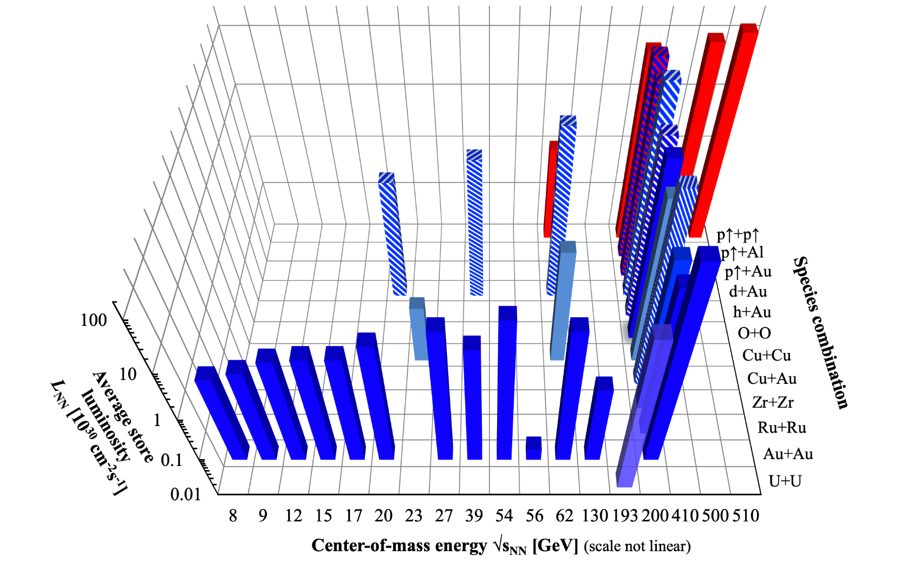
RHIC Energies, Species Combinations, and Luminosities (Run-1 to Run-22)

Slide 9
Run Parameters
Mode Name | Energy/ Nucleon [GeV] | No. Bunches | Ions/ bunch [10⁹] | Β* [m] | rms emittance [μm] | Run Avg. Store Polarization [%] | STAR Luminosity [pb⁻¹] | STAR Luminosity [rel. to Run-17]
1A | 254.2 | 111 | 200 | 1.5◻1.2◻1.0 | 2.5◻3.6 | Blue: 50 Yellow: 49.5 | 807 | 1.48x
1B | 26.5 | 12 | 1 | 5.0 | - | - | - | -
Total 18 days setup for physics
Nominal store length of 8 hours
first β*-squeeze immediately after energy ramp, second β*-squeeze after 3h

Slide 10
Time Spent per Mode

Slide 11
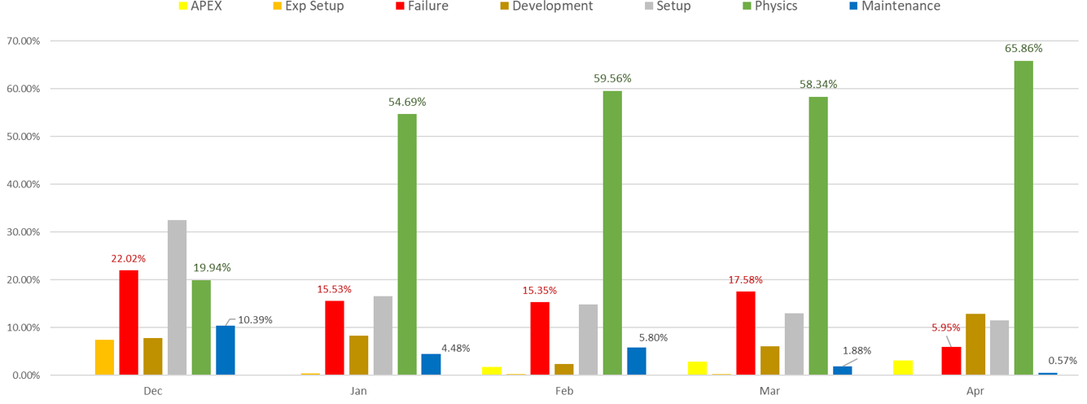
Run-22 Mode percentages

Slide 12
Mode percentages comparison

Slide 13
Failure Hours by System/Group

Slide 14
CeC Operations

Slide 15
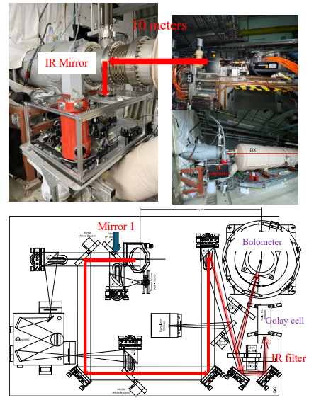
Cec results from run-22
Run-22 goal of demonstrating Coherent electron Cooling not met, CeC lost ~71% of operational time due to issues with Integrated Current Transformer and damage to the SRF gun during a cathode exchange
Primary CeC achievement for Run-22 was verifying high Plasma Cascade Amplification (PCA) gain at frequencies of 6 THz and above thanks to new pieces of IR diagnostics (For long time maximum observed PCA gain was ~ 5 with frequencies under 6 THz).
PCA Gain is measured by comparing IR radiation from PCA and relaxed lattice configurations. The radiation is delivered to the two most sensitive IR detectors (shown on right):
Golay cell: equipped with new IR filter (passband of 3.5 - 10 THz) improved its sensitivity at high frequencies
Cry-cooled bolometer: (spec sensitivity range: 6 THz -60 THz) first became operational and played important role

Slide 16
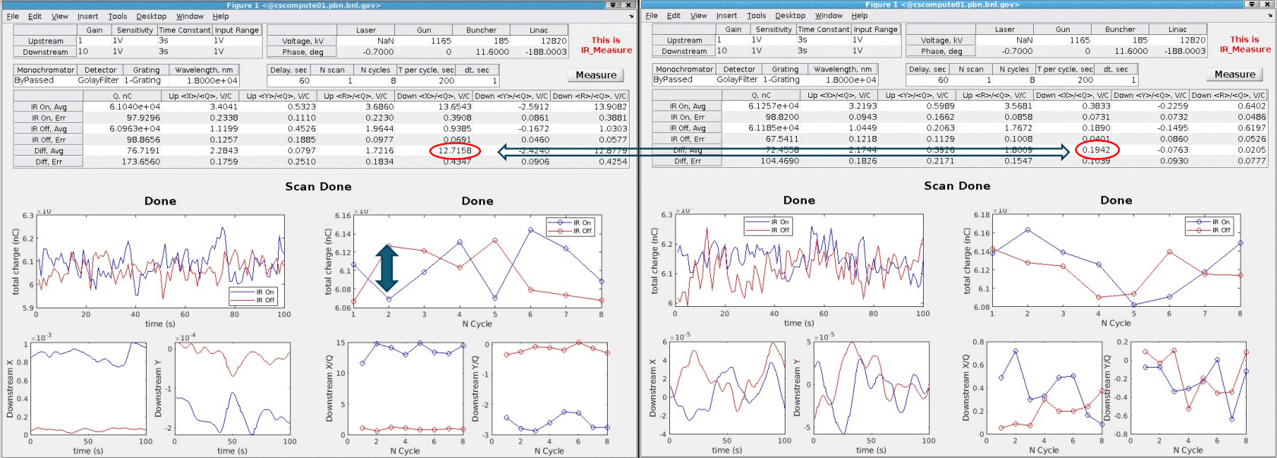
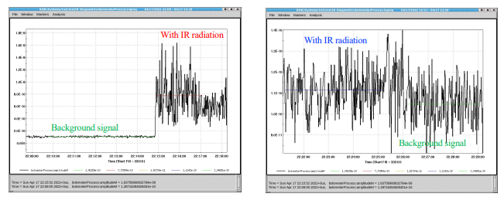
Cec results from run-22
Golay Cell Measurement*:
Gain = PCA /Relaxed = 65
Bolometer Measurement*:
Avg Gain = PCA /Relaxed ~ 100
Peak Gain = PCA /Relaxed ~ 300
*For a more in-depth explanation of these results and measurement methods, see the CeC presentation documented on the RHIC retreat page (linked at the end of presentation in the “Useful Links” section.

Slide 17
Luminosity for Polarized Proton Physics

Slide 18
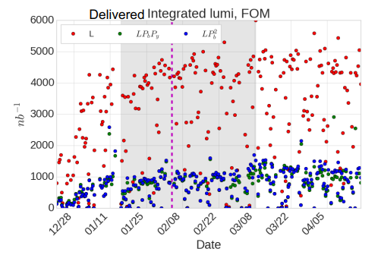
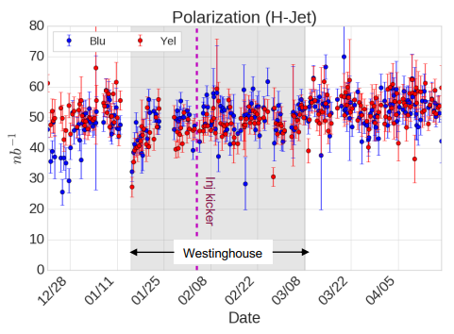
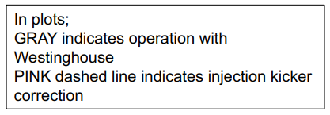

Slide 19
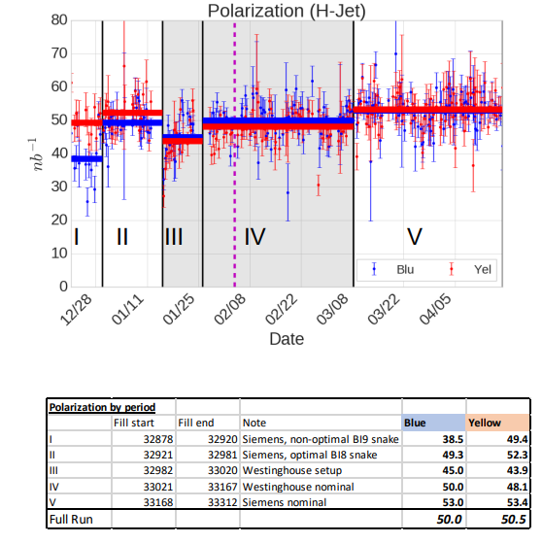
Siemens vs Westinghouse polarization

Slide 23
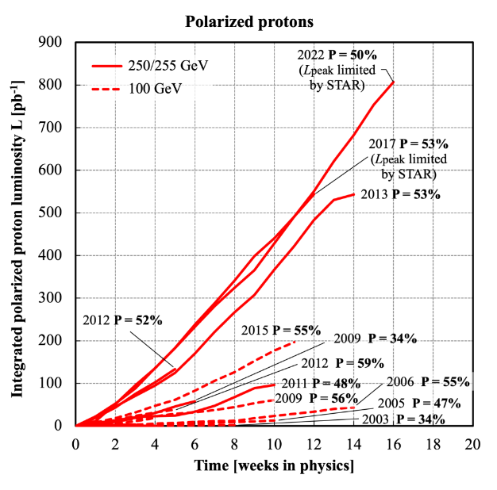
Comparison with other polarized proton runs

Slide 24
Power and Cryo Use

Slide 25
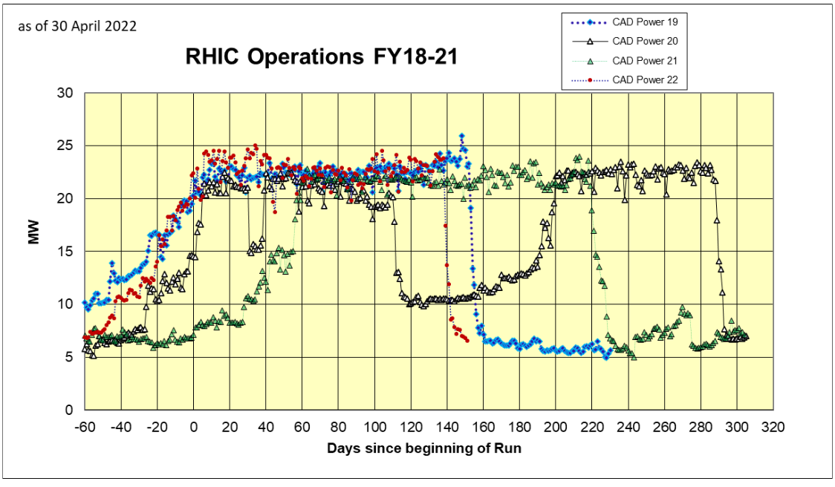

Slide 26
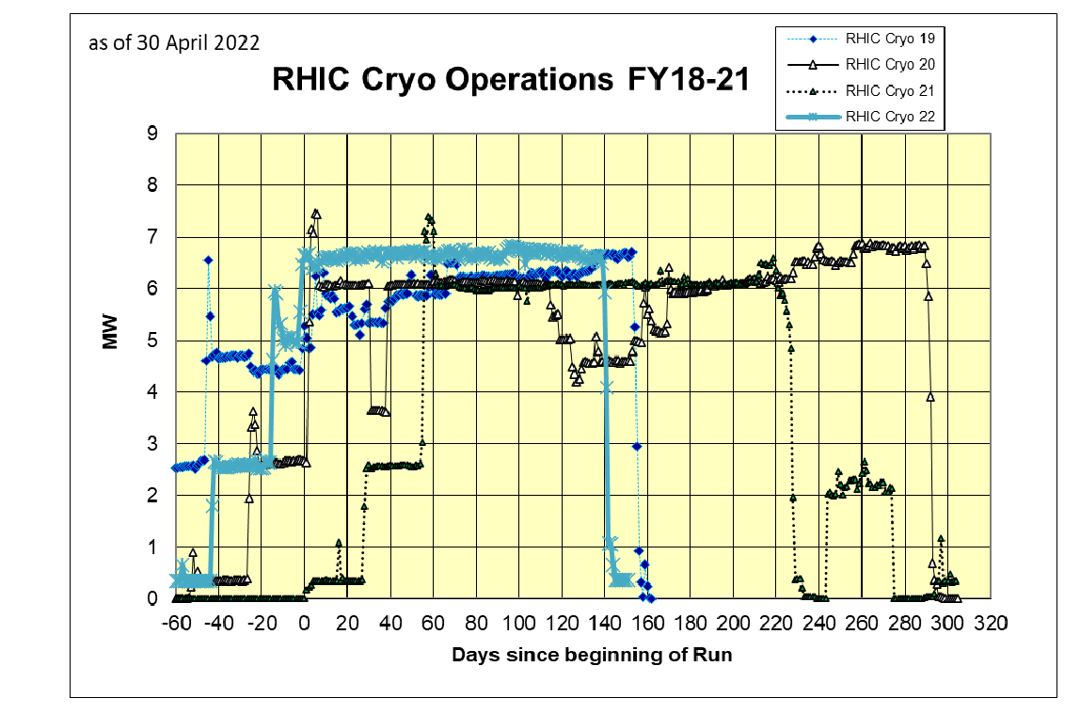

Slide 27
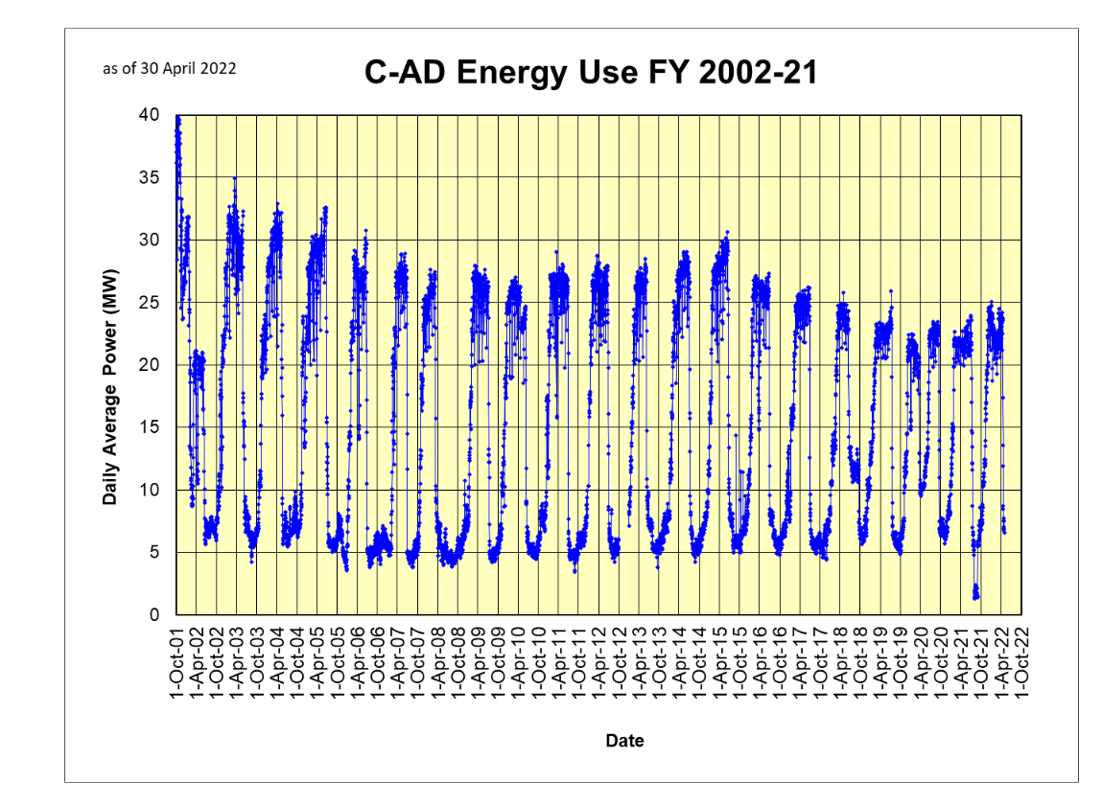

Slide 28
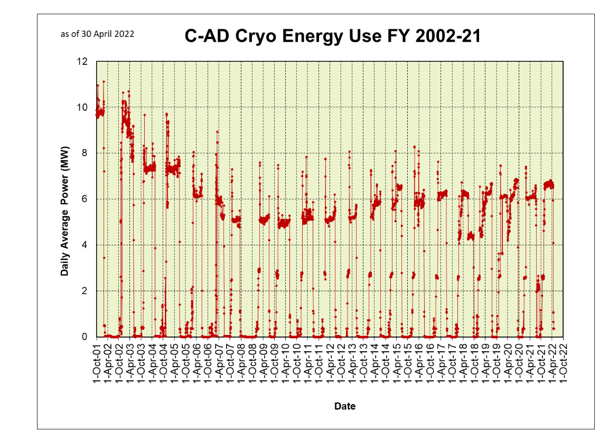

Slide 29
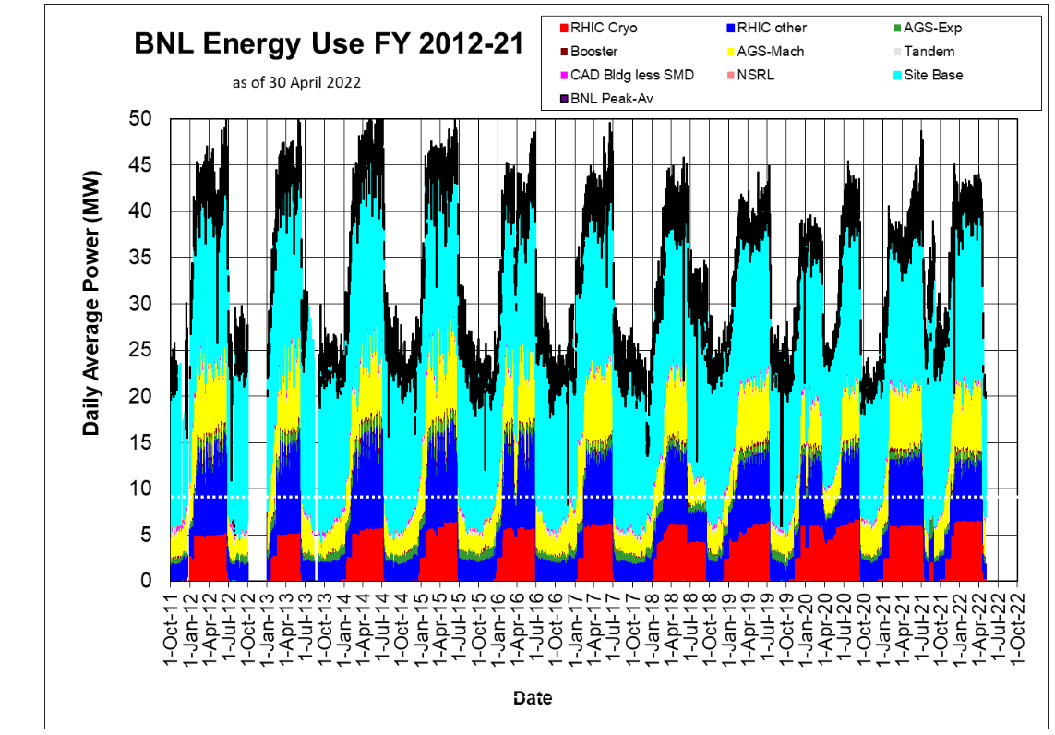

Slide 30
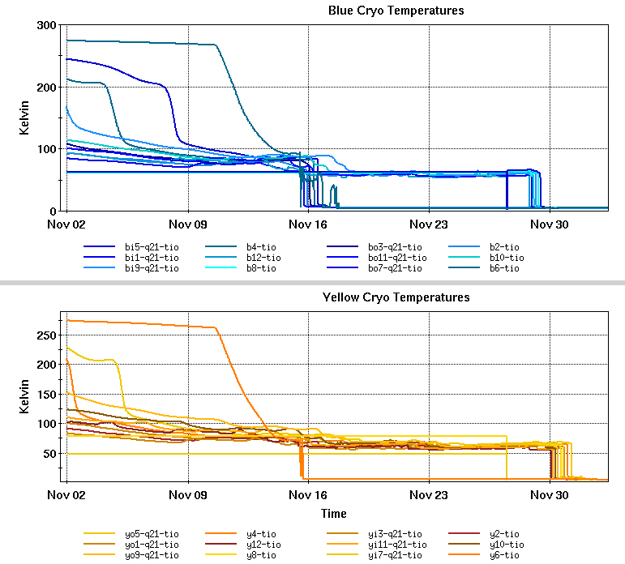
20 cryo-weeks cooldown

Slide 31
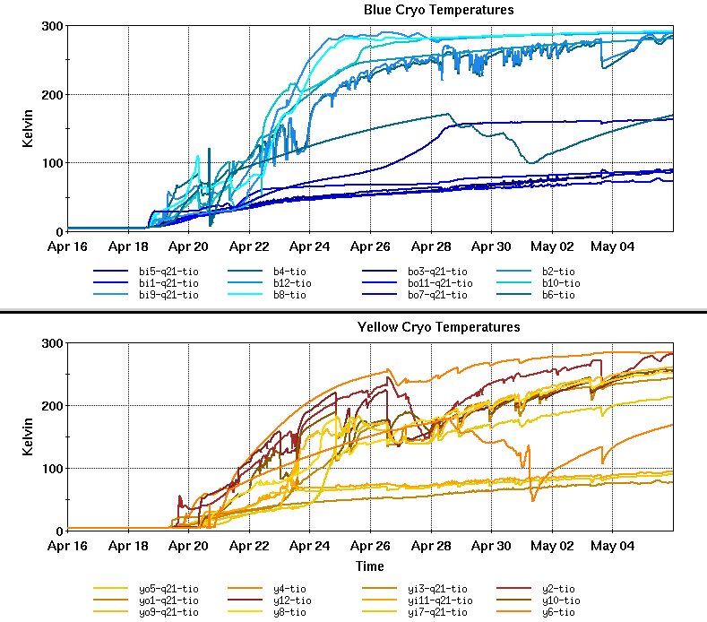
20 cryo-weeks warm up

Slide 32
Useful Links
Machine/Detector Planning Page
http://server.c-ad.bnl.gov/esfd/RMEM_22/rhic_planning.htm
RHIC Run Overview (FY01-FY22)
https://www.rhichome.bnl.gov/RHIC/Runs/index.html#Run-22
RHIC Retreat Page (FY22)
https://indico.bnl.gov/event/15353/
Store Statistics
https://www.cadops.bnl.gov/AGS/Operations/Run22/
Scheduling Physicist
https://www.c-ad.bnl.gov/esfd/Scheduling_Physicist/FY22_Collider-Accelerator_Schedule.htm

