Slide 1
RHIC Machine/Expt Planning Meeting
Jamie Dunlop
April 25 2023

Slide 2
Calendar Run 2023
Start Cooldown
15 weeks
20 weeks
Cooldown May 8
Nominally 20 cryoweeks:
  ends Sept 25

Slide 3
PAC Recommendations
The PAC continues to strongly support focusing in Run 23 on sPHENIX commissioning using 200 GeV Au+Au collisions. This is the highest priority and must come first.
Successful detector commissioning should be followed by continued running of 200 GeV Au+Au collisions to begin the sPHENIX scientific program. A central goal of this part of Run 23 can be referred to as “physics commissioning”
The allocation and deployment of beam time and computing resources during Run 23 should be guided by the perspective that successful sPHENIX installation, detector commissioning and “physics commissioning” is the prerequisite to successful operation of sPHENIX in Runs 24 and 25 so as to accomplish its science goals, which are the overarching priority for RHIC in 2023-25.
STAR has made a strong case for a broad, diverse, and complementary science program that it will be able to carry out using Au+Au data, beginning in Run 23. We commend STAR for its plans and look forward to seeing their measurements to come.

Slide 4
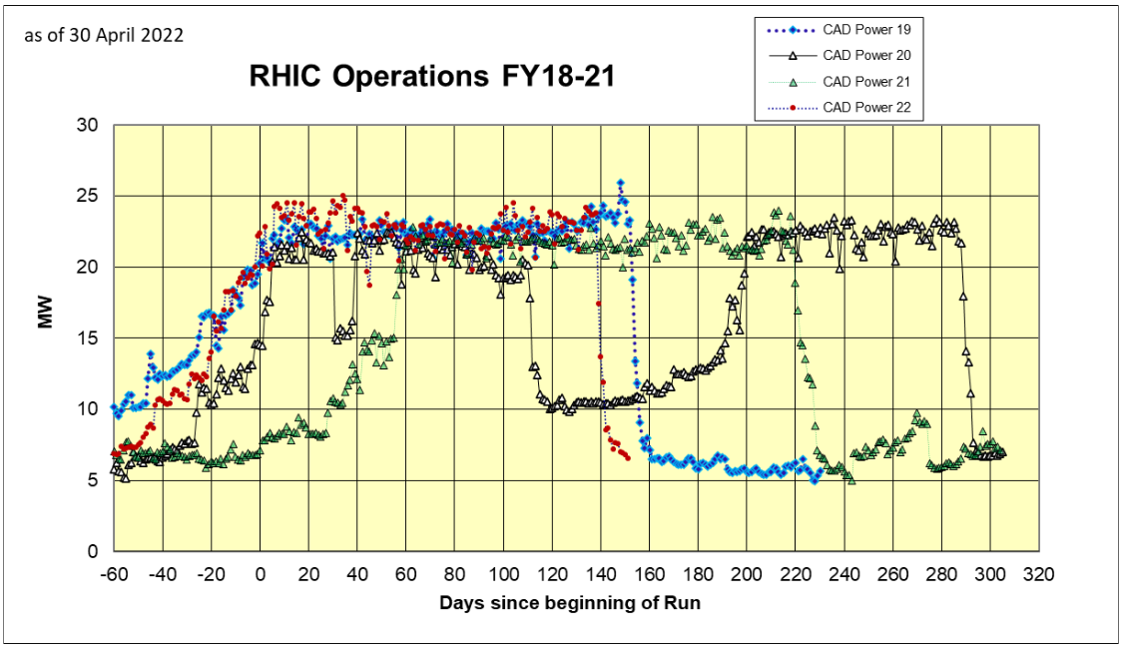
Costs of RHIC Running with full Cryo
1 hour of RHIC running uses enough energy to drive a Chevy Bolt ~100k miles
Effective communication needed for efficient use of time

