Slide 1
Take 5 for Safety
The Ripple Effect
C-AD ESSHQ Website
More on Housekeeping
Collider-Accelerator Department
1-12-2010

Slide 2
The Ripple Effect
Ring lighting especially at RHIC is degrading
Many cable trays are being installed that block existing lighting without moving the lights to an effective location as part of the tray work
Poor lighting slows down work in that portable lighting must be transported to the work site, set up, taken down and returned, which is further compounded by lack of sufficient vehicles
Outcome:
High stress levels due to less time devoted to performing assigned task
Aisle ways blocked by light stands and trip hazards from power cords
Consensus is that safety is definitely #1 from BNL management down to the worker; however, time pressures naturally cause workers to take shortcuts and use workarounds because they want to succeed in finishing their assigned work

Slide 3
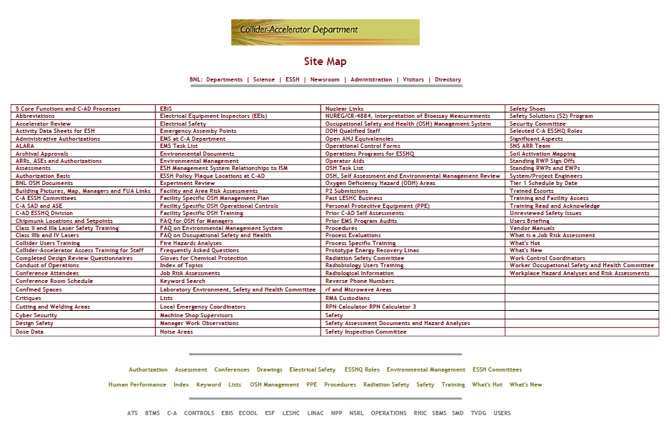
C-AD ESSHQ Website – oper8

Slide 4
More on Housekeeping at C-AD
Some staff do not feel energized about housekeeping in their workspaces and do not keep them very clean; reasons given:
Buildings go months without hot water, weeds blow into the work areas, there is not enough space for equipment or spares, rooms have not been painted for tens of years, roofs leak, lights do not work or are poorly arranged, in some areas custodial services do not exist, etc.
It is important to remember that we must fix the things we are responsible for (e.g., housekeeping in our own offices and work areas) and that we can’t control the work of others

Slide 5
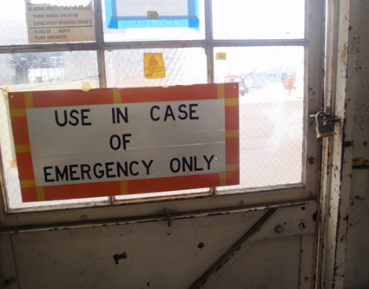
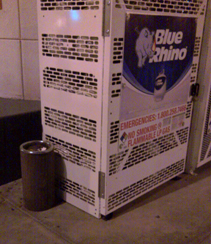
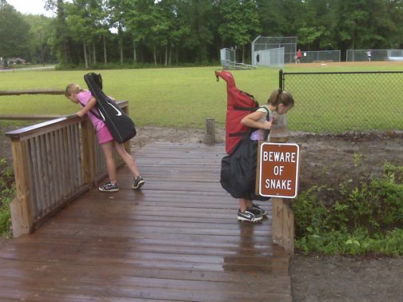
Signs

