Slide 1
PHENIX Status
Stefan Bathe

Slide 2
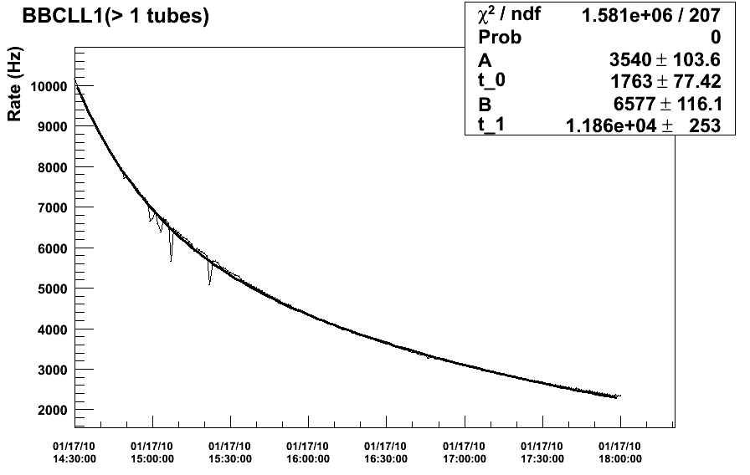
Beam Life Time
DAQ archiving rate

Slide 3
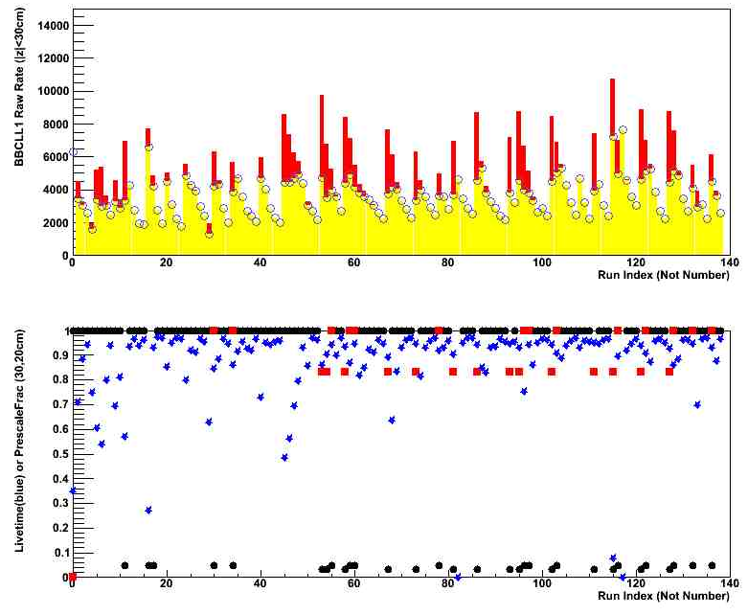
DAQ Performance

Slide 4
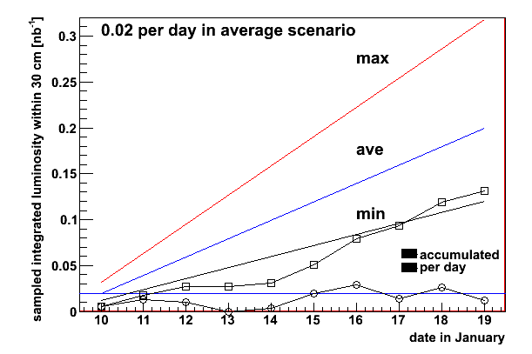
Sampled Integrated Luminosity

Slide 5
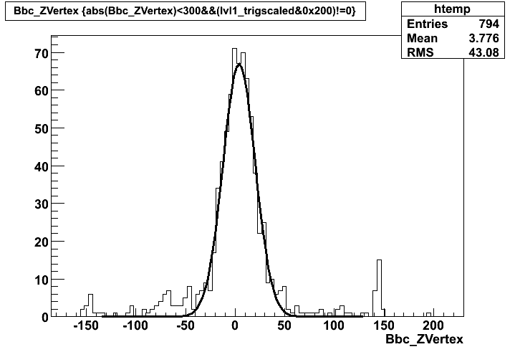
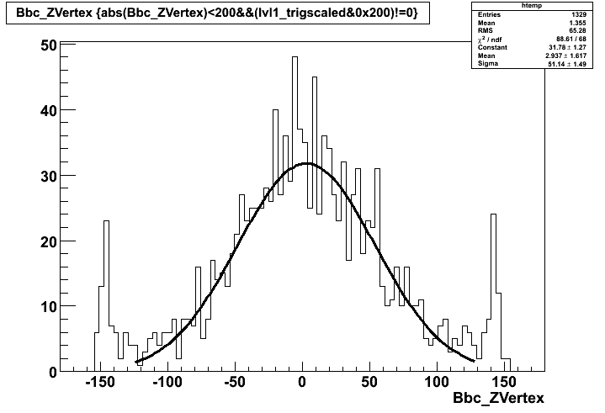
with rebucketing
fill 11382, 1/7
σ = 16.3 cm
cut acc.
30 cm => 90 %
20 cm => 76 %
10 cm => 45 %
without rebucketing
fill 11437, 1/12
σ = 50 cm
cut acc.
30 cm => 44 %
20 cm => 31 %
10 cm => 16 %
acc. hit
0.49
0.41
0.36

Slide 6
Extra slides

Slide 7
