Slide 1
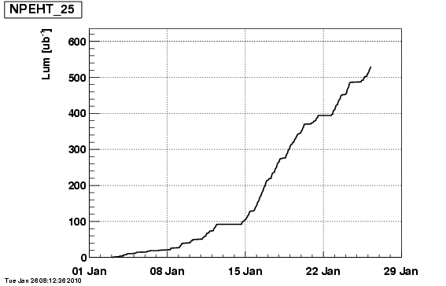
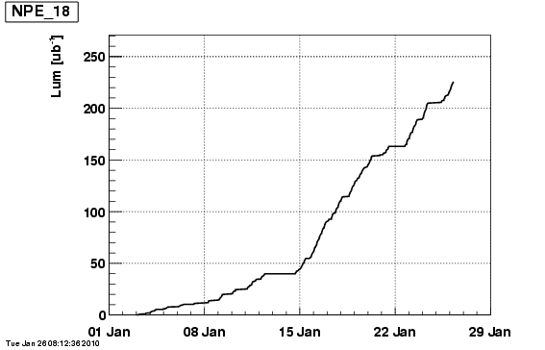
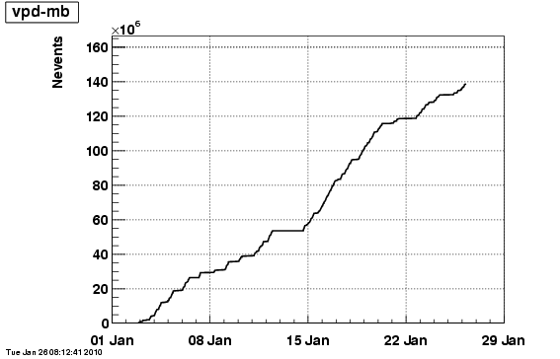
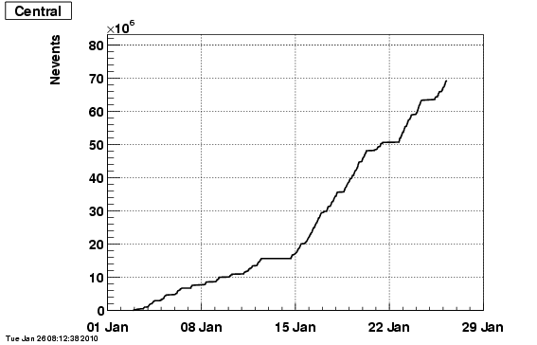
High Tower Trigger
No vertex cut
Thres. = 5.9 GeV
High Tower Trigger
Vertex cut ~ 40 cm
Thres. = 4.2 GeV
Base for Upsilon
“min-bias” Trigger
Vertex cut ~ 40 cm
Top 10% Central Trigger
Vertex cut ~ 40 cm

Slide 2
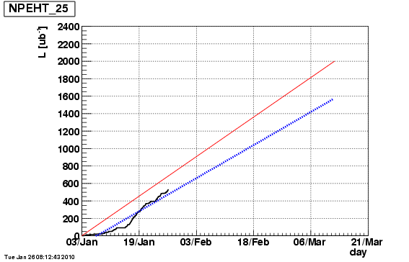
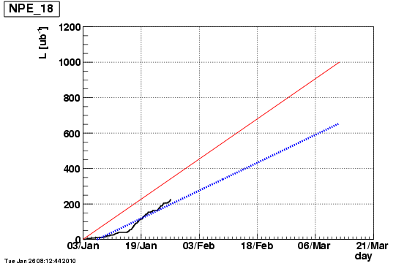
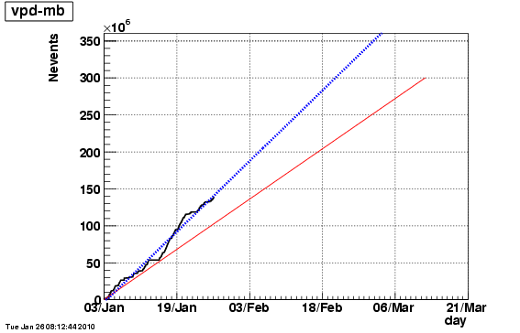
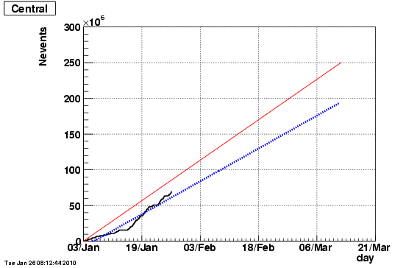
High Tower Trigger
No vertex cut
Thres. = 5.9 GeV
High Tower Trigger
Vertex cut ~ 40 cm
Thres. =4.2 GeV
Base for Upsilon
“min-bias” Trigger
Vertex cut ~ 40 cm
Top 10% Central Trigger
Vertex cut ~ 40 cm

