Slide 1
PHENIX Status
Time Meeting, 1/26/2010
Stefan Bathe

Slide 2
Sampled Integrated Luminosity

Slide 3
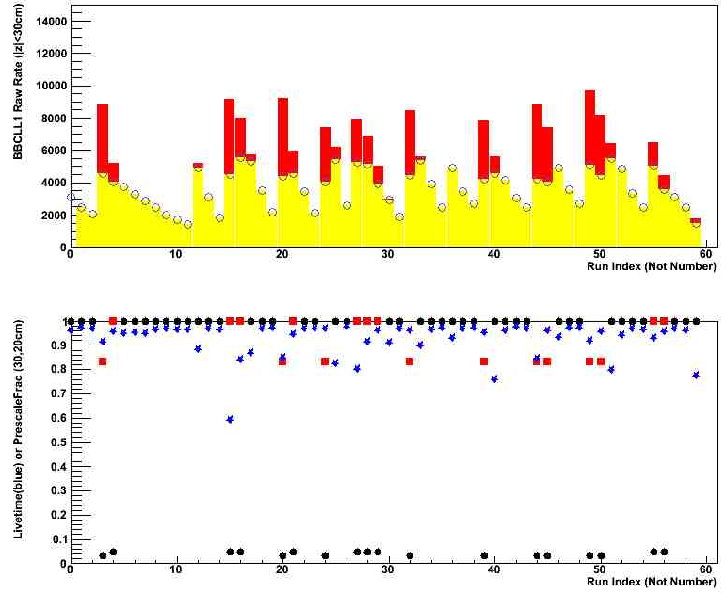
DAQ Performance
Friday (1/22) – today (1/26)

Slide 4
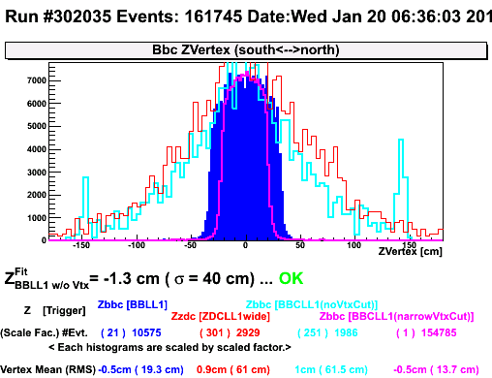
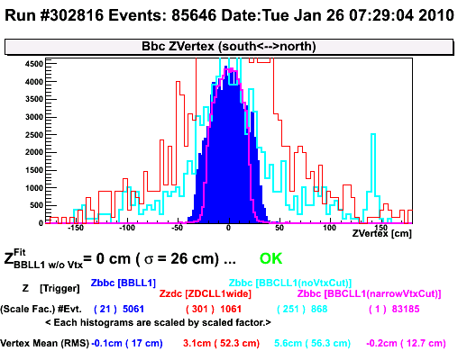
1-2 h into fill
w/ rebucketing
62% of 6.8 b (BBC)
48% of 10 b (ZDC)
1-2 h into fill
w/o rebuck.
43%, 25%
1-2 h into fill
No common
Cavities
48%, 28%
1-2 h into fill
2 common
Cavities
53%, 32%

Slide 5
1-2 h into fill
w/o rebuck.
43%, 25%
Used for luminosity estimate:
65%
1-2 h into fill
No common
Cavities
48%, 28%
1-2 h into fill
2 common
Cavities
53%, 32%

Slide 6
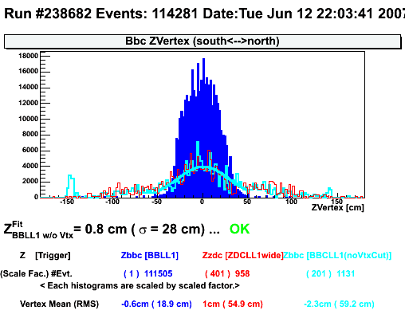
1-2 h into fill
Run-07
48%, 29%
1-2 h into fill
w/o rebuck.
43%, 25%
1-2 h into fill
No common
Cavities
48%, 28%
1-2 h into fill
2 common
Cavities
53%, 32%

Slide 7
Beam Life Time
DAQ archiving rate
Saturated for
1.5 h
(was 1 h 10 min on 1/17

Slide 8
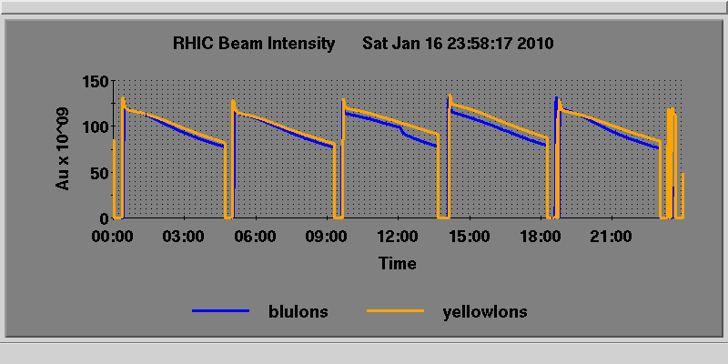
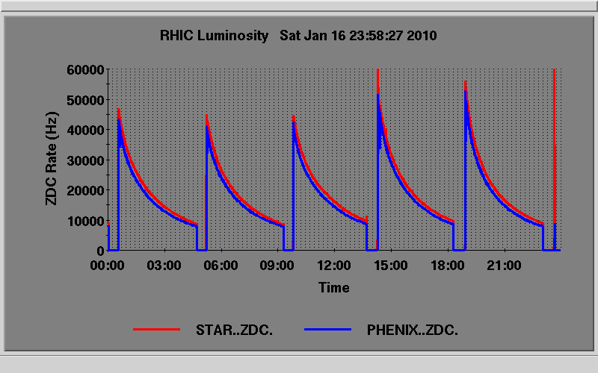
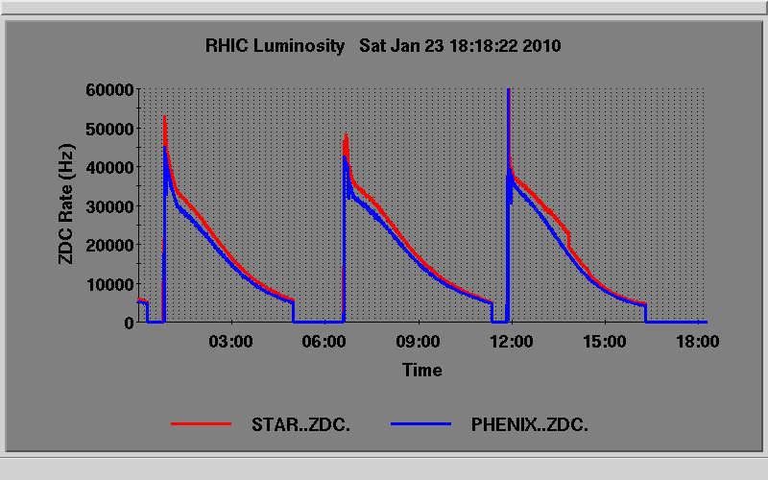
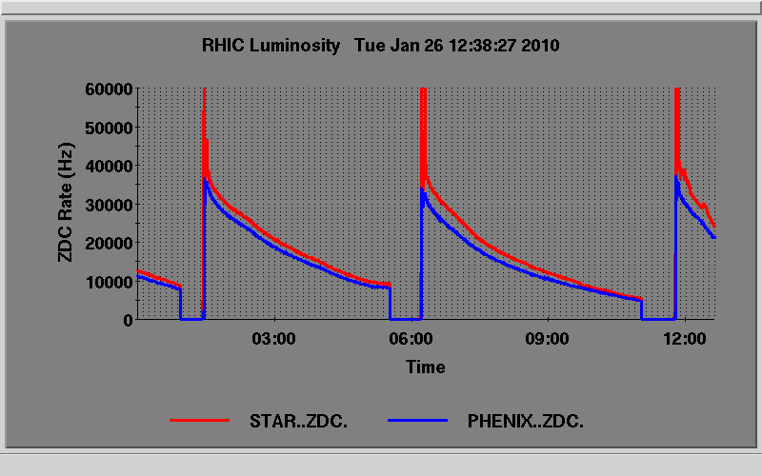

Slide 9
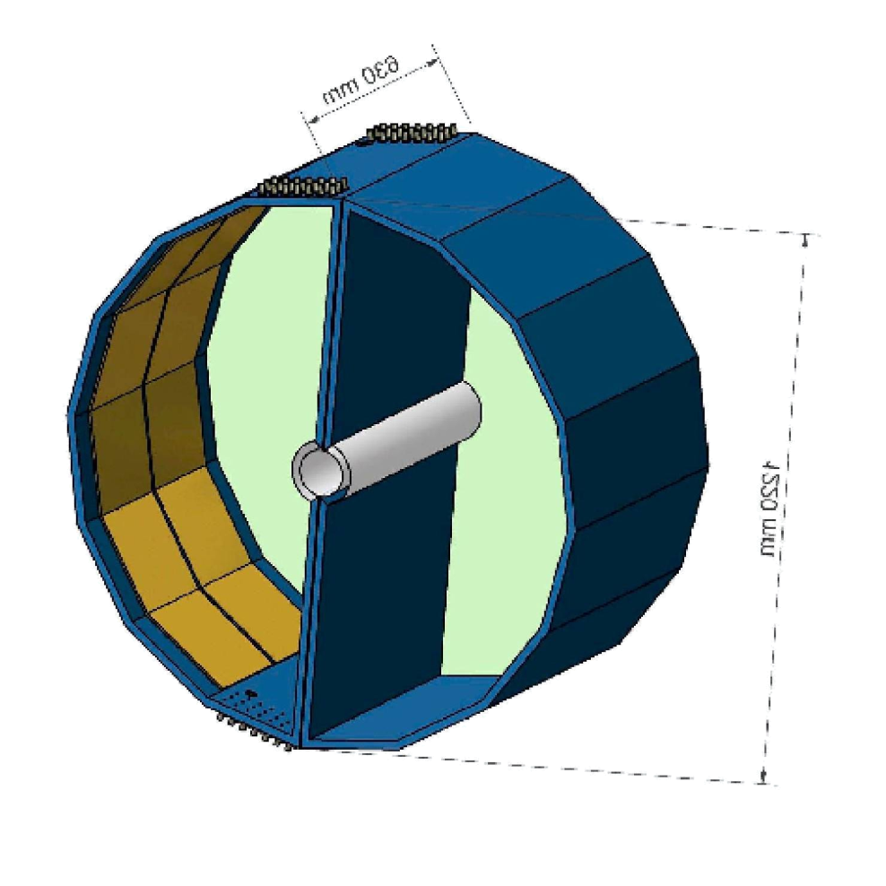
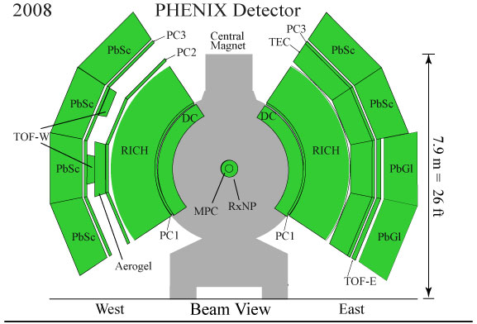
Maintenance Day
EN2
in Central Arm acceptance
1/20 modules
DC.W, three modules
(5% of acceptance)
WN1
Half in Central Arm acceptance
1/20 modules

Slide 10
Backup

Slide 11
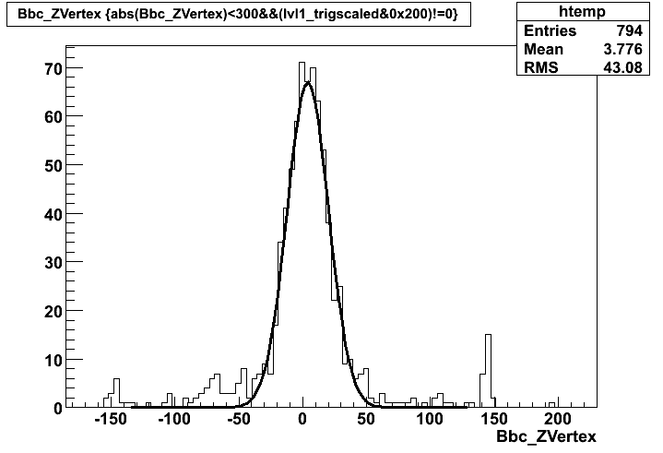
with rebucketing
fill 11382, 1/7
σ = 16.3 cm
cut acc.
30 cm => 90 %
20 cm => 76 %
10 cm => 45 %
without rebucketing
fill 11437, 1/12
σ = 50 cm
cut acc.
30 cm => 44 %
20 cm => 31 %
10 cm => 16 %
acc. hit
0.49
0.41
0.36

Slide 12
Beam Life Time
DAQ archiving rate

