Slide 1
Take 5 for Safety
Wooden Stair Issues at PPPL
Collider-Accelerator Department
2-2-2010

Slide 2
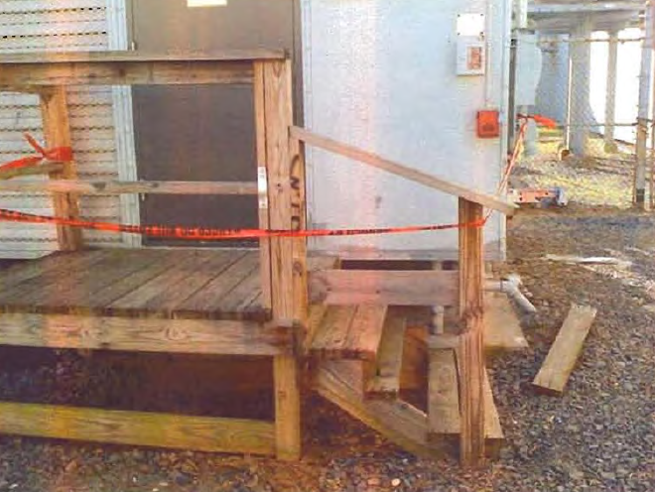
New Stair Report From PPPL
On November 17, 2009 a subcontractor employee turned to come down set of stairs at PPPL and as he reached the second step from the bottom, the step broke free causing the subcontractor to step through the stairway and fall forward, breaking his arm and a rib

Slide 3
Seal or Paint Wood

Slide 4
Install Handrail That is Easily Graspable (Too wide)

Slide 5
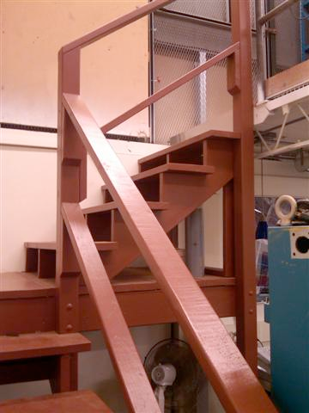
Handrails OK (2x4)

Slide 6
This Is OK – Concrete Pad

Slide 7
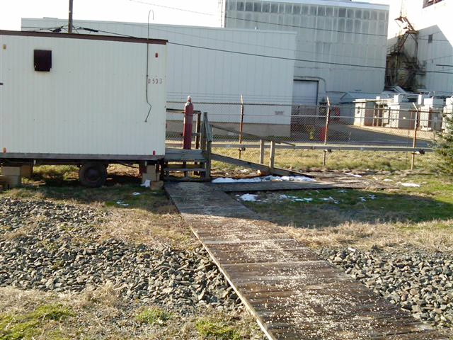
Need Graspable Railings and Concrete Pad If Outdoors

Slide 8
Missing Railings, Treads are Undersized

Slide 9
Upgrade Handrails When Any Rebuilding Occurs (4x4)

Slide 10
Remove Platform

Slide 11
Replace Handrail

Slide 12
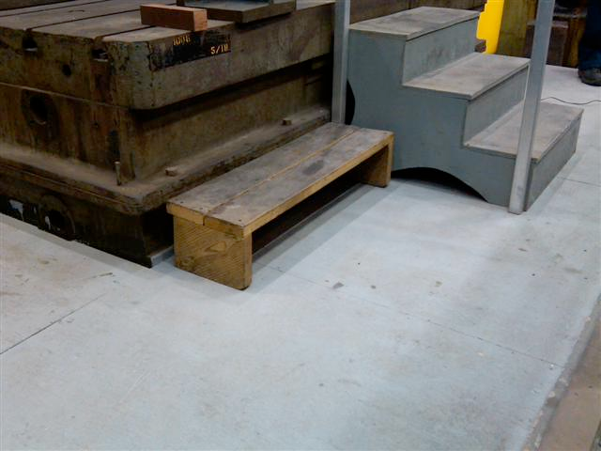
Remove From Service – Legs Rounded

Slide 13
OK to Use – Two Step Portable Stool

Slide 14
Railing Required – Gap Between Platform and Wall too Wide

Slide 15
OK – Two Steps on Concrete

Slide 16
Railings Needed If Stairs are Over 30 Inches High

Slide 17
Replace- Need Equal Riser Height

