Slide 1
PHENIX Status
Time Meeting, 2/2/2010
Stefan Bathe

Slide 2
Sampled Integrated Luminosity
0.375 / 1.4 (nb^-1)
= 26 % of goal (for sampled int. lumi.)
23/70 (days)
= 33 % of time

Slide 3
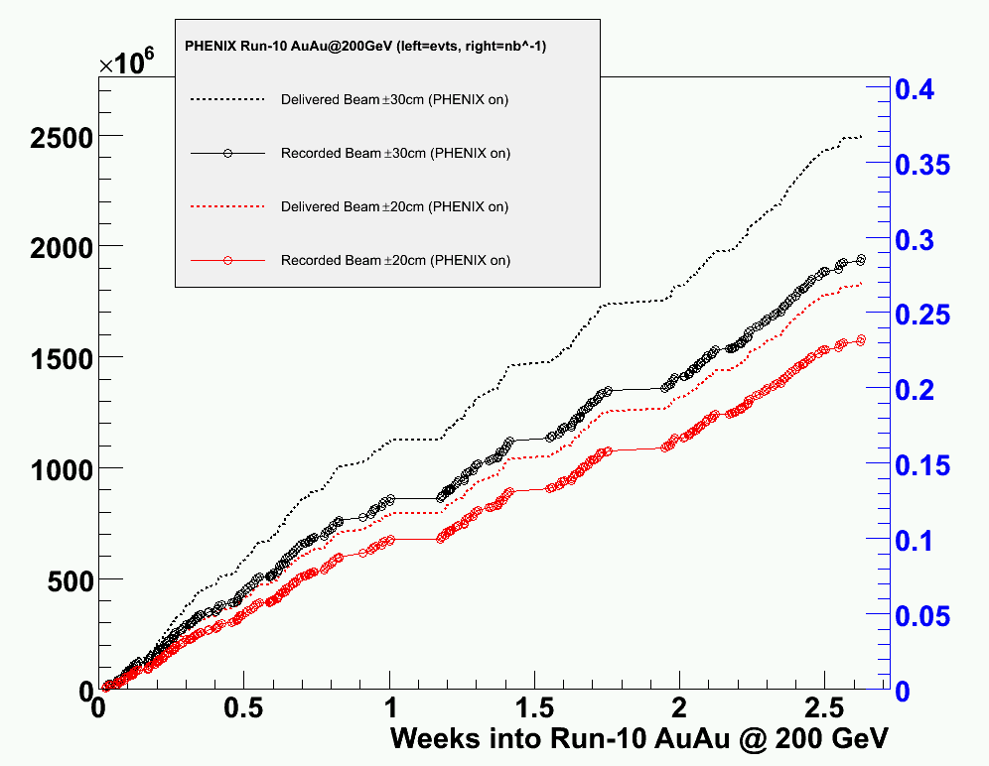
DAQ Performance
if rate had been > 5 kHz at all times:
could have recorded 2.96 billion events or 0.44 nb^-1
# events
Int. lumi. in nb^-1
Taking min bias data:
with |z| < 30 cm if DAQ rate < 5 kHz
with |z| < 20 cm if DAQ rate > 5 kHz
Delivered beam ± 30 cm
(PHENIX on)
Recorded beam ± 30 cm
(PHENIX on): 77 %
Delivered beam ± 20 cm
(PHENIX on)
Recorded beam ± 20 cm
(PHENIX on): 86 %
HBD acceptance:
± 20 cm

Slide 4
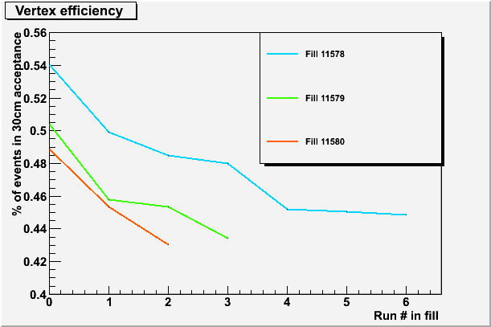
Beam z Profile
All weekend
Now: 46 %
Run-07: 50 %
Projected Run-10: 65 %
Cavity HV study

Slide 5
Repairs
Maintenance Day
Fixed 2/3 broken DC modules
Fixed 1/2 broken HBD modules
Monday access
Fixed HV of South Aerogel

