Slide 1
Take 5 for Safety
Reducing Communication Errors
Collider-Accelerator Department
2-9-2010

Slide 2
Example of Written Communication With 17 Errors
Nothing is more embarassing than making a writing mistake. Of course, we all think its funny when we spot a mispelled word in magazine ads or on billboards. If one of your employee’s are making the the mistakes, it can be disasterous. And if you have a typo in a memo to the boss, how do you think they will view your professionalism? These kind of mistakes can be prevented, irregardless of the persons job title. The people that make the mistakes can seriously effect how other’s view you’re company. That can cost any organization money and hurt it’s profits.

Slide 3
Errors

Slide 4
Reducing Communication Errors
Recommended Practices When Using Procedures
Compare the working copy to the controlled copy to verify it is the most recent revision
Review all prerequisites, precautions, initial conditions and instructions before starting work
Confirm your understanding of the procedure's overall purpose and verify it is appropriate for the system or equipment condition
Use the procedure according to its designated level of use (check-off list or reference)
Follow the procedure as written, aware of the potential impact an action can have on equipment
STOP the task, place the equipment in a safe condition, and contact your supervisor if:
A procedure step cannot be performed as written
Injury or damage to equipment will occur if used as is
The procedure is technically incorrect
Unexpected results occur after performing the step
Report procedure problems when they are found

Slide 5
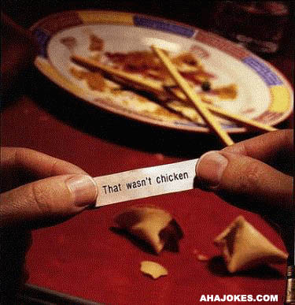
Examples of Atypical Communication

