Slide 1
PHENIX Status
Time Meeting, 2/9/2010
Stefan Bathe

Slide 2
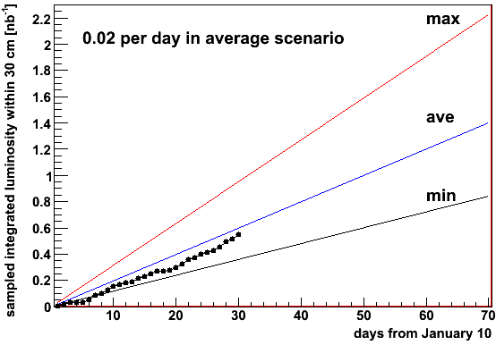
Sampled Integrated Luminosity
0.55 / 1.4 (nb^-1)
= 39 % of goal (for sampled int. lumi.)
30/70 (days)
= 43 % of time

Slide 3
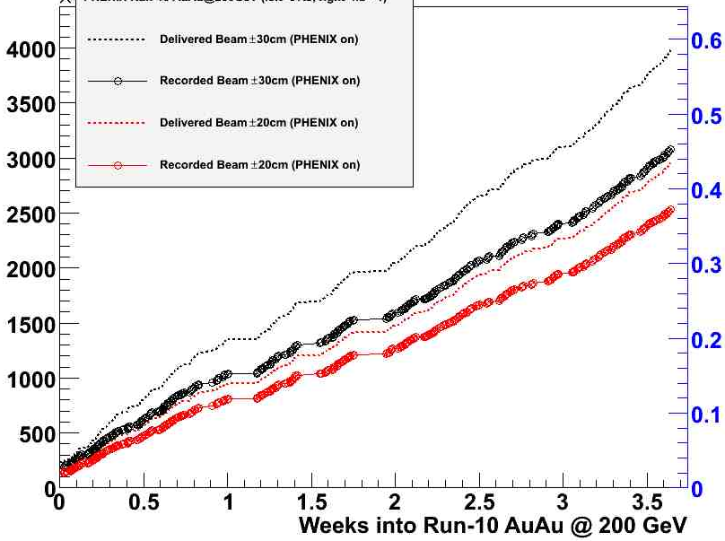
DAQ Performance
if rate had been > 5 kHz at all times:
could have recorded 4.49 billion events or 0.66 nb^-1
# events
Int. lumi. in nb^-1
x 10^6
Taking min bias data:
with |z| < 30 cm if DAQ rate < 5 kHz
with |z| < 20 cm if DAQ rate > 5 kHz
Delivered beam ± 30 cm
(PHENIX on)
Recorded beam ± 30 cm
(PHENIX on): 77 %
Delivered beam ± 20 cm
(PHENIX on)
Recorded beam ± 20 cm
(PHENIX on): 86 %
HBD acceptance:
± 20 cm

Slide 4
Beam z Profile
Now: 50-60 %
Run-07: 50 %
Projected Run-10: 65 %
Begin fill: 59 %
After 3 h: 50 %

Slide 5
Plan for Maintenance Day
MuTr FEM and HV fixes
Change MuTrig TLD's on South Station-1
Fix West Carriage light
HBD rack work
RPC work in North Tunnel

