Slide 1
Take 5 for Safety
Reducing Errors
Collider-Accelerator Department
2-16-2010

Slide 2
No Instructions Or Checklists
A KC-135 Aircraft was being pressurized at ground level
The outflow valves used to regulate the pressure of the aircraft were capped off during a 5 year overhaul and never opened back up
The technician who, "had always done it that way," was using a pressure gauge with no maximum markings, and no procedure
The rear hatch was blown over 70 yards away, behind a blast fence

Slide 3
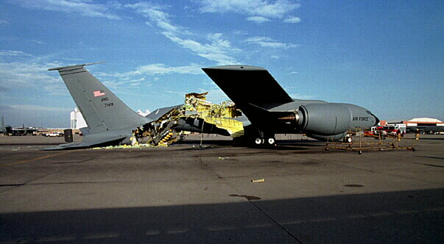

Slide 4
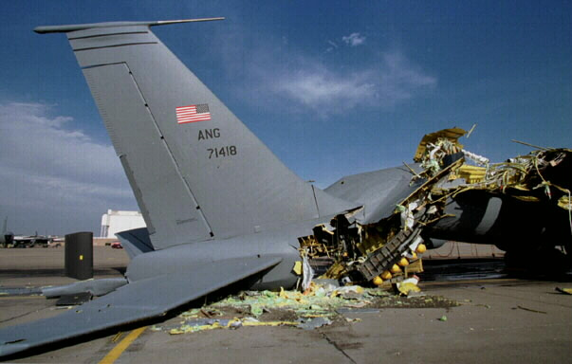

Slide 5
No Instructions Or Pre-job Briefing
A crane was staged for use on a DOE site and a manual charger was used to charge the batteries when one of the batteries failed explosively, spreading battery acid 25 feet and injuring three people
The worker performing manual battery charging did not understand the potential problems
The charger's output was set at 24 volts, delivering a constant charging current of approximately 10 amps until it is manually shut off
If not shutoff when the battery is fully charged, a manual charger can overheat and destroy a battery
In contrast, an automatic charger or "Smart" charger will adjust its charge rate dependent upon electrical resistance, and will gradually step down the charging current as the battery charges

Slide 6
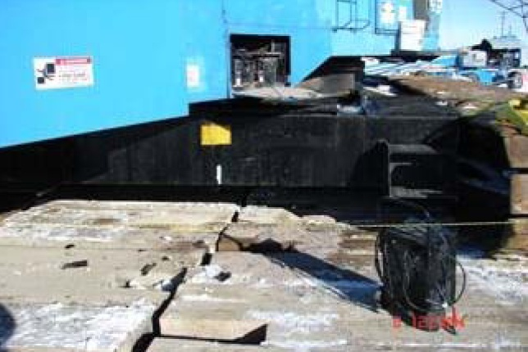

Slide 7
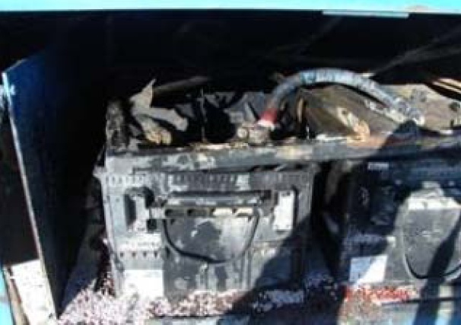

Slide 8
Error Reduction Strategies
Pre-job briefing
Questioning attitude
Double verification
Independent verification
Conservative decision making
Flagging (color coding, labeling, procedures, checklists)
Communicating the operating experience to workers
Supervisor / manager monitoring

