Slide 1
PHENIX Status
Time Meeting, 2/15/2010
Stefan Bathe

Slide 2
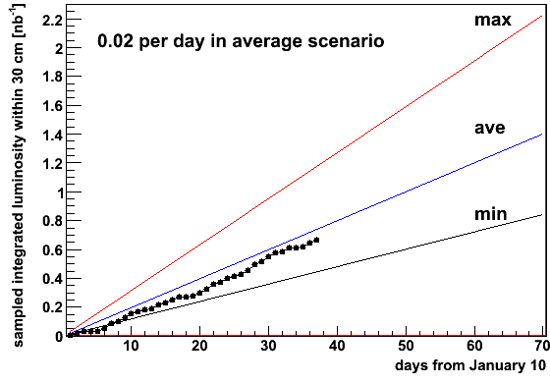
Sampled Integrated Luminosity
0.67 / 1.4 (nb^-1)
= 48 % of goal (for sampled int. lumi.)
37/70 (days)
= 53 % of time

Slide 3
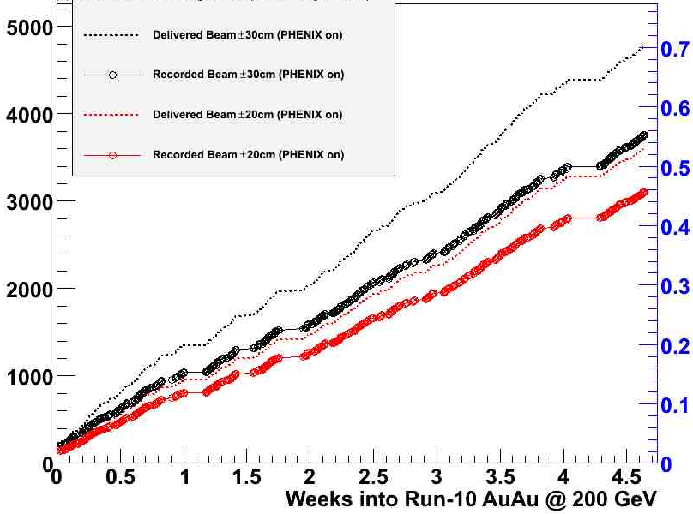
DAQ Performance
if rate had been > 5 kHz at all times:
could have recorded 5.48 billion events or 0.81 nb^-1
# events
Int. lumi. in nb^-1
x 10^6
Taking min bias data:
with |z| < 30 cm if DAQ rate < 5 kHz
with |z| < 20 cm if DAQ rate > 5 kHz
Delivered beam ± 30 cm
(PHENIX on)
Recorded beam ± 30 cm
(PHENIX on): 79 %
Delivered beam ± 20 cm
(PHENIX on)
Recorded beam ± 20 cm
(PHENIX on): 86 %
HBD acceptance:
± 20 cm

Slide 4
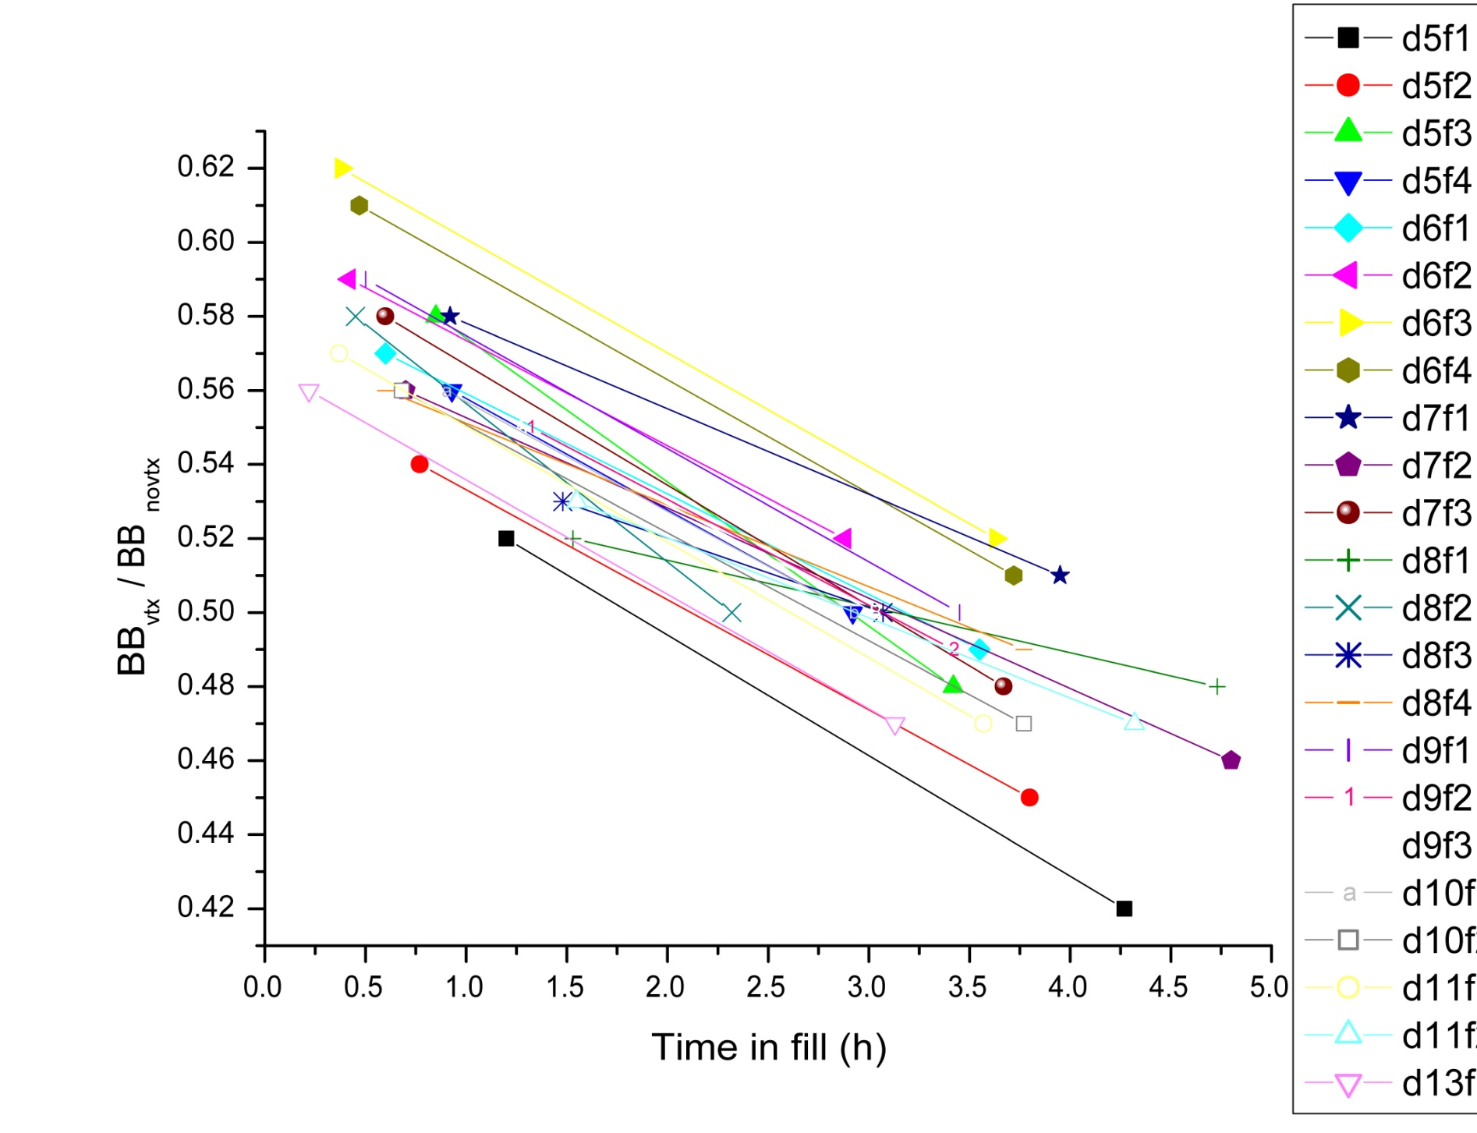
Vertex Cut Acceptance
Goal: 0.65
Blue longitudinal cooling alone doesn’t help much yet
After 2/4 beam development
With Blue longitudinal cooling

Slide 5
HBD Performance
singles
doubles
Peak should be here
Peak should be here
HBD works as expected

Slide 6
Plans
Magnet polarity switch Thursday morning during store
Will stay at zero field after switch until end of store
Should have minimal impact on ramp
Plus-Minus configuration → small field (100 Gauss) at beam pipe
How much time does CAS need to reverse polarity?
Affects when in store to switch

