Slide 1
Take 5 for Safety
Safety Review for Modifications
Calling For Help
Safety Photo of the Week
Collider-Accelerator Department
2-23-2010

Slide 2
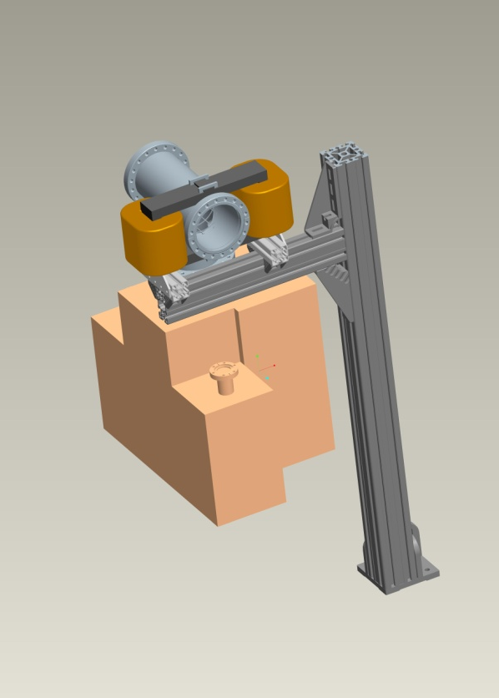
Safety Review for Accelerator or Experiment Modifications
Responsibility:
Liaison Engineer / Liaison Physicist
Project Engineer / Project Physicist
Process
Design Review Questionnaire / Hazard Tool
Design Reviews with Chief Engineers
Where applicable:
RSC Review
ASSRC Review
BNL Pressure and Cryogenic Safety Review
Recent examples
Low Energy Running
Linac Laser Profile Monitor
PP Source Upgrade
New 10 Hz RHIC Magnets at 5 o’clock

Slide 3
Calling For Help
Medical Emergency x911 or x2222
Operations Coordinator x4662
CAS Watch x2024
First Aid – Contact Supervisor and Clinic (x3670)
Notes:
All injuries that occur at the Laboratory of such severity as to require first aid or a physician's treatment should be reported to the BNL Occupational Health Clinic (x3670). If a medical emergency occurs while working in the experimental areas, then also notify the Main Control Room (C-A Main Control Room, x4662). Emergency medical assistance is always available by calling x911.

Slide 4
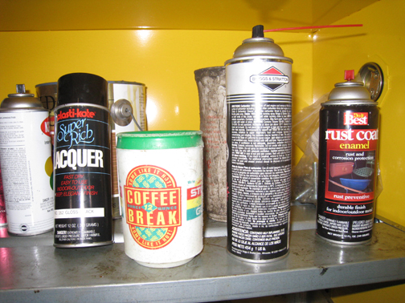
Safety Photo of the Week - Mugged
This coffee travel mug was found stored in a flammable cabinet at a US naval base
The owner said: “In case you’re wondering why it’s stored there, it’s because there’s a chemical stored in the mug!”
Things that you shouldn’t put hazmat in,
even just a little bit for a little while, coffee mugs,
soda cans and disposable plastic drinking cups

