Slide 1
PHENIX Status
Time Meeting, 2/23/2010
Stefan Bathe

Slide 2
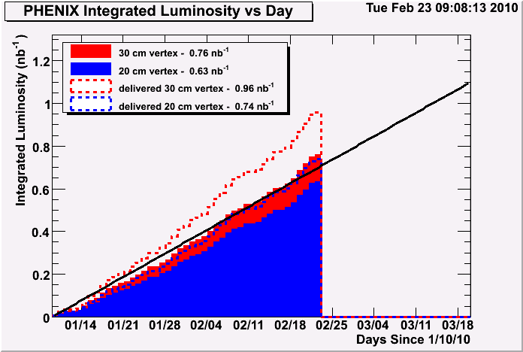
Integrated Luminosity: Accumulated
minimum goal
delivered
recorded

Slide 3
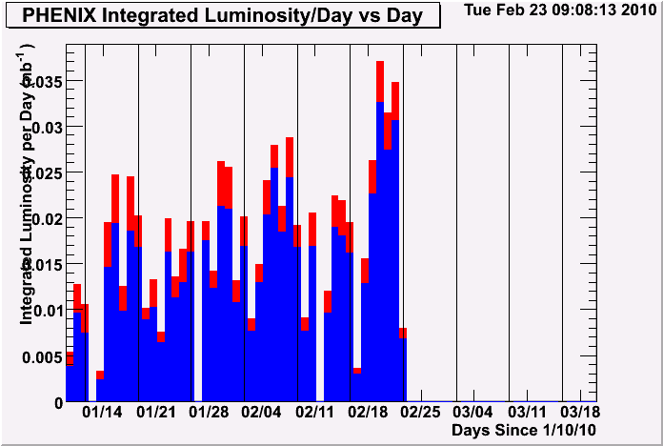
Integrated Luminosity: Per Day

Slide 4
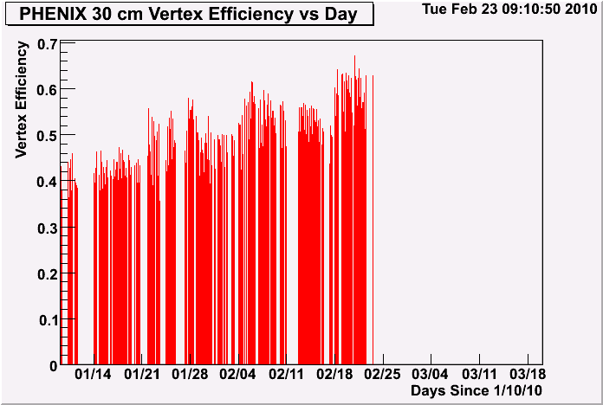
Vertex Efficiency (Per Day)
goal

Slide 5
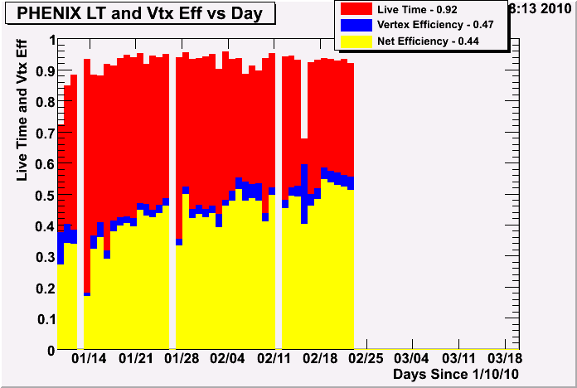
Efficiency
Fraction of all events recorded within 20cm = 0.86 (when PHENIX on)
Fraction of all events recorded within 30cm = 0.79 (when PHENIX on)

Slide 6
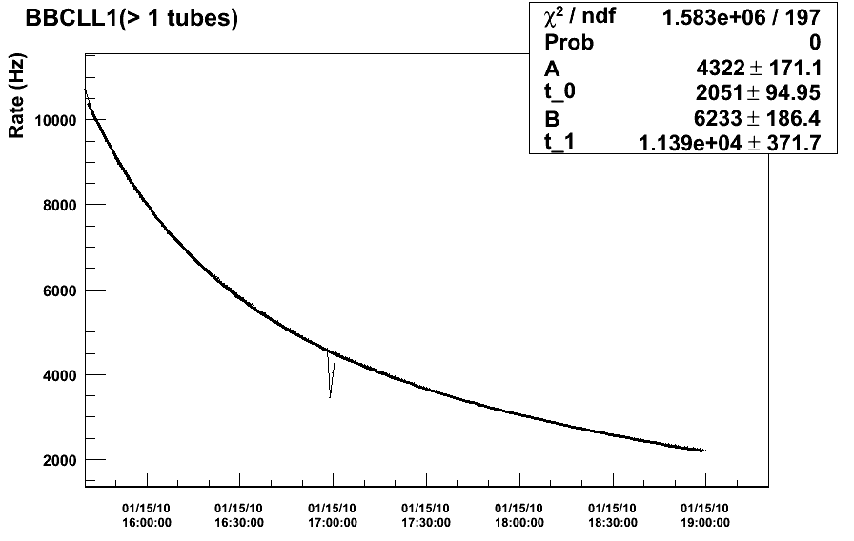
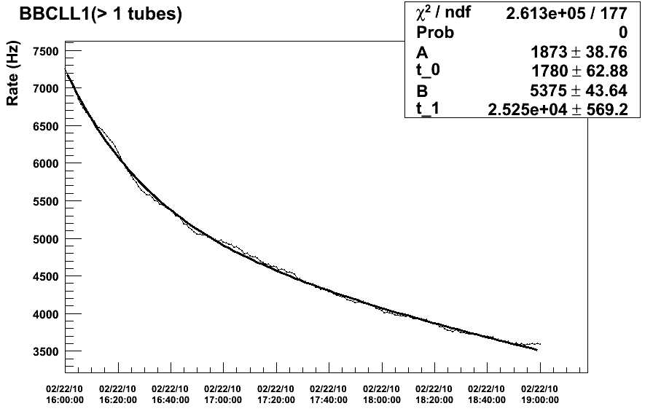
Beam Life Time
The Beginning: January 15
The Best (so far): Feb 23, 3pm-8pm
Fraction of short component decreased from 0.4 to 0.25
Time constant of long component increased from 3.2 h to 7 h

