Slide 1
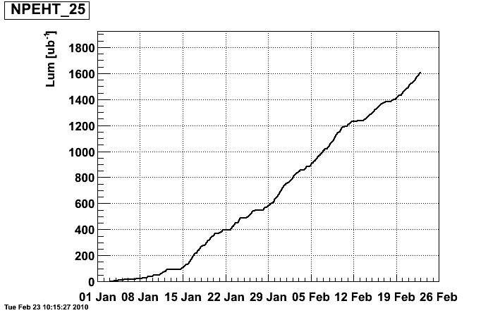
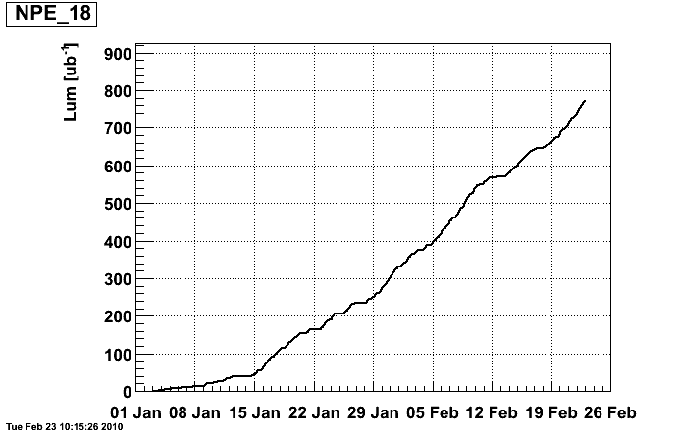
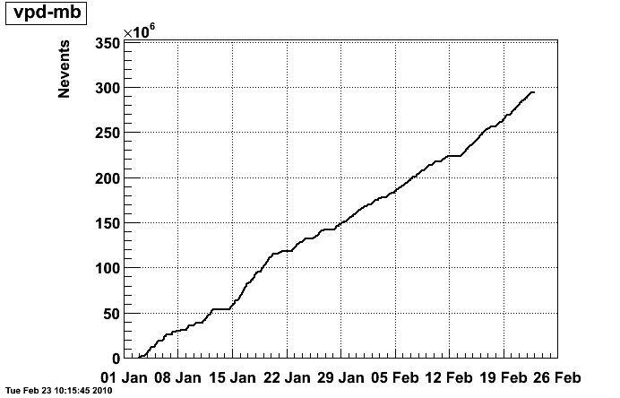
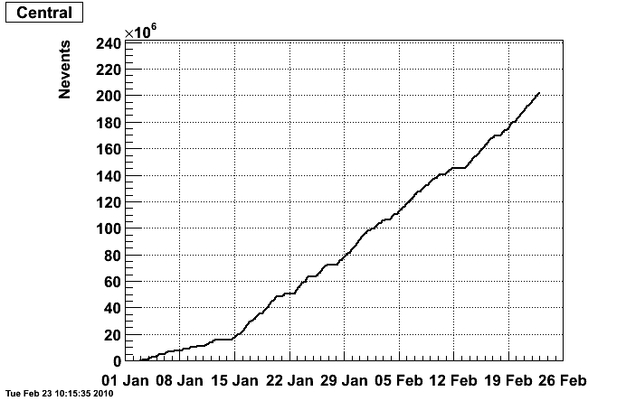
STAR Status. C-AD Time mtg. 02/24/10
High Tower Trigger
No vertex cut
Thres. = 5.9 GeV
Goal 2 nb⁻¹
High Tower Trigger
Vertex cut ~ ± 40 cm
Thres. = 4.2 GeV
“min-bias” Trigger
Vertex cut ~ ± 40 cm
Goal 300 Mevts
Top 10% Central Trigger
Vertex cut ~ ± 40 cm
Goal 250 Mevts

Slide 2
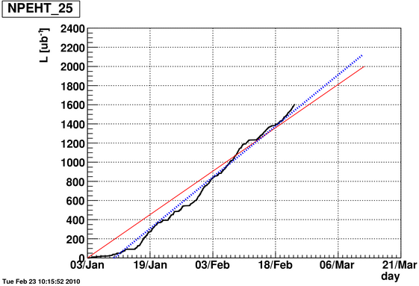
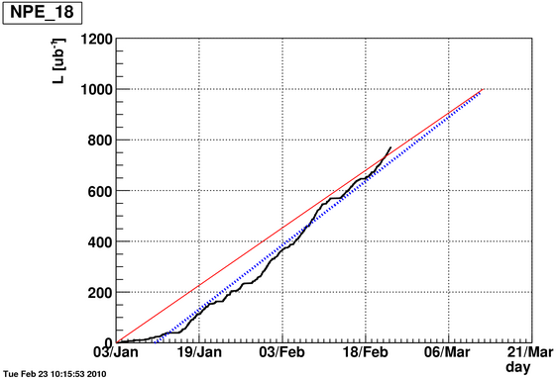
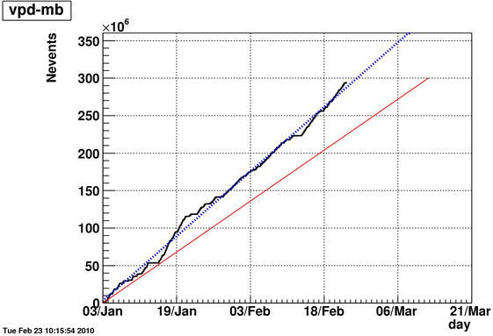
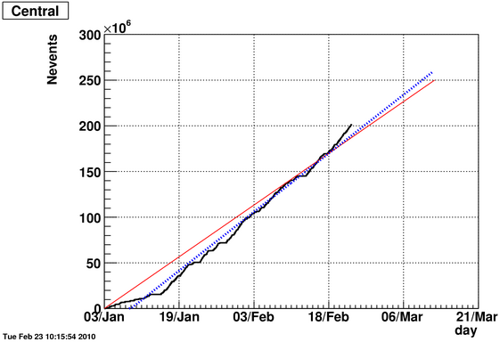
High Tower Trigger
No vertex cut
Thres. = 5.9 GeV
Goal 2 nb⁻¹
High Tower Trigger
Vertex cut ~ ± 40 cm
Thres. = 4.2 GeV
“min-bias” Trigger
Vertex cut ~ ± 40 cm
Goal 300 Mevts
Top 10% Central Trigger
Vertex cut ~ ± 40 cm
Goal 250 Mevts

