Slide 1
Take 5 for Safety
Feedback from Recent Group Meetings
Positive Events
High Voltage Hazards
Safety Photos of the Week
Collider-Accelerator Department
3-2-2010

Slide 2
Some Feedback from Recent Group Meetings
Floors need to be cleaned regularly since air cooled equipment is pulling in dirt
Better lighting and more electrical outlets needed for bench work
Alcove lighting in RHIC tunnel and lighting at the valve boxes need improvement
Valve box platform rails and stairs need improvement
Roads at RHIC are poorly lit
Excessive overtime is causing fatigue and stress
Service buildings need better seals to keep out animals and dirt
Service building doors do not lock or close properly
Roads near service buildings need to be paved to reduce dirt in building
No BNL stockroom causes work delays; overnight shipping costs are very high
The Winstets LOTO program is not user friendly
Gas should be reimbursed when using private vehicles to reach work areas
Group vehicles are needed with lift gates and with room for both equipment and passengers
PA system needed in RHIC tunnel for alarm testing and other routine communications
RHIC has many phones with same number; prevents routine use between locations
BNL’s “minus 1 rule” for arc flash PPE is confusing
Better controls on the number of jobs scheduled on Maintenance Day are needed
Increase the Controlled Access time beyond 4 hours before sweep is required in AGS

Slide 3
Positive Events
Injury performance is good
Occurrence performance is good
External auditors are finding noteworthy practices
Some roofs fixed and more are planned for spring
Send roof leak information to Joe Tuozzolo
Team Maintenance arrived three months early this year
Awnings installed at some doors and more planned
Clean-ups occurred at 928, 929 and other buildings
Work-vehicle problems are entering the discussion phase
Send work-vehicle issues to Stephanie LaMontagne
PA system for RHIC is in the planning phase
Some stairs and railings fixed, more planned
Some lighting fixed, more planned
Some rooms painted, more planned
Over 150 issues from Group meetings have been assigned for follow up

Slide 4
High Voltage Hazards
Ground Potential Rise (GPR) occurs when a large current flows to earth such as from lightning or during a short to ground at a sub-station
The potential relative to a distant point on the earth is highest at the point where current enters the ground, and declines exponentially with distance from the source
The drop of voltage with distance may be so steep that a person could be injured due to the voltage developed between two feet, or between the ground on which the person is standing and a metal object that is connected to the earth ground of the faulted sub-station (e.g., a ground wire, a bonded cable tray)
GPR can cause hazardous voltage many hundreds of feet away from the fault location
Many factors determine the level of hazard, including soil conditions, clearing time, and the amount of current entering the earth
Potential sources of GPR at C-AD:
Short to ground at a sub-station / transformer yard (62)
GPR is not a problem at EBIS high voltage platform or the future EDM in A Cave, which are current limited sources
Protection
Fences out to the GPR point of influence (300 V)
Rubber gloves, leather protectors and cotton liners when touching conductive objects connected to earth ground in high voltage areas

Slide 5
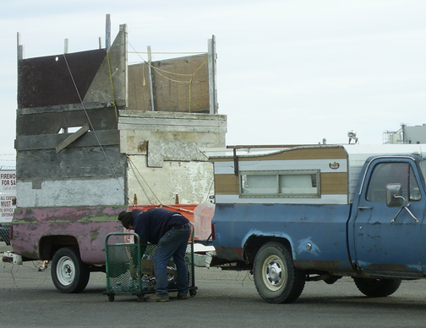
Wooden PPE and Wooden Engineering Marvel

