Slide 1
PHENIX Status
Time Meeting, 3/02/2010
Stefan Bathe

Slide 2
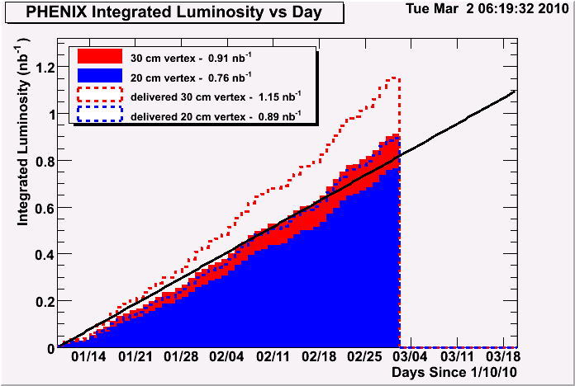
Integrated Luminosity: Accumulated
minimum goal
delivered
recorded

Slide 3
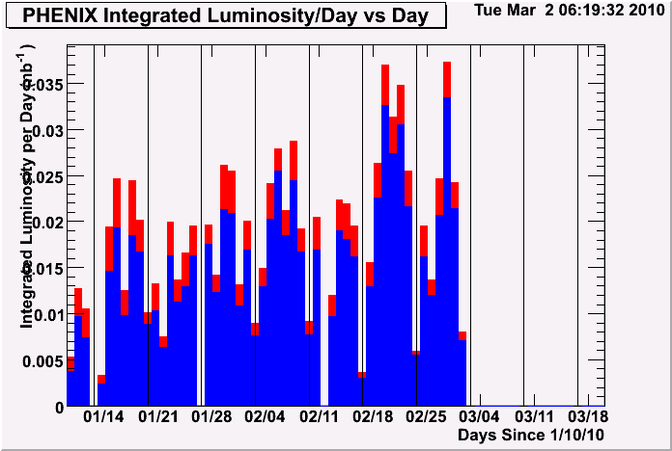
Integrated Luminosity: Per Day
good days and bad days

Slide 4
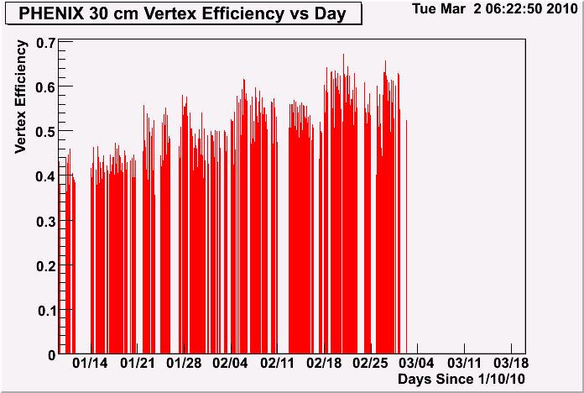
Vertex Efficiency (Per Day)
goal

Slide 5
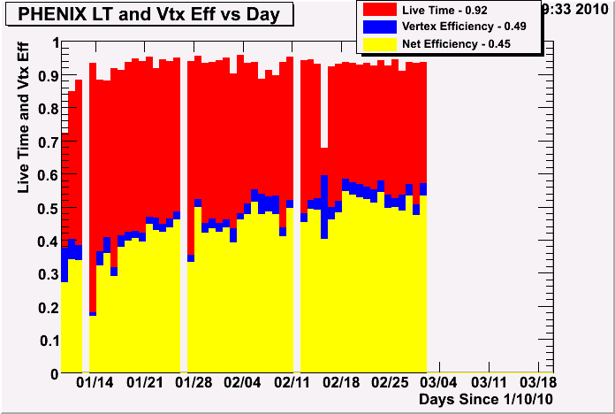
Efficiency
Fraction of all events recorded within 20cm = 0.86 (when PHENIX on)
Fraction of all events recorded within 30cm = 0.79 (when PHENIX on)

Slide 6
RICH Problem Fixed
2/27
RICH SouthWest0 breaks, taking out 1/8 of the RICH acceptance
3/1
after two unsuccessful tries in the morning and onthe previous day, RICH SouthWest0 finally recovered in 2 h access

Slide 7
Accidental Beam Losses
Accidental beam losses have affected Muon Piston Calorimeter (MPC)
Before losses
After 5 channels were lost on 2/10 at 5:56am
After an additional 4 channels were lost on 2/26 at 2:30pm

