Slide 1
PHENIX Status
Time Meeting, 3/09/2010
Stefan Bathe

Slide 2
Past Week History
Had to swap HV mainframe for DC E Wednesday night: lost 10 h of beam
DAQ problems Friday night: lost 7 h of beam
Otherwise smooth running
Plan for Wednesday
HBD work (one module is developing short)

Slide 3
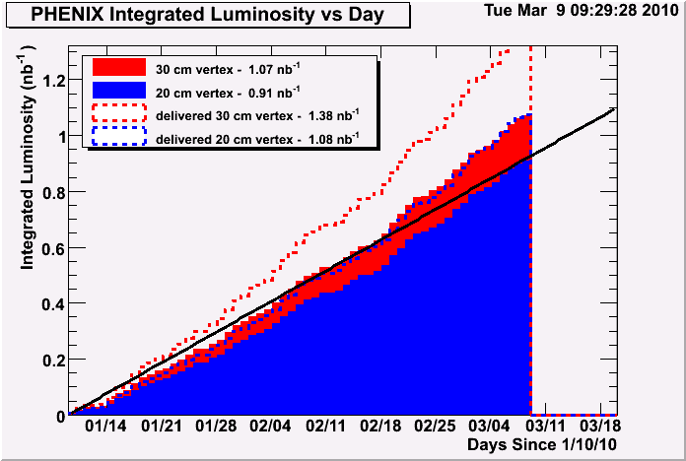
Integrated Luminosity: Accumulated
desired
minimum goal
delivered
recorded

Slide 4
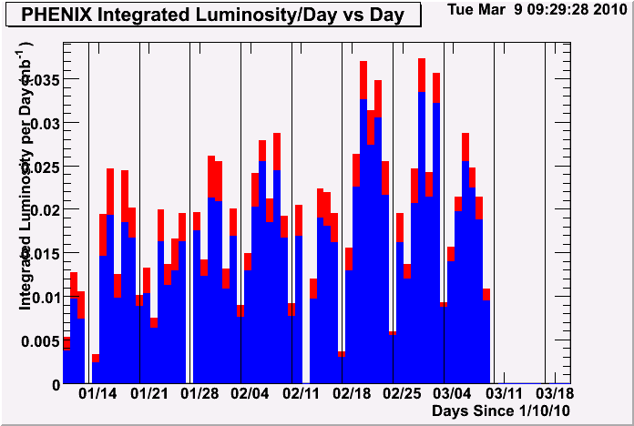
Integrated Luminosity: Per Day
Past week not particularly good

Slide 5
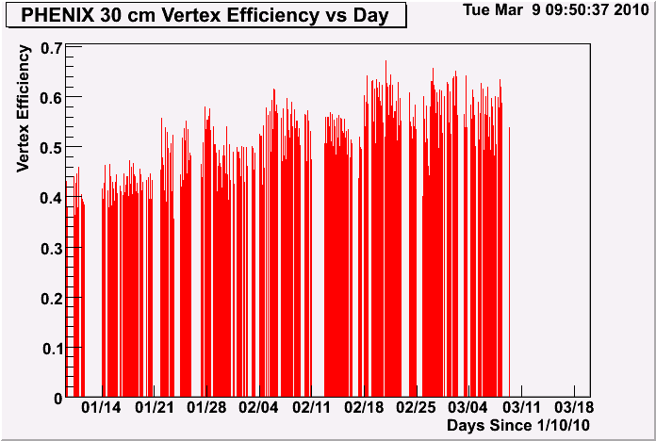
Vertex Efficiency (Per Day)
goal

Slide 6
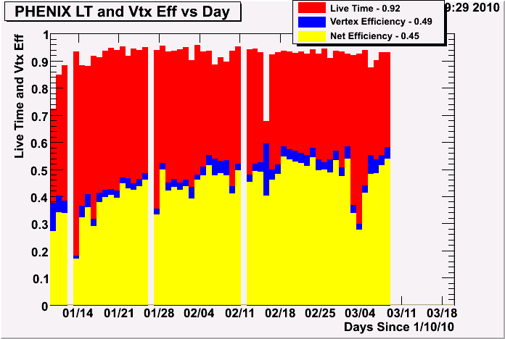
Efficiency
Fraction of all events recorded within 20cm = 0.84 (when PHENIX on)
Fraction of all events recorded within 30cm = 0.77 (when PHENIX on)

Slide 7
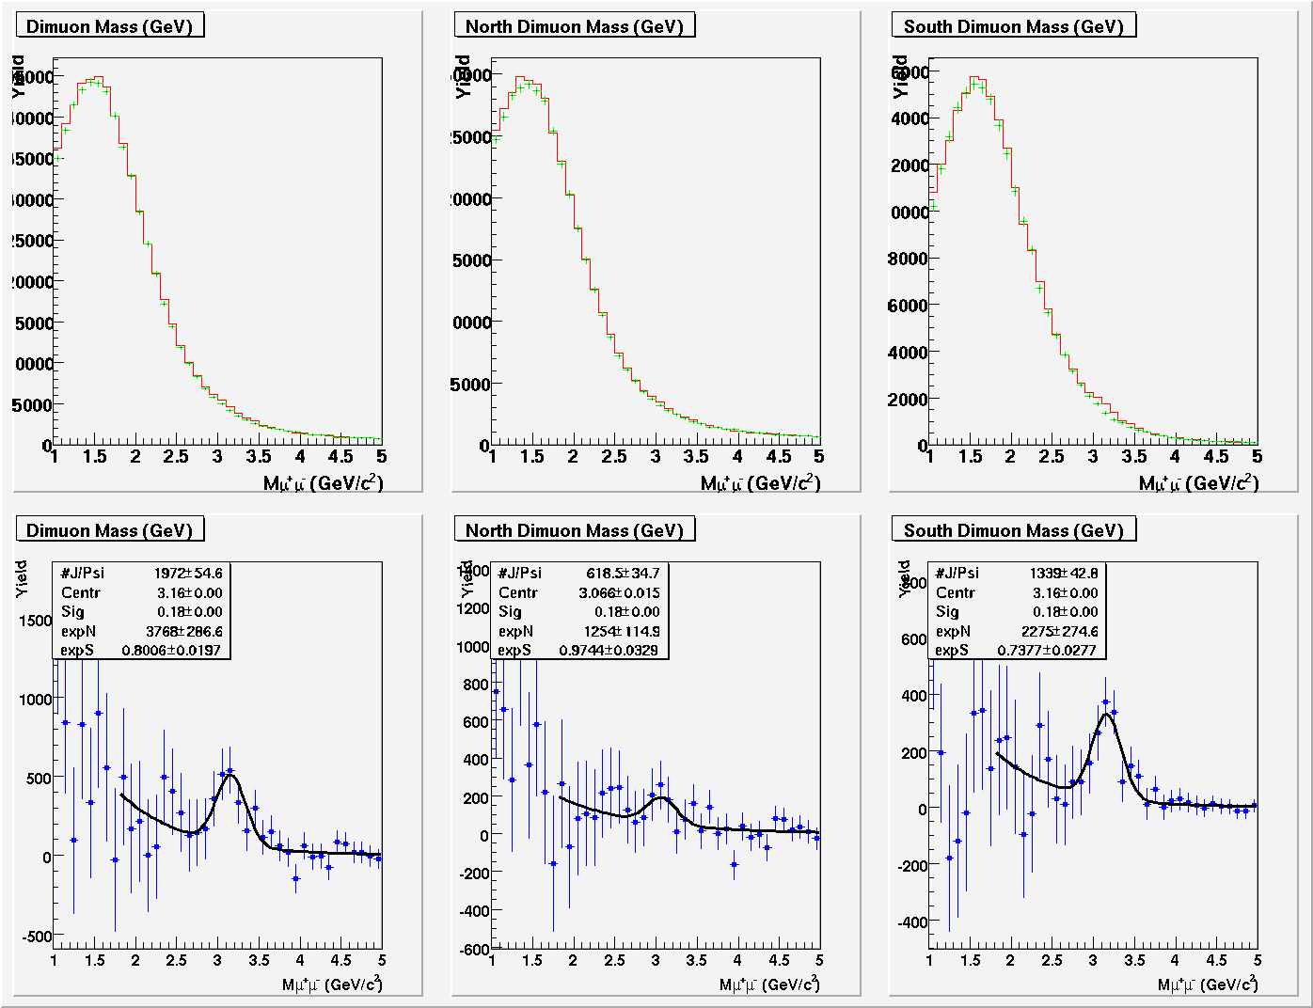
J/ψ
Analyzed Luminosity (for mass plots): 89.17 μb⁻¹ with 234M LVL2 events, and 8856 segments which gives 22.1 +- 0.6 (stat) J/Ψ per μb⁻¹ Thu Mar 4 13:02 EST 2010Compared to Run7 Au+Au which had about 18.2 J/Ψ per μb⁻¹
Consistent with Run-7

