Slide 1
Take 5 for Safety
Equivalence to Code Processes
Safety Notes
Safety Photos of the Week
Collider-Accelerator Department
3-16-2010

Slide 2
Equivalence Process for Pressure Vessels at BNL
If a new pressure vessel or pressurized piping cannot be manufactured to comply with the ASME codes, what is the equivalence process at BNL?
Equivalence means the solution must provide equivalent protection. Review and documentation must meet three basic requirements:
Design drawings, sketches and calculations must be reviewed by the BNL Pressure and Cryogenic Safety Sub-Committee
Qualifications of personnel used to perform examinations, inspections, fabrications and testing must be documented
Documents such as qualification records, materials certifications, narrative descriptions of design, pressure conditions, testing, inspection, operation, repair and maintenance of the pressurized system must be retained by the Department in a formal document control system
BNL approved equivalences for pressurized systems in the past two years have resulted in use of high-pressure piping that did not meet code requirements, alternatives to welding inspections, use of new materials such as niobium, and an increase in originally allowed operating pressure for a pre-2007 system

Slide 3
Other Equivalence-Like Processes at BNL
National Electrical Code Requirements
Request must go through the Lab Electrical Safety Committee
Example: non-tray rated cable in tray at STAR and PHENIX
Example: test GFCIs before use rather than monthly
OSHA Requirements
Formal BNL waiver needed
De minimis conditions only
Example 4-31: §1910.27(b)(1)(ii) allows 12 inches as the maximum distance between ladder rungs. Where the rungs are 13 inches apart, the condition is de minimis
NFPA Requirements
Request must go through BNL Fire Safety Committee
Example: Fire barriers at STAR and PHENIX
SBMS Requirements
Formal BNL waiver needed
Subject Matter Expert and Management System Steward must sign
Example: Na22 in soil at RHIC

Slide 4
Safety Notes
ISO 14001 and OHSAS 18001 Registrations in May
Refresher training in late April
Bring ODH monitors to Ann Marie Luhrs for calibration
Due every 6 months
Inspect ODH escape packs monthly
Check: hose connections, fill gauge, hood
Initial tag each month after check

Slide 5
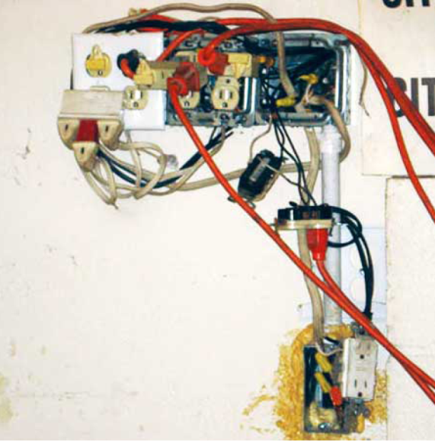
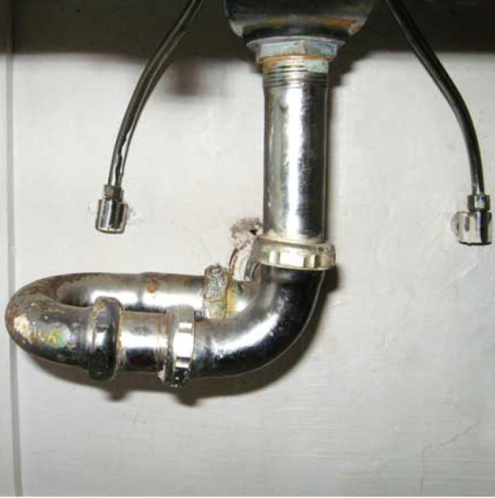
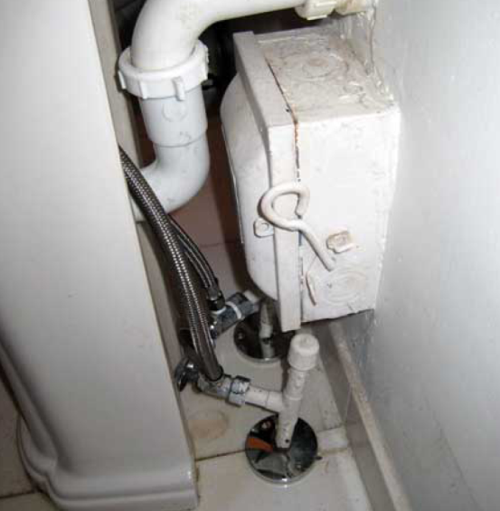
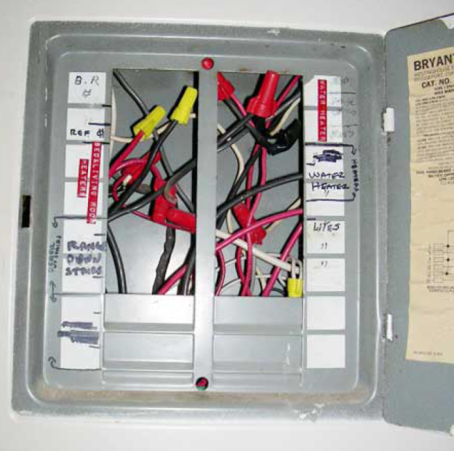
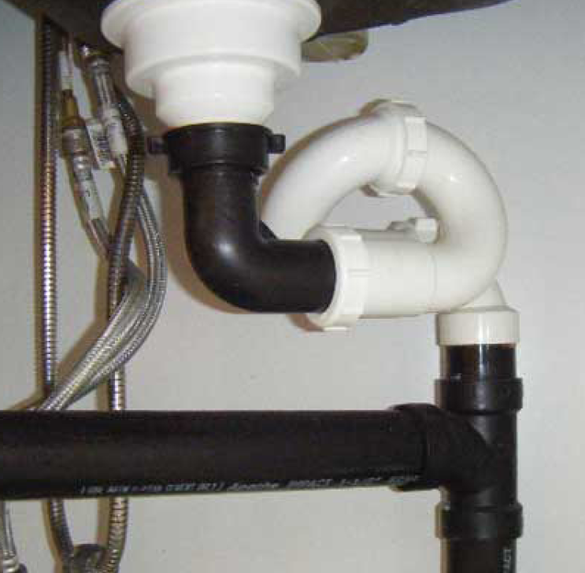
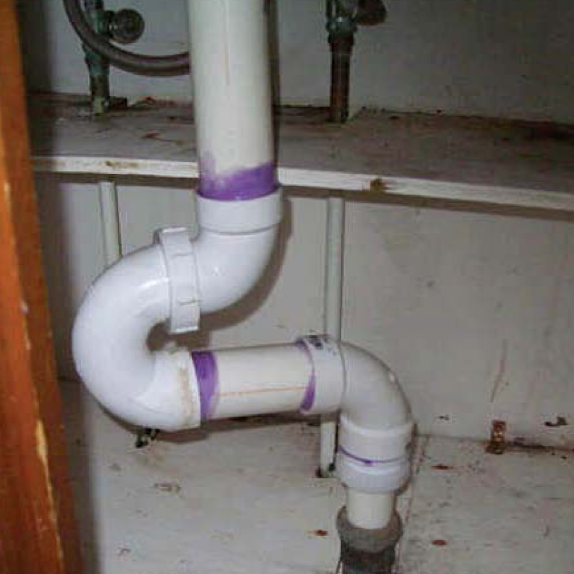
Safety Photos of the Week (From the Home Front)

