Slide 1
PHENIX Status
Time Meeting, 3/16/2010
Stefan Bathe

Slide 2
Past Week History
Repaired HBD module with low gain during Wednesday’s access
Another HBD module developed high gain Thursday (pre-existing short cured itself)
Fixed in Thursday access
Broken wire in DC West since Thursday morning
Taking out 5 % of acceptance
Repair chances low—decided not to fix
Blown fuse in PC this morning—access to fix

Slide 3
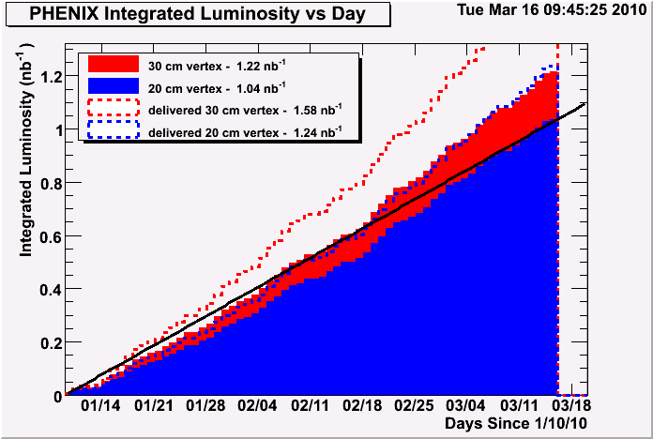
Integrated Luminosity: Accumulated
desired
minimum goal
delivered
recorded
1.22 nb⁻¹ recorded within 30 cm
1.32 nb⁻¹ sampled for high p_{T} photons
1.42 nb⁻¹ sampled for ultraperipheral collisions

Slide 4
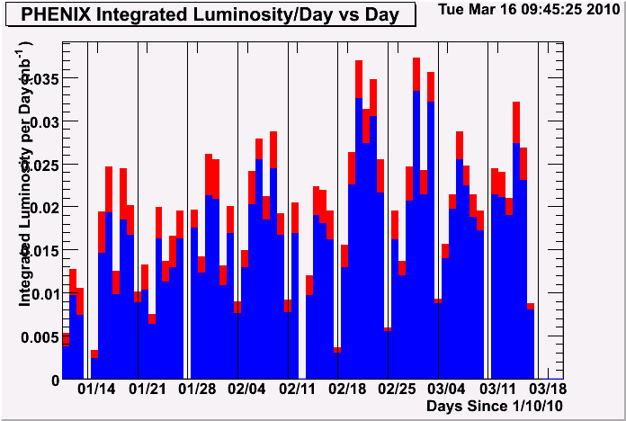
Integrated Luminosity: Per Day
Good past week

Slide 5
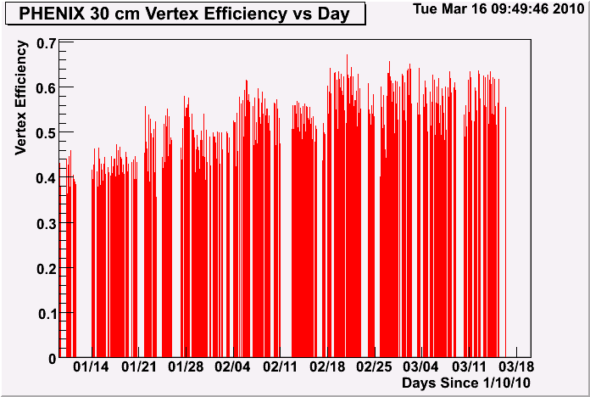
Vertex Efficiency (Per Day)
goal

Slide 6
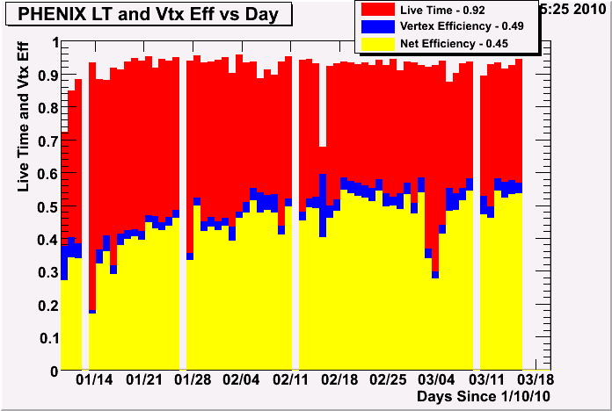
Efficiency
Fraction of all events recorded within 20cm = 0.84 (when PHENIX on)
Fraction of all events recorded within 30cm = 0.77 (when PHENIX on)

