Slide 1
Take 5 for Safety
Facility Authorization Basis at BNL
Safety Photos of the Week
Collider-Accelerator Department
3-23-2010

Slide 2
Facility Authorization Basis at BNL
Facility types allowed by BNL SBMS
Accelerator
Hazard Category 1, 2 and 3 Nuclear
Former Nuclear Facility Downgraded to Radiological
Radiological (facility has a Radiation Area and radioactivity)
Chemical (>29 CFR 1910.119 chemical inventory)
Industrial (<29 CFR 1910.119 chemical inventory)
All facilities must have BNL or BNL/DOE approval for
Design and construction
Documented hazard identification, assessment and controls
Readiness confirmation
Safety Envelopes or Operational Safety Limits and/or Facility Use Agreement (FUA)

Slide 3
Safety Photos of the Week: Rules are Rules
Good news: It was a normal day (April 18, 2002) in Sharon Springs , KS, when a Union Pacific crew boarded a loaded coal train for the long trek to Salina
Bad news: Just a few miles into the trip a wheel bearing became overheated and melted, letting a metal support drop down and grind on the rail, creating white hot molten metal droppings spewing down to the rail
Good news: A very alert crew noticed smoke about halfway back in the train, stopped the train in compliance with the rules, and walked ½ mile back
Bad news: The car with the hot wheel bearing was stopped on a wooden bridge with creosote ties and trusses; the crew tried to explain to higher-ups but were instructed not to move the broken car; they unhooked the front half of train
Federal Railway Agency Report: one car started the fire; crew stopped train to investigate cause of smoke; car with failed bearing had stopped on top of a wooden bridge and caused heat to ignite bridge; the heat ignited the coal that was loaded in the cars; when train started to fall, coal dust in the air flashed and completely destroyed the bridge and the cars on the bridge
No one hurt; $2M loss

Slide 4
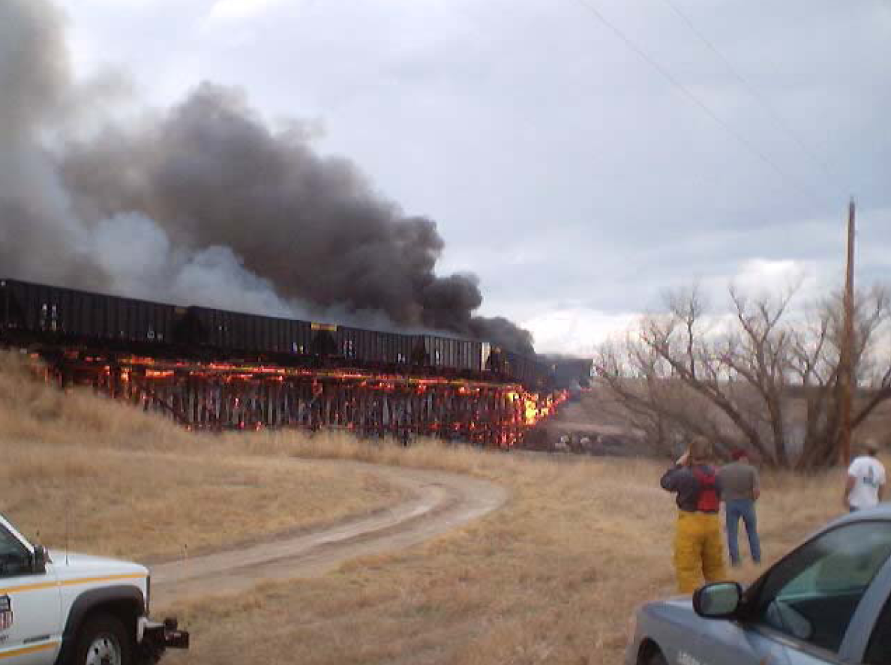

Slide 5
