Slide 1
PHENIX Status
Time Meeting, 3/23/2010
Stefan Bathe

Slide 2
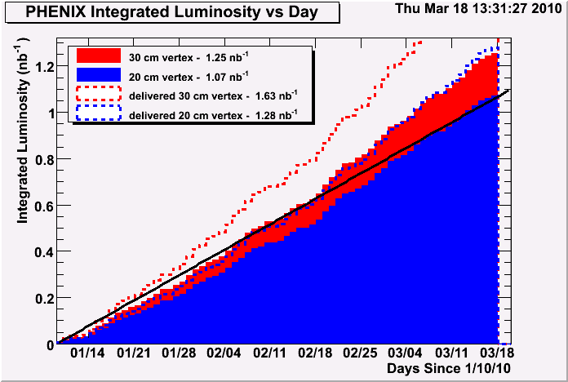
200 GeV Summary
Recorded
  8.2 B minimum bias events or 1.3 nb⁻¹ (±30 cm)
  7.0 B minimum bias events or 1.1 nb⁻¹ within (± 20 cm)
BUP goal
  record 1.4 nb⁻¹ (± 30 cm)
Expectation before run
  record 1.1 nb⁻¹ (± 30 cm) (DAQ bandwidth, average machine performance)
desired
min. goal
Run-10 data set factor 1.5 larger than Run-7 data and has functioning HBD!

Slide 3
Physics Goals at 62.4 GeV
Low-mass enhancement of dileptons in 200 GeV Au+Au (Run-4)
Also present at 62.4 GeV?
HBD enhances effective signal by factor ~15 (no HBD in Run-4)
400 M minimum bias events will give factor 4 higher effective signal compared to Run-4
PHENIX Run-04 AuAu 200 GeV arXiv:0706.3034

Slide 4
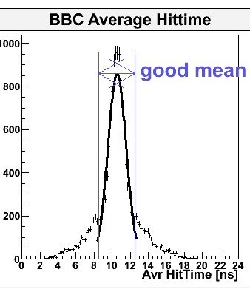
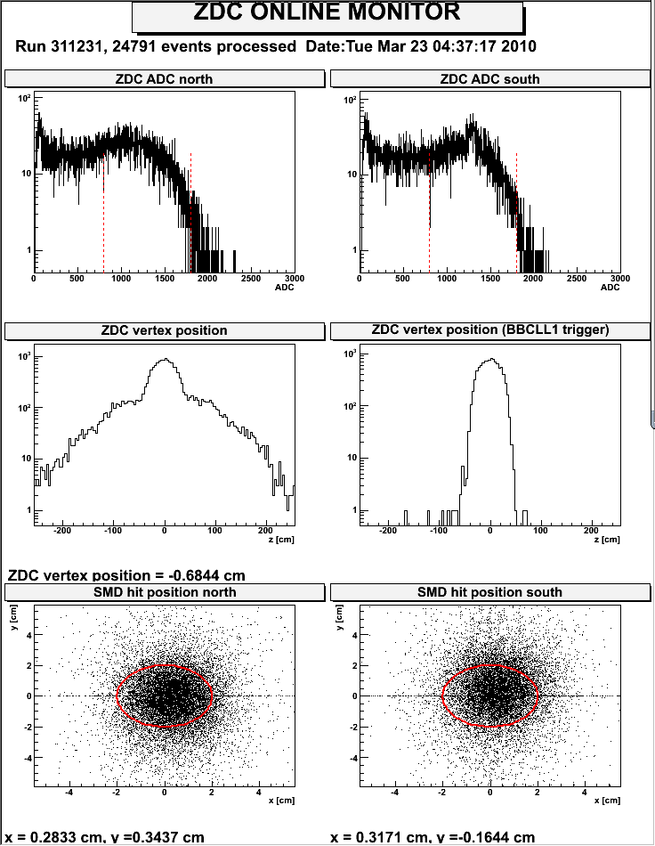
Changes for 62.4 GeV
Slight timing change (only few ns)
ZDC gains increased by factor 5 (to 7.5pC)
ZDC thresholds decreased by factor 3 from nominal settings for 200 GeV

Slide 5
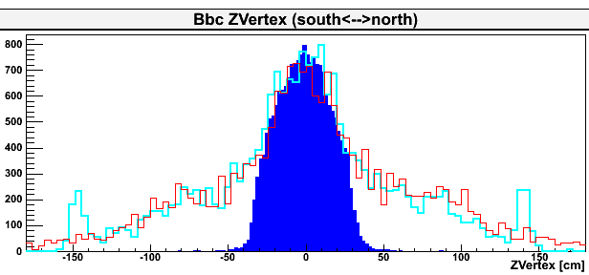
62.4 GeV History
Friday, 3/19, 5:50pm: CAD gives us beam for Physics
Friday, 3/19, 6:43pm: PHENIX Physics set-up completed; Physics data taking begins
Recorded 104 M minimum bias events in first five days
30 cm vertex cut acceptance: 55 % beginning, 45 % end of store

Slide 6
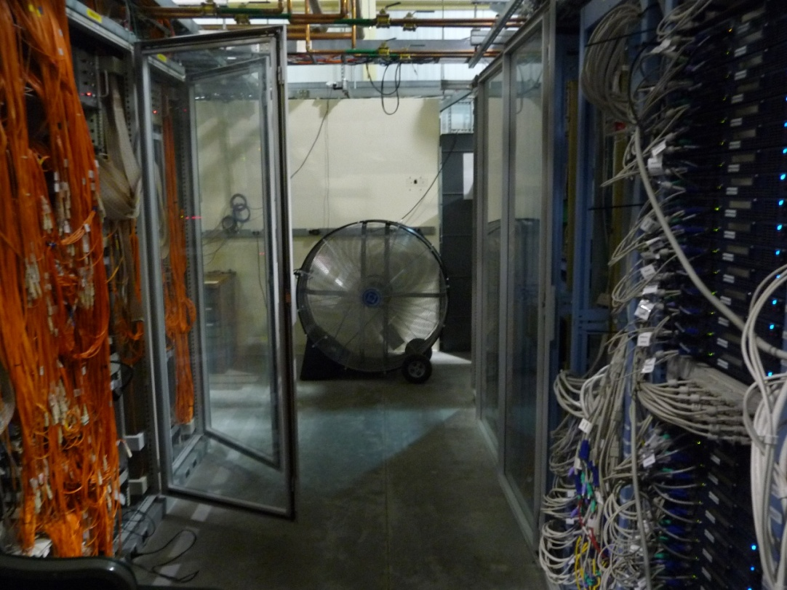
AC Problems
Had high-temperature alarms in rack room Wednesday through Saturday
AC was working
Problem is that only one out of two new compressors was hooked up last year
Second compressor promised for tomorrow and Thursday

