Slide 1
10 Hz Global Orbit Feedback System Success
R. Michnoff, P. Cerniglia, L. DeSanto, C. Folz, C. Ho, R. Hulsart, A. Jain, Y. Luo, W. MacKay, G. Mahler, W. Meng, K. Mernick, M. Minty, P. Popken, V. Ptitsyn, J. Ritter, P. Thieberger, A. Weston, P. Ziminski
March 30, 2010

Slide 2
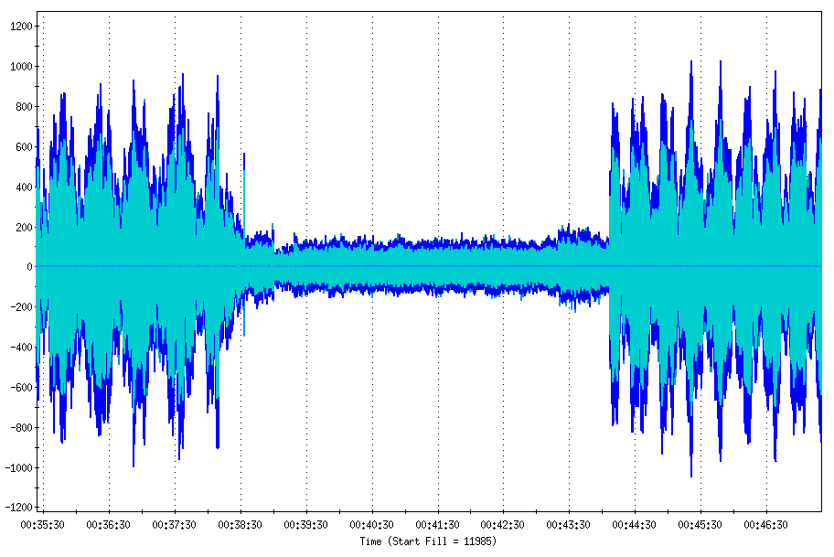
10 Hz Global Orbit Feedback Success!
Feedback OFF
Feedback OFF
Feedback ON
Microns
IR6 and IR8 Blue Q1 and Q3 horizontal BPM measurements with 10 Hz feedback ON vs. OFF
(31.2 GeV Gold)
March 24, 2010

Slide 3
FFT of bi8-bh3 BPM Feedback ON vs. OFF (linear scale)
(K. Mernick)

Slide 4
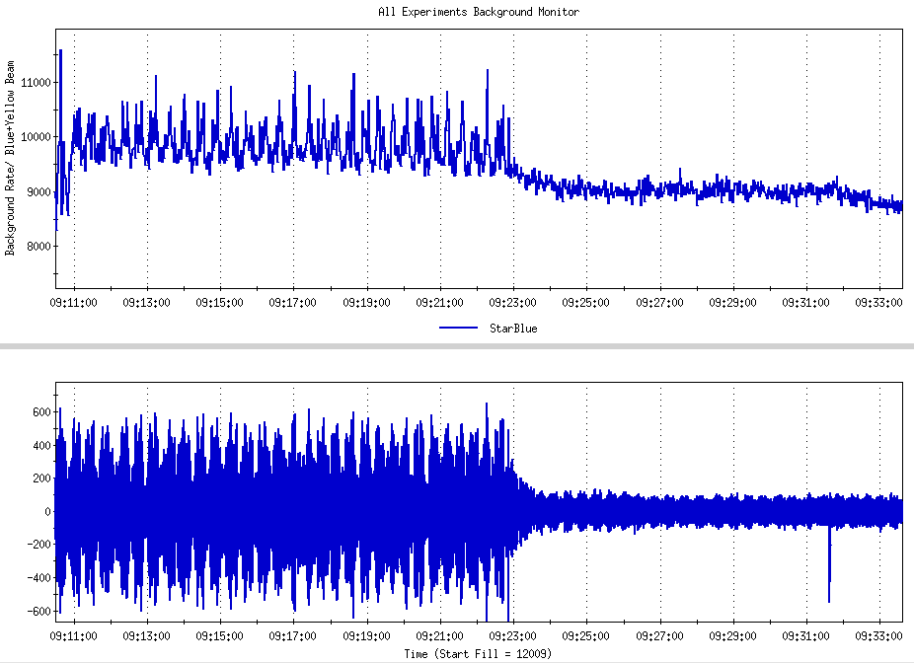
Star backgrounds decreased when feedback engaged
BPM position : bi8-bh1
Microns
Feedback engaged during 31.2 GeV physics store
March 26, 2010

