Slide 1
Take 5 for Safety
Safety Photo of the Week
Power Taps
Collider-Accelerator Department
3-30-2010

Slide 2
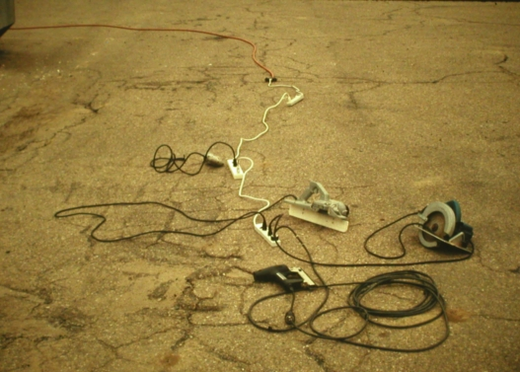
Daisy Chaining to the Extreme

Slide 3
Power Taps
What: A relocatable power tap, or power strip, is used to provide multiple receptacles from a single facility outlet
It has a 1.5 ft to 25 ft integrated power cord, and a housing containing several receptacles (typically 3 to 8)
In addition, it may contain:
power switch
over current protection (a resettable breaker)
surge suppression
Where: very common in offices with computers, small kitchen areas, and laboratory areas

Slide 4
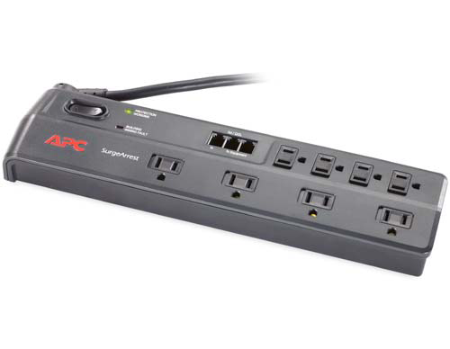
Rules – OSHA and UL
The power strip must be NRTL listed (UL, CSA, etc.)
The power strip must be plugged into a facility receptacle that is permanently wired in a laboratory or office
The power strip must NOT be permanently mounted; no tools can be used to mount the power strip, and any screws used to hang the strip can not be accessible for tightening
Do NOT plug a power strip into another power strip, into an extension cord, or into a UPS

Slide 5
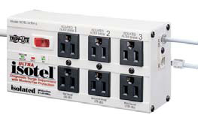
Rules – OSHA and UL
Most power strips are rated for 15 amps but you should not approach this rating with one load
Most appliances are rated in power (watts); a 15 amp power strip is rated at 1800 watts total for 120 volt service
Never exceed the maximum rated load (1800 watts or 15 amps)
Avoid any single load at 1000 watts or more

Slide 6
Rules – OSHA and UL
NEVER plug into a power tap:
window air conditioner 1200 to 3000 watts
space heater 1000 to 1800 watts
microwave oven 1100 to 2000 watts
large coffee maker (10 cup) 1200 watts
toaster oven, hot plate, etc. 1200 to 1500 watts
laser printer 600 to 1200 watts
any motor > 1/3 hp or > 750 watts running or > 1500 watts startup
large refrigerator 600 to 800 watts running or > 1500 watts startup

Slide 7
Rules – OSHA and UL
ALLOWED in a power tap, please add up to get total
small coffee pot (4 cup) 650 watts
computer with monitor 200 to 500 watts
inkjet or dot matrix printer 100 to 200 watts
small refrigerator 300 watts
clock radio, small radios, VCR 50 to 100 watts
small portable fan 200 to 300 watts
slow cooker 200 watts
charger (cell, PDA, etc.) < 5 watts
laptop power supply 60 to 80 watts

