Slide 1
PHENIX Status
Time Meeting, 3/30/2010
Stefan Bathe

Slide 2
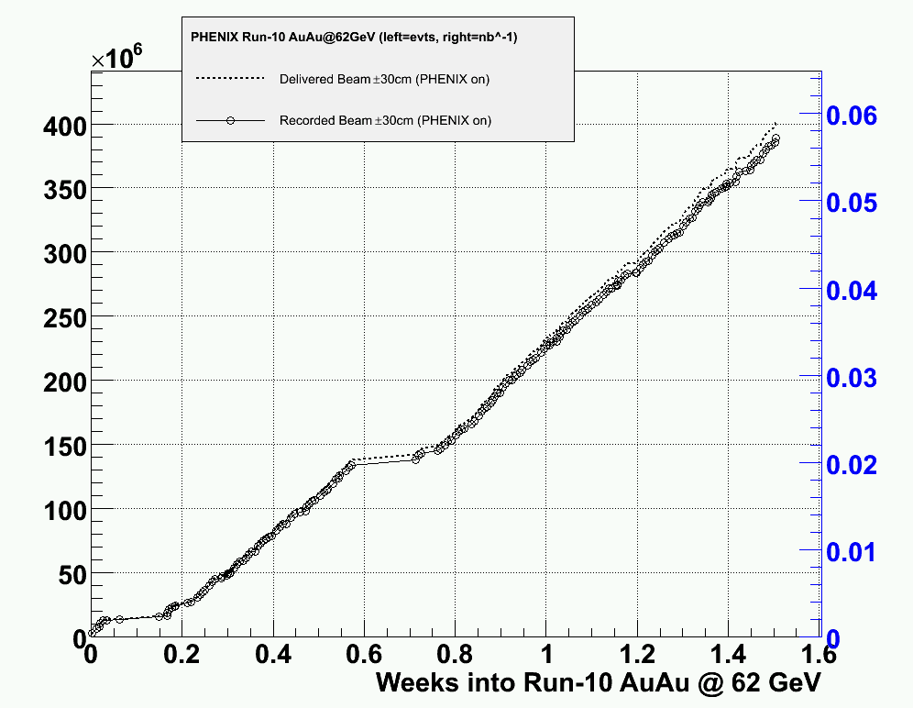
Integrated Luminosity @ 62.4 GeV
Delivered
(PHENIX on)
Original goal
after 4 weeks
Recorded
(PHENIX on)

Slide 3
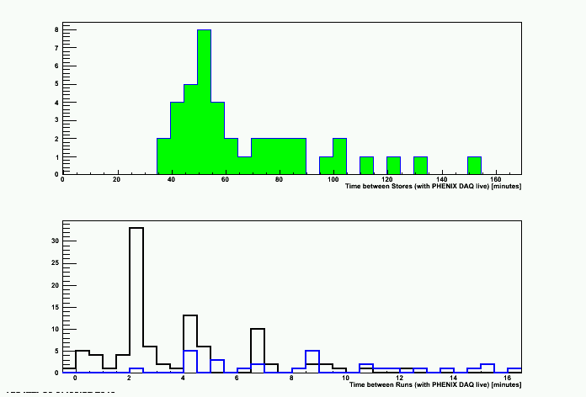
Turn-Around Time @ 62.4 GeV
50 minutes
Time between Stores (with PHENIX DAQ live [minutes]
2 minutes
Run # consecutive
Run # not consecutive
Time between Runs (with PHENIX DAQ live [minutes]

Slide 4
AC
AC was repaired on Wednesday and Thursday (thanks!)
Since then all AC systems have been working
Work of caution: let’s wait and see if it holds up when it gets warm again

