Slide 1
Take 5 for Safety
DOE Electrical Assessment of C-AD:
Inaccurate Electrical Panel Schedules
Missing Knockouts
Panel Modifications
Picture of the Week
Collider-Accelerator Department
4-6-2010

Slide 2
Recent Assessment Results
Level 1 Finding:
A number of circuit breaker cabinets within the AGS, STAR and PHENIX were found with inaccurate panel schedules
Openings due to removed conduit and / or missing hardware on the front panel covers
Feeder circuits supplying circuit breaker cabinets were not identified within any of the four toured CAD facilities
A number of circuit breaker lighting cabinets were found to have been modified within the AGS tunnel facility

Slide 3
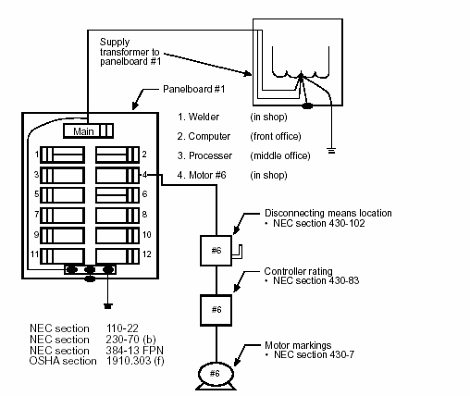
DOE: Switches In Service Panels, Subpanels, Or Elsewhere Shall Be Marked To Show What Loads Or Equipment Are Supplied; NEC: Source (Feeder Circuit) Shall Be Labeled On Panel
Loads, Disconnects,
Controllers Should
Be Labeled With
Same ID# As Indicated
On Service Panel

Slide 4
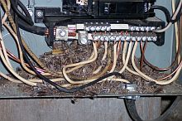
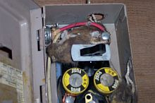
Web Examples of Openings Due to Outer Panel Box Missing Hardware
PPE at BNL was calculated assuming the panel enclosure offered no protection in an arc flash
Do not use -1 rule if panel has missing hardware
Main issue: bees and animals can get in

Slide 5
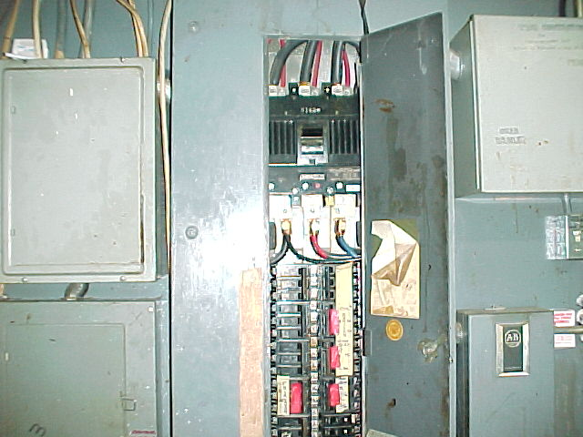
Web Examples of Missing Hardware Inside Panel (Shock Hazard); Not Observed During Assessment

Slide 6
Panel Modifications
Circuit breaker lighting cabinets were found to have been modified within the AGS tunnel
Transparent Lexan panels were installed over relays to protect exposed conductors
Lighting cabinets were approved by a NRTL
Lexan modification requires review from by C-AD EEI

Slide 7
Notes:
Advertising Stunt – Still OK?

