Slide 1
PHENIX Status
Time Meeting, 4/06/2010
Stefan Bathe

Slide 2
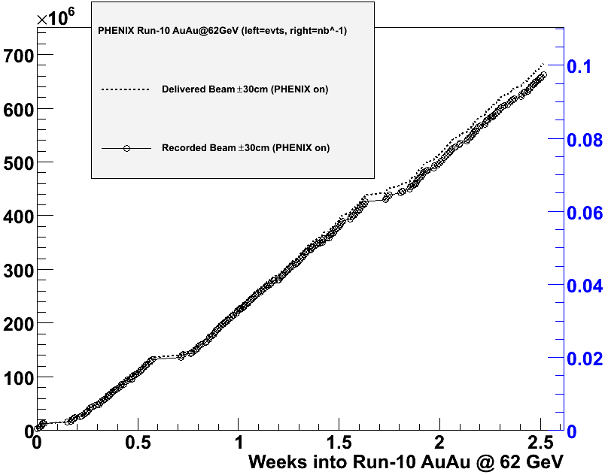
Integrated Luminosity @ 62.4 GeV
Delivered
(PHENIX on)
Recorded
(PHENIX on)
Original goal
after 4 weeks

Slide 3
First Glimpse at J/ψ Peaks
Peak visible from about
25 % of statistics
Encouragement that with increased data set (700 M instead of 400 M events) we can not only do dilepton measurement with HBD, but also J/ψ measurement (as promised last week)

