Slide 1
Take 5 for Safety
20 Minute C-11, 10 Minute N-13 and 2 Minute O-15 Gas Emissions from BLIP
Collider-Accelerator Department
4-13-2010

Slide 2
Textbook Cone-Shaped Plume

Slide 3
Short Stack and Lower Nearby Buildings – Wind Tunnel Simulation
Cavity Zone
Wake Effect from Building or Cone-shaped Hill
Heat from ground produces recirculation inside the cavity zone

Slide 4
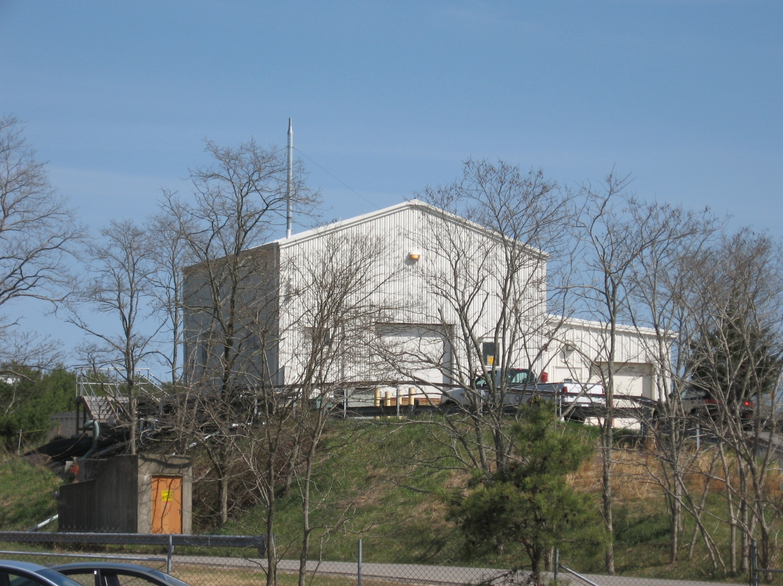
BLIP Building Looking North

Slide 5
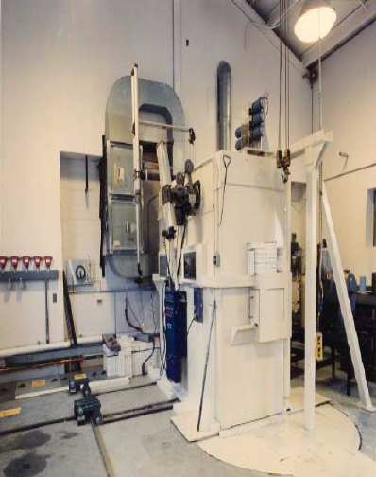
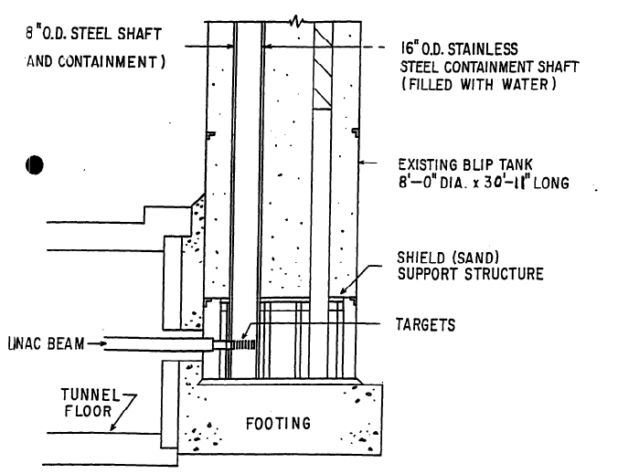
Inside BLIP

Slide 6
Looking West From BLIP

Slide 7
Looking South From BLIP

Slide 8
North Side of BLIP Building

Slide 9
North Side of BLIP Building Looking from “NSRL Valley”

Slide 10
MicroR/h on April 6, 6 PM, 20 mm Water Path for Beam, 485 CFM, Routine Medical Production Targets, 117 MeV Beam
Radiation survey was performed at various outdoor locations around the following buildings/facilities:
NSRL, EBIS, HITL, REF, and LINAC
No readings above background were found in these areas
Outside wall of BLIP was 2000 microR/h near cooling water pipe

Slide 11
MicroR/h on April 7, 11 am, BLIP Off

Slide 12
MicroR/h on April 8, 5 AM, South Wind, 65 mm Water Path, 485 CFM, 181 MeV Beam, Simos Targets Plus Normal BLIP Targets

Slide 13
MicroR/h on April 8, 2 PM, South Wind, Reduced Water Path to 50 mm (25%) and Reduced Ventilation to 300 CFM (38%)
BLIP outside wall reduced from 8000 microR/h to 6000 microR/h (25%)
Area exposure rates dropped to 20 to 30 microR/h along the NSRL beam line, and 8 microR/h inside the NSRL building
Factor of 3 ± 1 reduction in NSRL area exposure rates
This met BNL criteria for less than 50 microR/h in uncontrolled areas, and C-AD HP requirement for less than 13 microR/h background to release NSRL targets

Slide 14
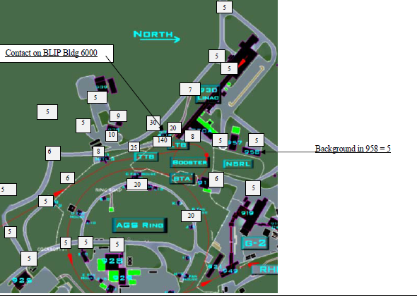
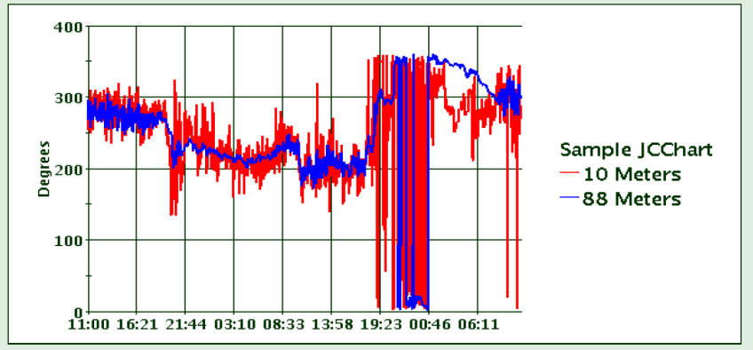
MicroR/h on April 10, 2 PM, West Wind, Reduced Water Path to 50 mm and Reduced Ventilation to 300 CFM

Slide 15
MicroR/h on April 12, 12:30 AM, North Wind, 50 mm Water Path, 300 CFM, 181 MeV

Slide 16
Next Steps
Finish FY10 BLIP program with Simos targets and 50 mm or less water path and 300 CFM
Develop system to independently review modifications to BLIP targets and stack
Options:
Increase stack height
Minimize water path to 20 mm or less

