Slide 1
PHENIX Status
Time Meeting, 4/13/2010
Stefan Bathe

Slide 2
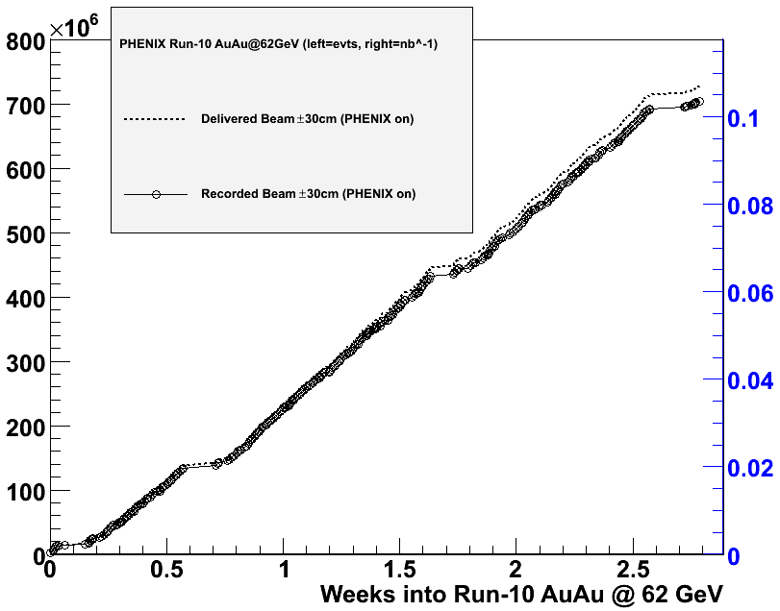
62.4 GeV Close-Out Mar 19 – Apr 8
Goal: 400 M events in 4 weeks for dileptons with HBD
Performance twice better than expected
Requested 600 M events in 3 weeks for new J/ψ measurement
Achieved: 700 M events in 3 weeks
# of events
Integrated lumi. [nb⁻¹]
Original HBD goal reached.
New J/ψ goal reached also.
Success!

Slide 3
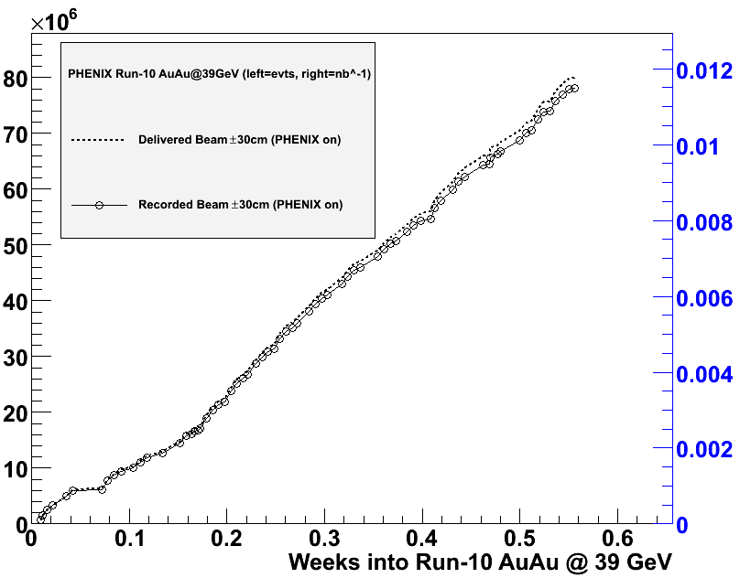
39 GeV: April 9 – . . .
Events on Friday, April 9
Broken HBD channel fixed in the morning
Beam development completed by noon
Taking Physics data since 12:08pm
Lost two channels in Drift Chamber (10 % of acceptance in one of two arms)
Expectation
New physics in reach
Original goal: 50 M events in 1.5 weeks for light quark R_{AA} measurement
New goal: 280 M events in 2.5 weeks for dilepton measurement with HBD in addition
Performance so far
80 M events in 4 days
Projection
280 M events In 2 weeks (by Friday, April 23)
# of events
Integrated lumi. [nb⁻¹]

Slide 4
Rates and Live Time
600 Hz min. bias rate in beginning of store
250 Hz min. bias rate at end of store
Was 1500 and 600 Hz at 62.4 GeV
40 % of what it was at 62.4 GeV
Exactly E² scaling (not better) even though not going through transition
DAQ live time always close to 100 % as expected

