Slide 1
PHENIX Status
Time Meeting, 4/20/2010
Stefan Bathe

Slide 2
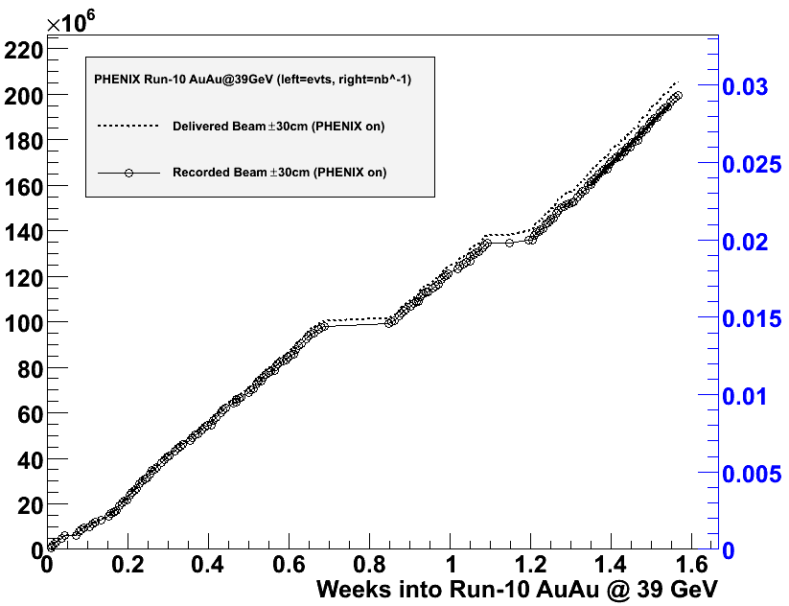
39 GeV
Good performance
New physics in reach
Dileptons with HBD
Run extended by two days
Goal
250 M events in 13 days
Performance so far
200 M events in 11 days
24 h lost due to non-PHENIX problems
Projection
240 M events by Thursday morning
chipmunk
->2 h
# of events
Integrated lumi. [nb⁻¹]
magnet trip
18 h
APEX
27 h

