Slide 1
Take 5 for Safety
Culpability and Human Performance
Safety Photo of the Week
Collider-Accelerator Department
4-27-2010

Slide 2
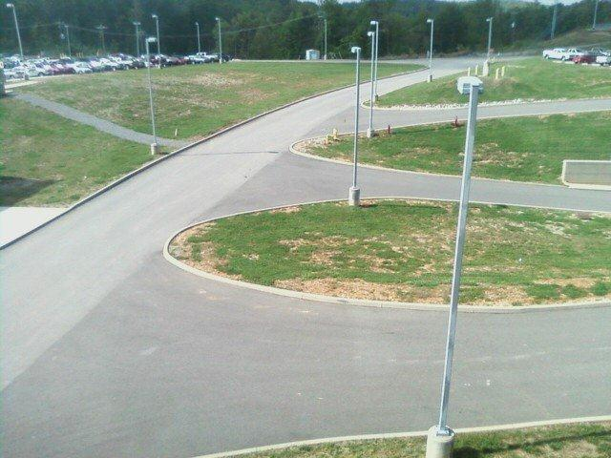
SNS Plan of the Day Talks – Safety Minute
A person was observed walking on the blocks
He slipped and stumbled potentially into the path of an oncoming flatbed truck, who fortunately was moving slowly and stopped
Was the person walking carelessly and was he culpable for this near miss?

Slide 3
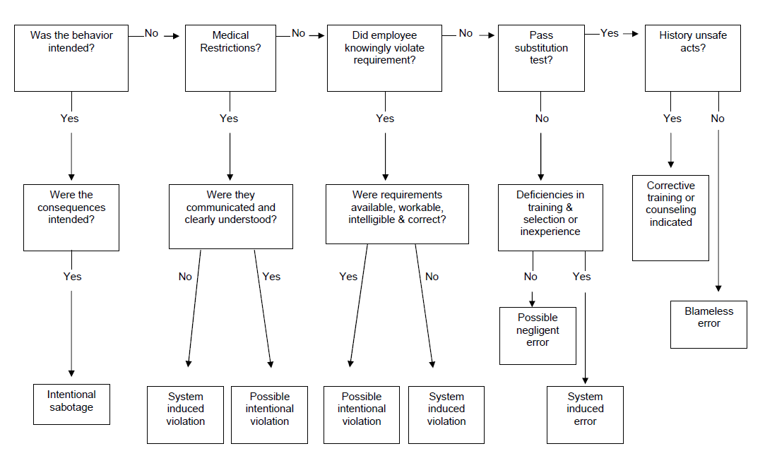
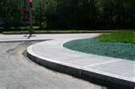
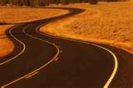
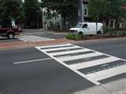
Culpability Chart, OPM 1.26.1
Trained not to
walk on grass
Notes:
No sidewalks; no crosswalk painted in the road; no road lines and person was trained not to walk on grass.

Slide 4
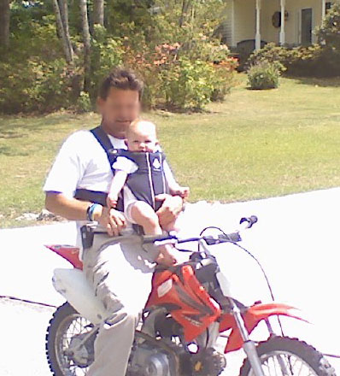
Is it any surprise that this guy is not wearing a helmet?
Notes:
Knucleheadedness can be passed down. History of unsafe acts from generation to generation.

