Slide 1
PHENIX flying into new era
Stefan Bathe, Time Meeting, April 27, 2010

Slide 2
Beam Clock Fixed
Beam clock fixed last night!
Thanks to:
Tom Hayes,
Freddy Severino,
Rob Michnoff,
Kevin Smith,
Joe Mead,
Jack Fried,
Todd Satogata,
our own John Haggerty,
and others . . .
Lumi increase by factor 3!
600 K events in 4 weeks
seem reachable
New slope: 150 K mbias events/week
21.4 K/day
0.25 Hz

Slide 3
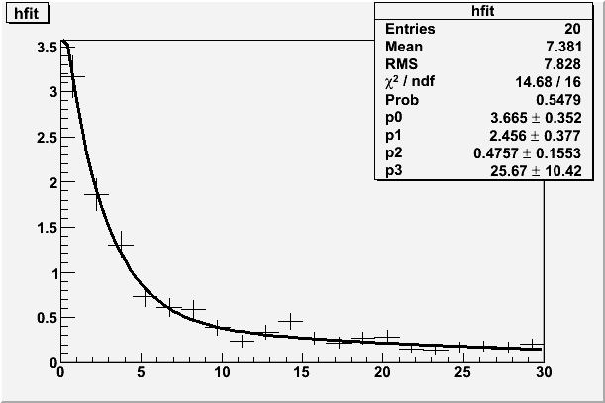
PHENIX BBCLL1 rate [Hz] vs. time [min.]
PHENIX BBCLL1
(2 Hz bckgrd from laser subtracted)
100% clean
90% efficient
counts at all times
2-3 Hz in beginning of store z_{vtx} within +/- 30 cm
rate(t=0) = 2.5 Hz
component 1:
fraction=88.5%, t_{1/2}=2.5min
component 2:
fraction=11.5%, t_{1/2}=25.7 min

Slide 4
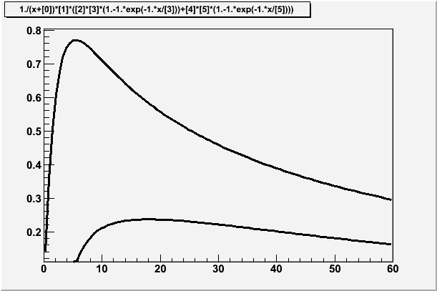
Optimum Store Length
Assumption:
8 min. between stores
6 min. store length =
50 % luminosity gain
0.5 Hz rate roughly consistent
with actually recorded events
Factor 3 increase also consistent
Continuous running
Having to switch clocks (4 min. loss)

Slide 5
Data Validation I
Data
In central events:
BBC charge NOT close to zero
= No inefficiency for central events
UrQMD +
frammentation afterburner
Data and simulation agree → physics triggers

Slide 6
Event Validation II
Looks as expected

Slide 7
Event Validation III
Looks as expected
Mean BBC time in ns

