Slide 1
PHENIX Status @ 7.7 GeV
Stefan Bathe, Time Meeting, May 04, 2010

Slide 2
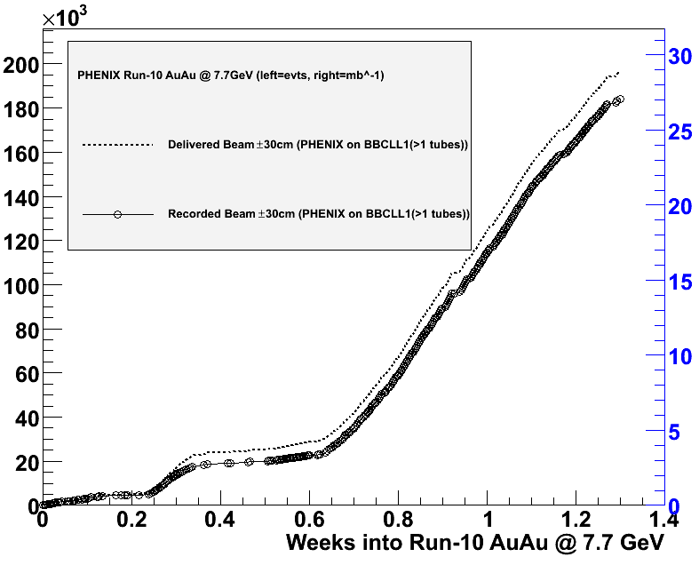
Accumulated luminosity
BBCLL1(>1 tubes)
Real collision rate down/
background up after
going to 6 m beta* Wednesday
Stable running since reverted to
10 m beta* Thursday
beam
clock
glitches
beam
problems
264 K
mbias evts/week
180 K minimum bias events recorded
to date
0.44 Hz averaged over all times
in past four days
→900 K events
in 4 weeks

Slide 3
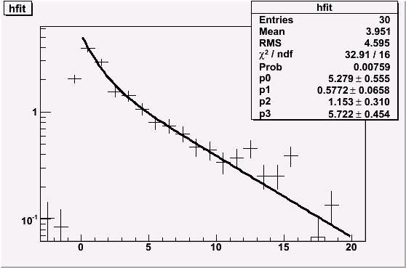
Time Dependence
PHENIX BBCLL1(>1 tubes)
+/- 30 cm vtx cut
(2 Hz laser rate subtracted)
very clean
~70% efficient
counts at all times
3-4 Hz in beginning of store
rate(t=0) = 5.3 Hz
component 1:
fraction=58%, t_{1/2}=1.15min
component 2:
fraction=42%, t_{1/2}=5.3 min
rate [Hz]
t [min.]

Slide 4
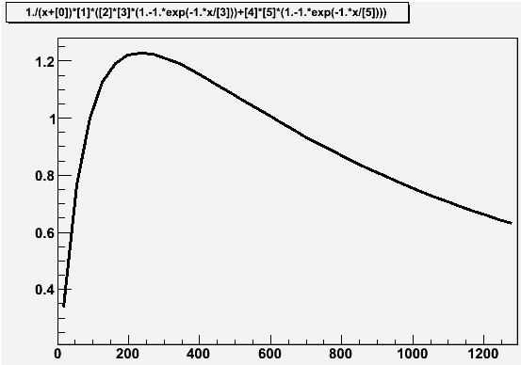
Optimum Store Length
Assumptions:
- 4 min. between stores
(dump to peak)
- Counted only from peak on
4 min. store length =
50 % luminosity gain
Typically 0.7 Hz average rate
while in store
average rate [Hz]
optimum store length:
4 minutes
Current store length:
15 minutes
t [s]

Slide 5
Rate
BBCLL1(>1 tubes) Rate (average for each run)
rate [Hz]
Over last 4 days, average physics trigger rate ~ 0.7 Hz taken over a given PHENIX run (which typically corresponds to one store).
We expect to “see” ~ 70% of the AuAu inelastic cross section within |z|< 30cm.
5/4/2010
5

Slide 6
Spectator Fragments
“banana” shape of BBC signal
vs. centrality as expected from
spectator fragments

Slide 7
URQMD is normalized to match the real data integral for PC1 hits > 40.
URQMD is not matched to the z distribution in real data. However, note that there is no rescaling of the x-axis.
Then comparing the integrals implies (as a first look) that the BBCLL1(>0 tubes) fires on 77% of the cross section and the BBCLL1(> 1 tubes) fires on 70% of the cross section.
No indication of deviation at low PC1 hits from background (at least by this particular check).
URQMD AuAu @ 7.7 GeV through PHENIX full simulation
PHENIX AuAu @ 7.7 GeV Data
w/ BBCLL1(>0 tubes) |z| < 30 cm
PHENIX AuAu @ 7.7 GeV Data
w/ BBCLL1(>1 tubes) |z| < 30 cm

