Slide 1
PHENIX Status @ 7.7 GeV
Stefan Bathe, Time Meeting, May 11, 2010

Slide 2
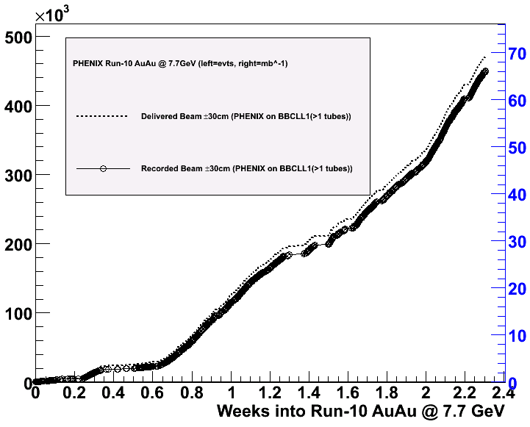
Accumulated luminosity
BBCLL1(>1 tubes)
2nd attempt at 6 m beta* also
caused high background rate
As of Sunday morning,
luminosity twice higher than before
due to higher intensity
450 K minimum bias events
recorded to date
1 Hz in store average
0.7 Hz all-time average
470 K
mbias evts/week
→1.1 M events
in 4 weeks

Slide 3
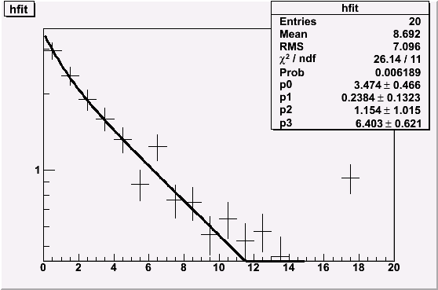
Time Dependence
PHENIX BBCLL1(>1 tubes)
+/- 30 cm vtx cut
(2 Hz laser rate subtracted)
very clean
~70% efficient
counts at all times
3-4 Hz in beginning of store
rate(t=0) = 3.5 Hz
component 1:
fraction=24%, t_{1/2}=1.15min
component 2:
fraction=76%, t_{1/2}=6.4 min
rate [Hz]
t [min.]
Significant lifetime improvement since last week

Slide 4
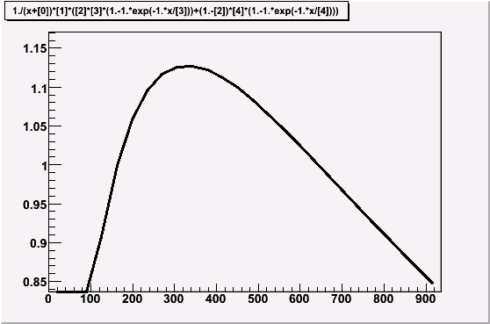
Optimum Store Length
Current store length:
15 minutes
Assumptions:
- 4 min. between stores
(dump to peak)
- Counted only from peak on
6 min. store length =
30 % luminosity gain
Typically 1 Hz average rate
while in store
average rate [Hz]
optimum store length:
6 minutes
t [s]

Slide 5
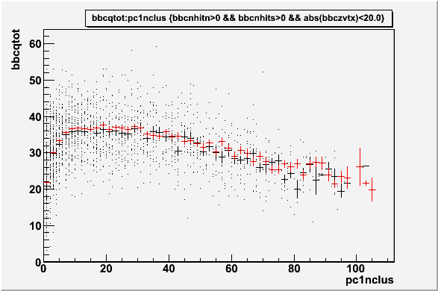
BBC Charge vs. η=0 Multiplicity
Almost PERFECT agreement with UrQMD
DATA
UrQMD
from Jeff Mitchell

Slide 6
Pseudorapidity dependence of particle production
from Kotaro Kijima

Slide 7
Cleanliness of BBCLL1(>1 tubes) trigger
BBCLL1 singles triggers (North, South separately) fire at 10s of Hz→no random coincidences
BBCLL1 coincidence trigger fires at ~0.004 Hz with just one beam in the machine (<0.5 % of collision rate)

