Slide 1
Take 5 for Safety
Feedback and Improvement
Bizarre Accident of the Week
Safety Photo of the Week
Collider-Accelerator Department
5-18-2010

Slide 2
Worker Feedback during Manager Work Observations, FY10 Examples
Scaffolds at some RHIC valve boxes not in good shape
Crane bells sound like fire alarm bells
Phones are not located close enough to work areas at RHIC
C-AD needs to develop a shutdown checklist for RHIC
Workers suggest we extend PA system at RHIC
Building managers need to be alerted by F&O for all work; beforehand and at end of job
Better shelves are needed in offices (not sturdy; too high)
Cabinets can be used to form walls such that walkways are created near disconnect panels
Sharp edges on cable tray exist at some locations
New power supplies have some water hoses that leak; hoses not marked with B31 ratings
Path to doors cleared in snow storm but parking areas not cleared at some buildings
There is no cell phone reception in the Cryo Control Room or in the RHIC tunnel

Slide 3
Feedback from Group Meetings, FY10 Examples
Vehicle shortages
Vehicles do not work in snow
Poor lighting or lights too high above work area
Roof leaks; trenches full of water
Snow removal is poor in some cases
Streets and parking lots need to be painted
Cable tray penetrations into buildings allow animals to come in
Air conditioning needs to be improved in some equipment rooms
More custodial services needed in some areas
Not enough time to do jobs assigned on maintenance days
Too much irrelevant training and re-training
Time pressures on maintenance day cause workers to take shortcuts
Better roads, working surfaces and walkways needed
Some confusion on PPE rules
Workers want managers to support safety even if it impacts schedule

Slide 4
Thank-You for the Feedback
Some Improvements
Work planning is being done in all groups
Workplace housekeeping is improving
Maintenance Day jobs fit time allowed or are postponed / canceled
Vehicle rental options are being considered for shutdown
Security of metals is improving
Configuration control is improving (e.g., procedures, drawings, records)
Electrical equipment is safer and improving
Lighting is improving
Reduced injuries
Reduced environmental impacts, e.g., tritium and sodium-22
Requests for paving, sidewalks, PA system, street-lighting, and roof repair are going forward
Requests to resolve fire safety deficiencies are going forward
Requests for more efficient work space going forward

Slide 5
Bizarre Accident of the Week - Woman Killed by Laptop Computer
Police in Surrey, British Columbia, say a 25-year-old woman was killed when she was struck in the back of the head and neck with her laptop computer
She was on a business trip with her luggage in the back seat of her car when a tow truck collided with her
Investigators say she would have survived the accident had it not been for her laptop
Her 7 lb. laptop was unsecured in the back seat at the time of the accident
Police believe the crash impact threw the laptop out of the back seat, striking the back of her head
Try not to keep unsecured items in your vehicle that can get airborne in an accident

Slide 6
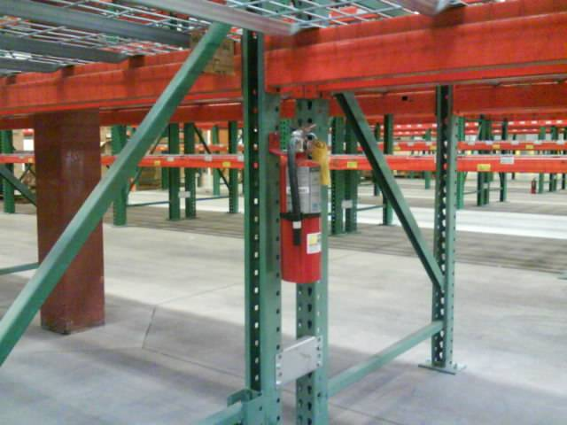
Safety Photo of the Week - Stop, Drop, Roll and Find the Extinguisher
A merchandiser from California posted this on the web. Workers had moved some racks in one area of his building, and as a result relocated some of the fire extinguishers. The problem is that the orange beam is only 36 inches off the ground.

