Slide 1
PHENIX Status @ 7.7 GeV
Stefan Bathe, Time Meeting, May 18, 2010

Slide 2
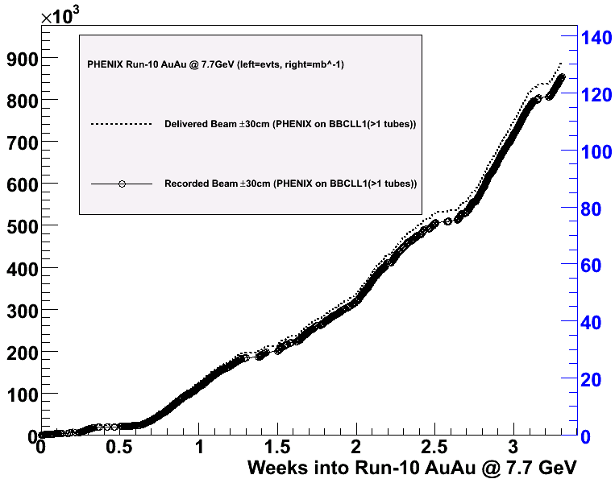
Accumulated luminosity
BBCLL1(>1 tubes)
As of Friday night, average rate in store up to 30 % higher
(depending on intensity)
Time between stores decreased from 4 min. to 2.5 min.
Average rate 30 % higher
1.25 Hz in store average
(up from 1 Hz)
1 Hz all-time average
(up from 0.7 Hz)
850 K minimum bias events
recorded to date
(up from 450 K)
currently 630 K
mbias evts/week
(up from 470 K)
→1.25 M events
in 4 weeks
(up from 1.1 M)

Slide 3
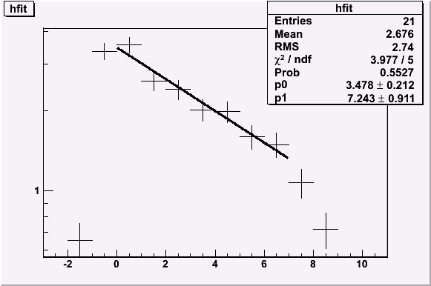
Time Dependence
PHENIX BBCLL1(>0 tubes)
+/- 30 cm vtx cut
(2 Hz laser rate subtracted)
rate(t=0) = 3.5 Hz
t_{1/2}=7 min (good store)
t_{1/2}=3.5 min (average store)
rate [Hz]
good store
t [min.]
Curious drop-off of rate 7 min. into store

Slide 4
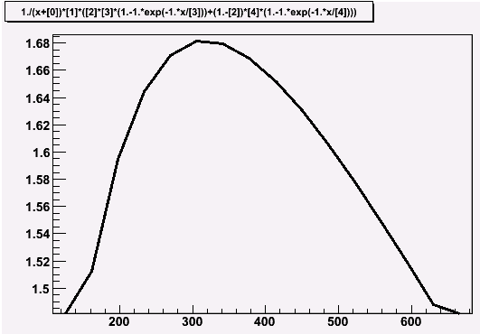
Optimum Store Length
Current store length:
10 minutes
Assumptions:
- 2.5 min. between stores
(dump to peak)
- Counted only from peak
5 min. store length =
10 % luminosity gain for good store
3.3 min. store length =
40 % luminosity gain for average store
average rate [Hz]
optimum store length:
< 5 minutes
good store
t [s]

Slide 5
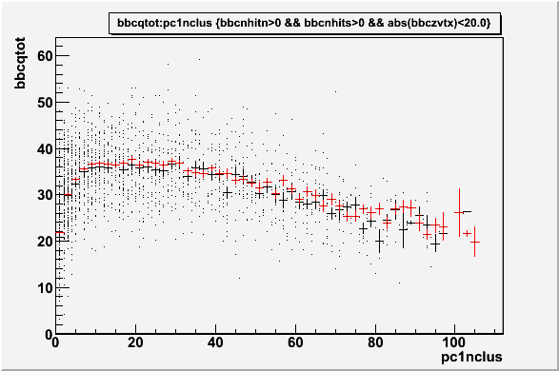
BBC Charge vs. η=0 Multiplicity
Almost PERFECT agreement with UrQMD
DATA
UrQMD
from Jeff Mitchell

