Slide 1
Take 5 for Safety
Impact of Low Energy Running on RHIC’s Residual Radiation Levels
Safety Photo of the Week
Collider-Accelerator Department
5-25-2010

Slide 2
Dose Rates Study For Low Energy Running up to 5-19-10
A survey of Yellow scraper on 5/19/10 indicated dose rates were 400 mrem/h contact and 40 mrem/h at 1 foot
A survey of Blue scraper on 5/19/10 indicated dose rates had increased; dose rates measured were 500 mrem/h contact and 60 mrem/h at 1 foot
A survey of U-Line upstream on 5/19/10 indicated dose rates had increases at two locations; 1) 20 mrem/h at contact and 2) 15 mrem/h at contact
A survey of U-Line Downstream on 5/19/10 indicated dose rates at UD-3 had increased to 30 mrem/h contact and 5 mrem/h at 1 foot
Surveys of the X & Y injection on 5/19/10 were similar to that obtained on 5/13/10
A survey performed on W-Line and dump on 5/19/10 indicated all dose rates that have been typically identified in the past
On either side of STAR where the beam pipe is reduced from 5 inches to 3 inches surveys were performed; both locations indicated <0.1 mrem/h

Slide 3
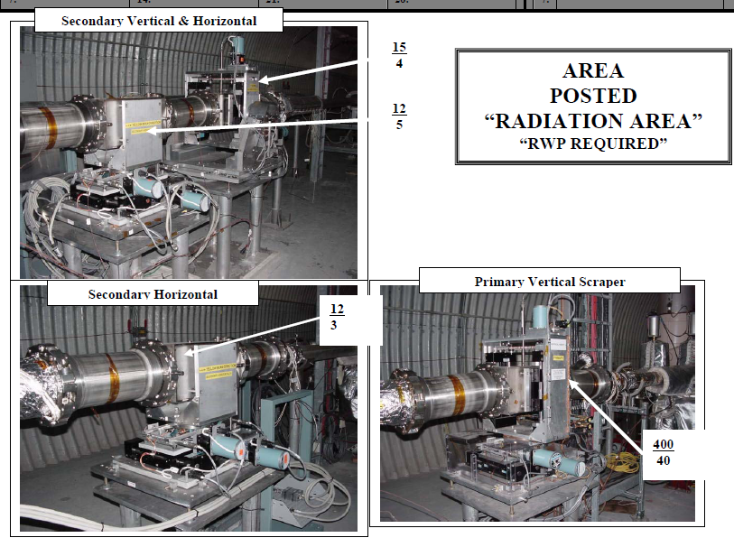
7 O’Clock Yellow Scraper 5-13-10 and 5-19-10

Slide 4
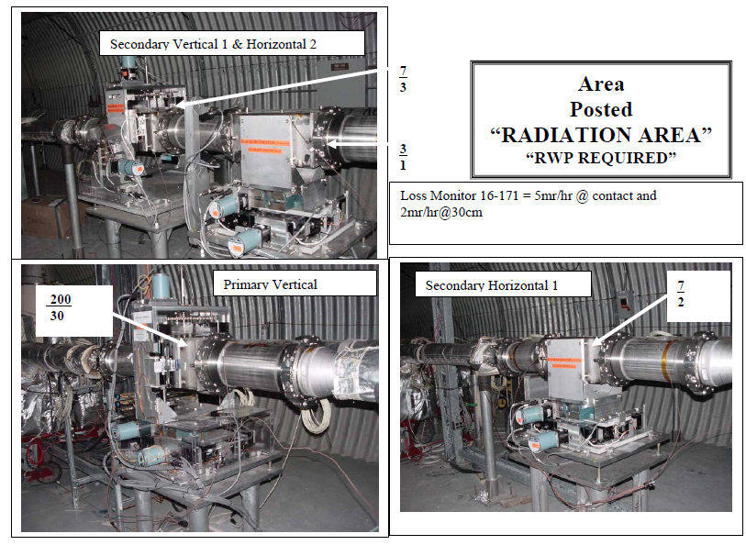
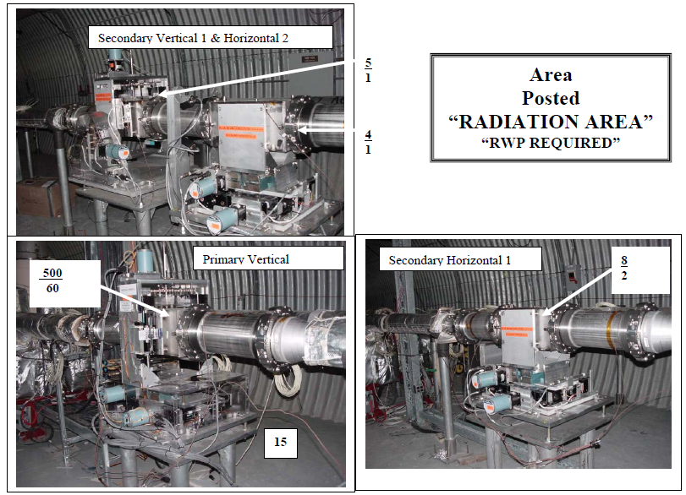
8 O’Clock Blue Scraper 5-13-10 and 5-19-10

Slide 5
U Line 5-19-10

Slide 6
U Line 5-19-10

Slide 7
X Injection 5-19-10

Slide 8
g-2, V Line / U Line, 12-10-99

Slide 9
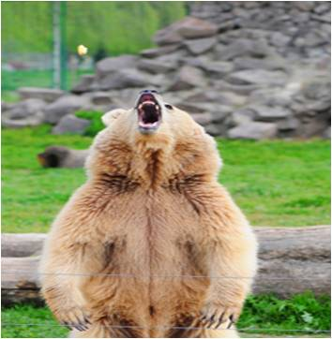
Safety Photo of the Week - Pot-smoking worker mauled by grizzly: Does he get comp?
Employee Brock Hopkins entered a pen at Great Bear Adventures in West Glacier, MT, to feed grizzlies
He was attacked by one of the bears and escaped by crawling under an electrified fence. He suffered severe injuries
Hopkins admits he smoked marijuana that day before entering the bear pen
His employer presented no evidence about his level of impairment on the day of the attack
Hopkins was initially denied workers comp on the grounds that his use of marijuana was the major contributing cause of the accident
Hopkins appealed to the state’s Workers’ Compensation Court
Here’s what the judge wrote: “When it comes to attacking humans, grizzlies are equal opportunity maulers, attacking without regard to race, creed, ethnicity, or marijuana usage. Hopkins’ use of marijuana to kick off a day of working around grizzly bears was ill advised to say the least and mind-bogglingly stupid to say the most”
The judge noted that, while using pot before interacting with bears may have been stupid, there was no evidence presented to conclude that Hopkins’ pot use was the major cause of the incident
The decision: Hopkins was entitled to workers’ comp benefits

