Slide 1
PHENIX Status @ 7.7 GeV
Stefan Bathe, Time Meeting, May 25, 2010

Slide 2
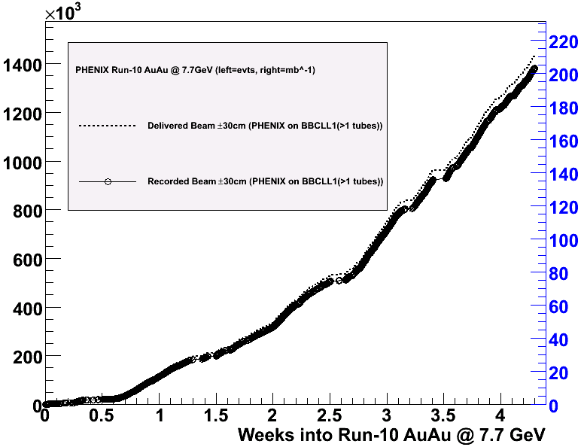
Accumulated luminosity
BBCLL1(>1 tubes)
1.4 M minimum bias events
recorded to date
(up from 850 K)
Improvement since last week
However, currently rates declining (30 % lower than maximum, see next slide)
currently 775 K
mbias evts/week
(up from 630 K)
→1.6 M events
in 4 weeks
(up from 1.25 M)

Slide 3
Rate Development
rate [Hz]
run index (= store)
Degradation over past 24 h

Slide 4
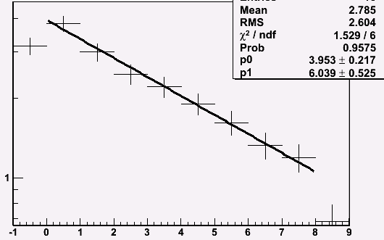
Time Dependence
rate [Hz]
PHENIX BBCLL1(>0 tubes)
+/- 30 cm vtx cut
(2 Hz laser rate subtracted)
rate(t=0) = 4 Hz
t_{1/2}=6 min (good store)
good store
t [min.]

Slide 5
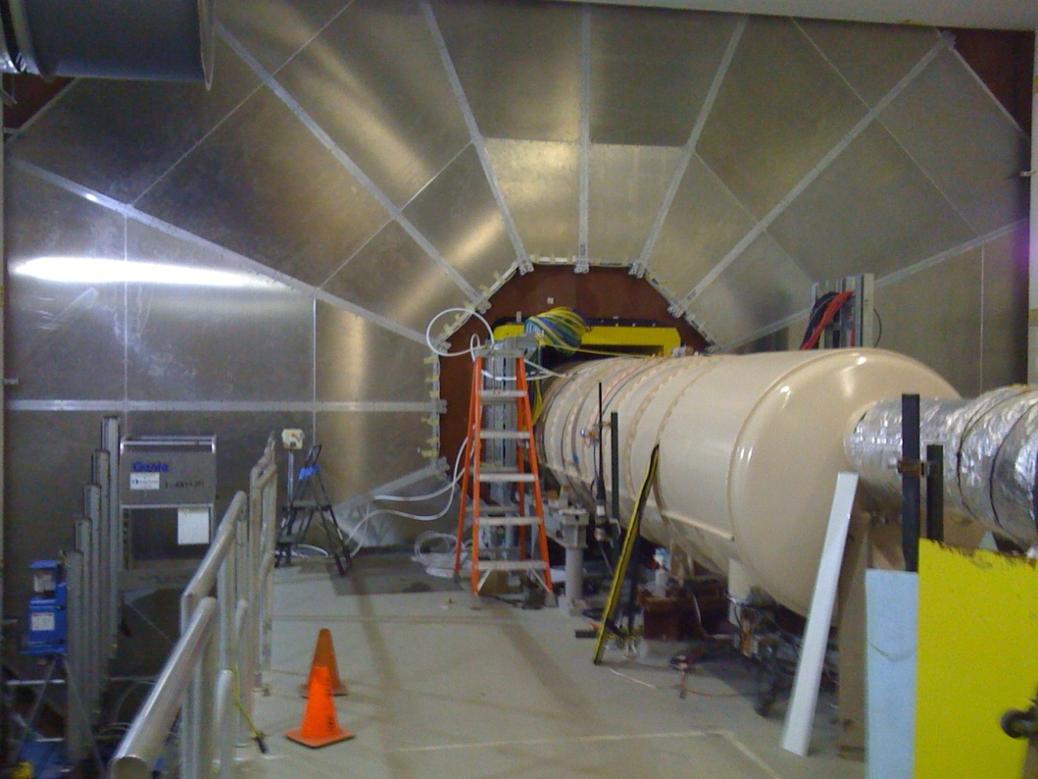
Plans for 11.5 GeV run
No collisions in PHENIX @ 11.5 GeV
Will commission new muon detectors with cosmic rays
Crucial for next year’s W physics program
2-person watch shifts + experts
2 h access on Thursday to finish detector set up
4 h access on Wednesday next week for end-of-run HBD calibration measurement

