Slide 1
Take 5 for Safety
Safety at Deep Water Horizon
Lighting News – Focus on Reducing Hazards
Preventing Errors Among Shift Workers
Safety Photo of the Week
Collider-Accelerator Department
June 1, 2010

Slide 2
Just How Many Injuries Would Workers Hide For Incentives? ☼
Transocean, an offshore drilling company, is a business partner with BP in connection with the Deepwater Horizon oil rig that exploded, killing 11 workers and sending huge, unknown amounts of oil into the ocean
Just two years ago, the Minerals Management Service (MMS), the federal agency that enforces safety rules on oil rigs, gave Transocean a top safety award for a “perfect performance period”
In 2009, Transocean chief executive Steven Newman danced at a lavish company luncheon for employees in Mumbai
Newman was reportedly making good on a promise to a dinner and a dance if the India Division team posted a top safety record two years running
This is the sort of safety incentive being called into question by OSHA administrator David Michaels
Michaels says safety programs should focus on reducing hazards, not rewarding a decline in injuries
The OSHA administrator suggests workers will hide injuries to get safety rewards, such as dinners or gift cards
☼Huffington Post

Slide 3
Lighting News – Focus on Reducing Hazards
Ed,
I would like to make you aware of a safety issue that we had in our bldg. We were operating a 208 breaker panel that required long sleeve shirt, long pants, safety glasses and gloves. Nine breakers in this panel were being used daily to turn on the lights for the 930 assembly area.
I had two concerns with this:
Excessive wear might cause a failure of one of these breakers.
Proper PPE might not be used to “just turn on the lights”
Wally was contacted as the Bldg. manager and within one day had electricians review the issue, within a week a GE Lighting contactor was installed and the issue was resolved.
I would like to thank Wally for his prompt response and mitigation of this possibly dangerous situation.
Sincerely,
Lawrence Vogt

Slide 4
Preventing Injuries Among Shift Workers
A study published in the Cochrane Library shows caffeine worked better than naps at reducing errors and improving performance among late-night workers. It worked as well as prescription medications and light therapy — and it costs less than those
Third-shift workers suffer more injuries on the job; some of the biggest workplace disasters occurred on the night shift: the Exxon Valdez and the Chernobyl and Three Mile Island nuclear incidents
Although no correlation has been shown yet to fatigued workers, the recent BP oil disaster in the Gulf of Mexico also happened at the start of the overnight shift
So the good news for night workers who’ve relied on caffeine is that there’s no reason to discontinue doing so, if they’re healthy
The best way for them to take advantage of caffeine’s effects: small doses spread out over time
If night workers find they’re losing concentration, a 20-minute break with caffeine might help; that’s how long it takes for the substance to have an effect

Slide 5
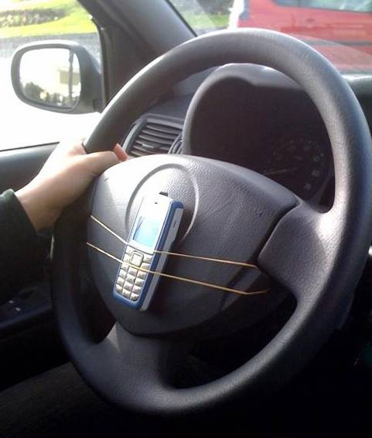
Safety Photo of the Week
A Few Recent Cell-Phone Accident Statistics
Talking on cell phones causes nearly 25% of car accidents
A car driver dialing a cell phone is 2.8 times more likely to get into a crash than a non-distracted driver
For every 6 seconds of drive time, a driver sending or receiving a text message spends 4.6 of those seconds with their eyes off the road

