Slide 1
PHENIX Status
Stefan Bathe, Time Meeting, June 1, 2010

Slide 2
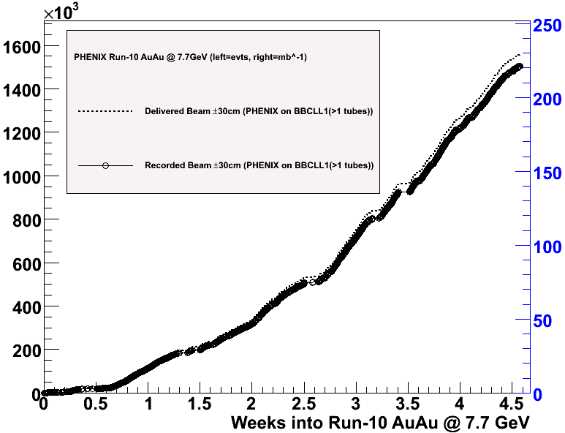
7.7 GeV Close-Out
BBCLL1(>1 tubes)
1.5 M minimum bias events recorded @ 7.7 GeV

Slide 3
Minimum Bias Event Rate
run index (= store)
Average rate of 1.8 Hz in 2nd half of 7.7 GeV run

Slide 4
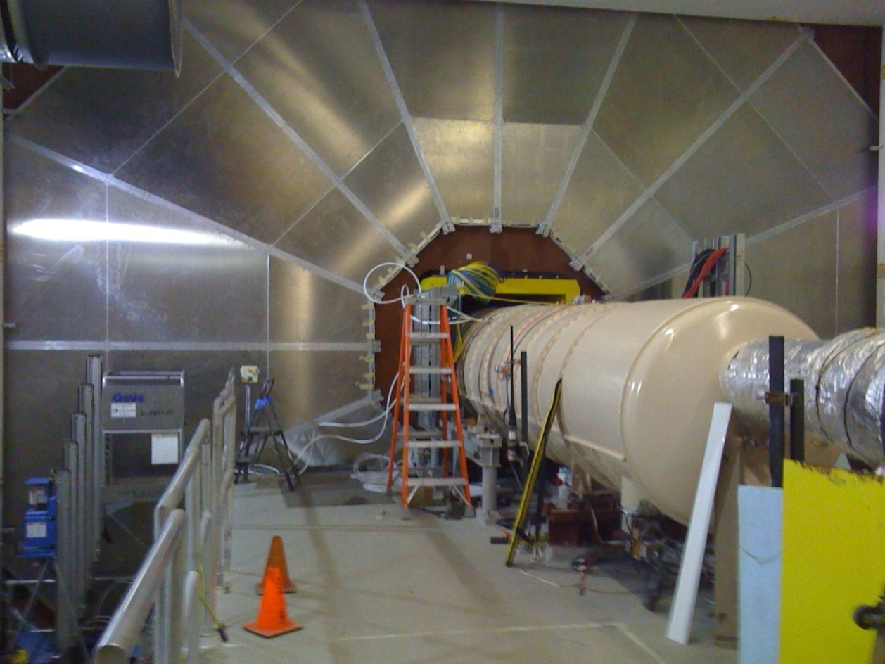
Muon Trigger Commissioning
No collisions in PHENIX @ 11.5 GeV
Commissioning new muon detectors with cosmic rays
Crucial for next year’s W physics program
2-person watch shifts + experts

Slide 5
Fire Alarm Last Night
At 1:00am last night smoke alarm shut off experiment
Originated from rack WCB2 rack (holds MuID Blue Logic electronics)
WCB2 was shut off first by safety system
Smoke apparently leaked out of rack enough to trigger VESDA HSSD system, which shut off entire experiment
Took access, no visible burning, but noticeable smoke odor
Turned circuit breakers back on
Re-established flammable gas flow
Currently switching on racks (except for WCB2), front end electronics
Expect to be back up tomorrow morning
Need 60-90 minute access to evaluate course of alarm

