Slide 1
Take 5 for Safety
Controlled Area at RHIC
ODH at RHIC
Collider-Accelerator Department
1-4-11

Slide 2
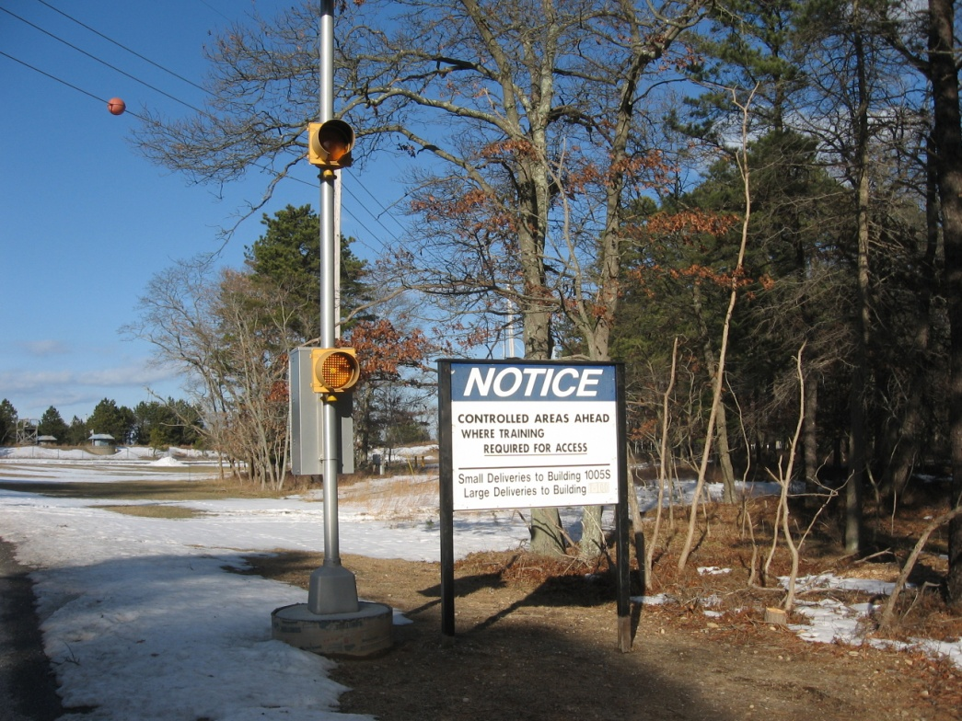
RHIC is Now a Controlled Area Including Building 1005S
Workers must be trained with General Employer Radiation Training (GERT)
Or under Escort by a person with Radiation Worker Training

Slide 3
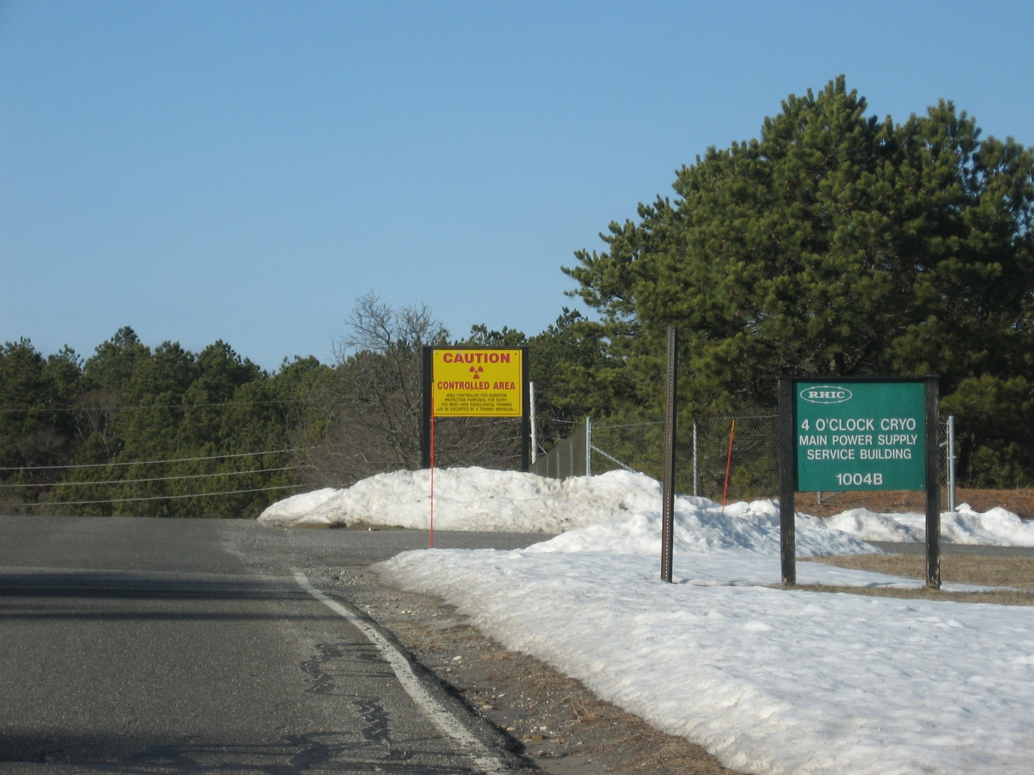
Controlled Area Starts at RHIC Berm

Slide 4
RHIC is now ODH 1 in the Tunnel except for Star and PHENIX. ODH 1 Requires training, medical, escape pack, and POM.

Slide 5
Service Buildings are ODH 0

