Slide 1
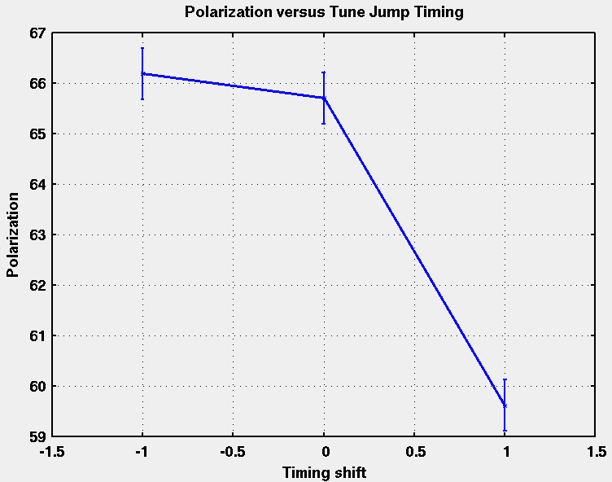
AGS Tune Jump Quad Development
Shifting timing from
the calculated resonance times shows positive effect on polarization.
Further work necessary to optimize the timing of the jumps.
Data taken 1/10/11

