Slide 1
RHIC Status
Haixin Huang
Time Meeting
01/18/2011

Slide 2
Progress in Last One Week
Jan. 12: Snow Storm, but RHIC held on well and commissioning continued.
Jan. 13: It took us three shifts of hunting to find out a wrong cable was put in for the yellow injection kicker timing.
Jan. 14: Circulated beam in Yellow with snake on. Some polarimeter setup was done in blue.
Jan. 15: Beam captured in Yellow with 28MHz cavity and snake on.
Jan. 16: P/S work done. Started ramp development and beam reached store in 4th try. The work was slowed due to various problems: LINAC mod8, RF station trips in the AGS.
Jan. 17: Done ring-to-ring synchro. Continue ramp setup, seen collisions at IP8. 111 bunch injection tested. Highest readings are at CNI polarimeters.
Jan. 18: Start 9MHz cavity capture at injection.

Slide 3
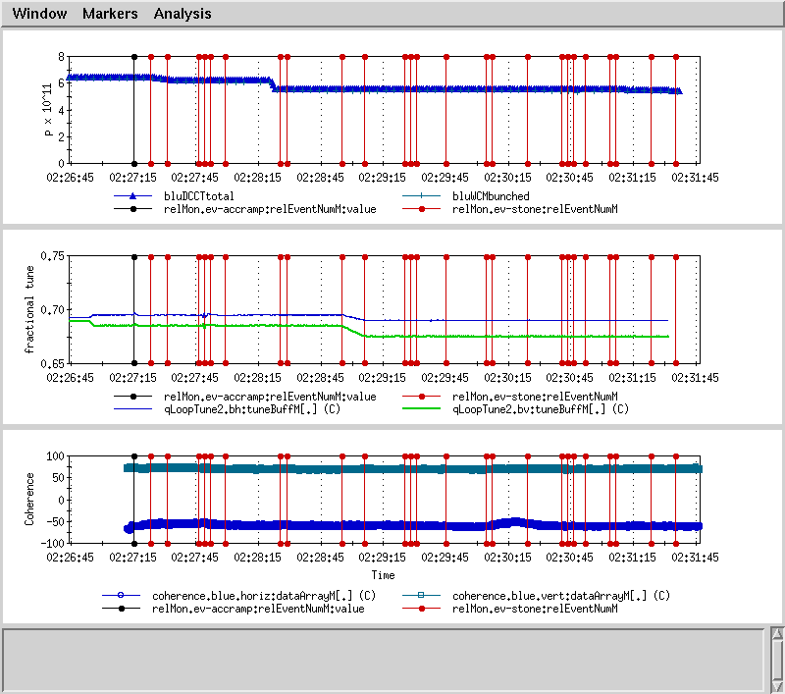
Straight Tunes on Ramp with Tune/Coupling Feedback

Slide 4
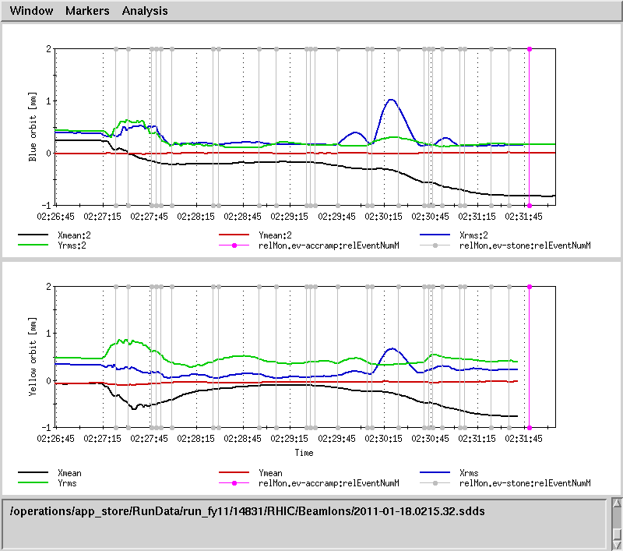
Orbit on Ramp Still Need Work

Slide 5
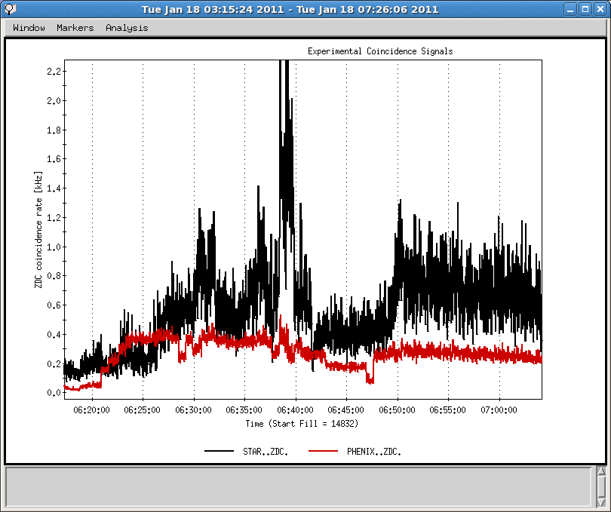
Collisions at IP8 Responsive to IR Steering

Slide 6
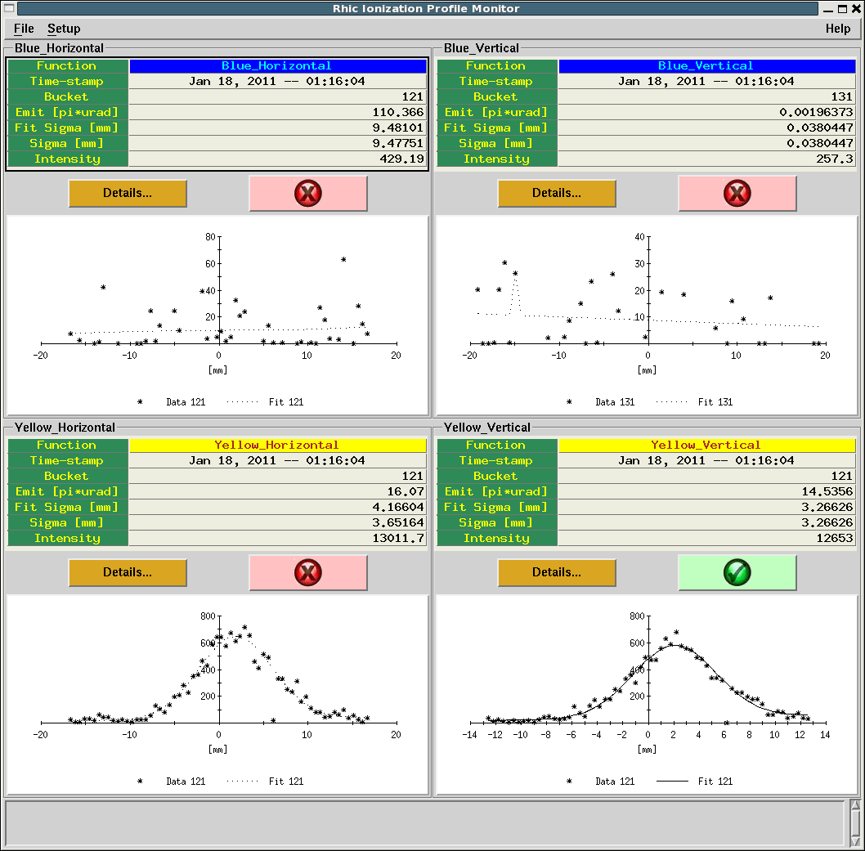
Yellow IPM Gives ~15pi Emittance

Slide 7
Near Term Plan
Setup ramp with 9MHz cavity during day and evening shifts.
Continue ramp development overnight with 28MHz cavity if 9MHz cavity is not ready yet.
Yellow polarimeter setup.
Store setup (collimation, collision). Increase bunch number gradually.

Slide 8
Original Schedule
Cool-Down Mode : one week (01/03-01/09)
Injection setup (6 days: first 4 days are blue only) (01/10-01/15).
Ramp development (6 days) (01/16-01/21)
Commissioning 9MHz at injection and on the ramp (5 days) (01/19-01/23)
Store development (6 days) (01/22-01/27)
Ramp development with intense beam (7 days) (01/28-02/03).
What left on the job list of first two periods: yellow polarimeter setup and capture beam with 9MHz cavity.

