Slide 1
BLIP operations 02-01-11
Status – running at 117.5MeV
  BLIP weekly average beam increased to 96.1µA, highest this year. Reliability very good with total operating time equal to 162.9 hours.
Operations issues
  Investigation of cause of Ga targets leaks continues.
    No Ga targets in beam now. Replaced with an Al disk.
    There is indirect evidence from our recent research irradiations that the beam spot is smaller this year, thus increasing the power density. We performed a high resolution phosphor image plate measurement of the beam profile that showed this year’s beam spot was 4% narrower than last year. It is not clear if this is the smoking gun . The same Ga targets have been successfully irradiated at LANL with 2.5 times more beam intensity than we have but with a raster beam creating a more uniform intensity profile. So we are pursuing a broader Gausssian tune at this time.
    Linac prepared a new tune that was measured to actually be narrower than before. We are trying again today.
  We will shutdown tomorrow for ~3.5 hours to collect 400mL of cooling water from which we will chemically extract Be-7 for ORNL research.

Slide 2
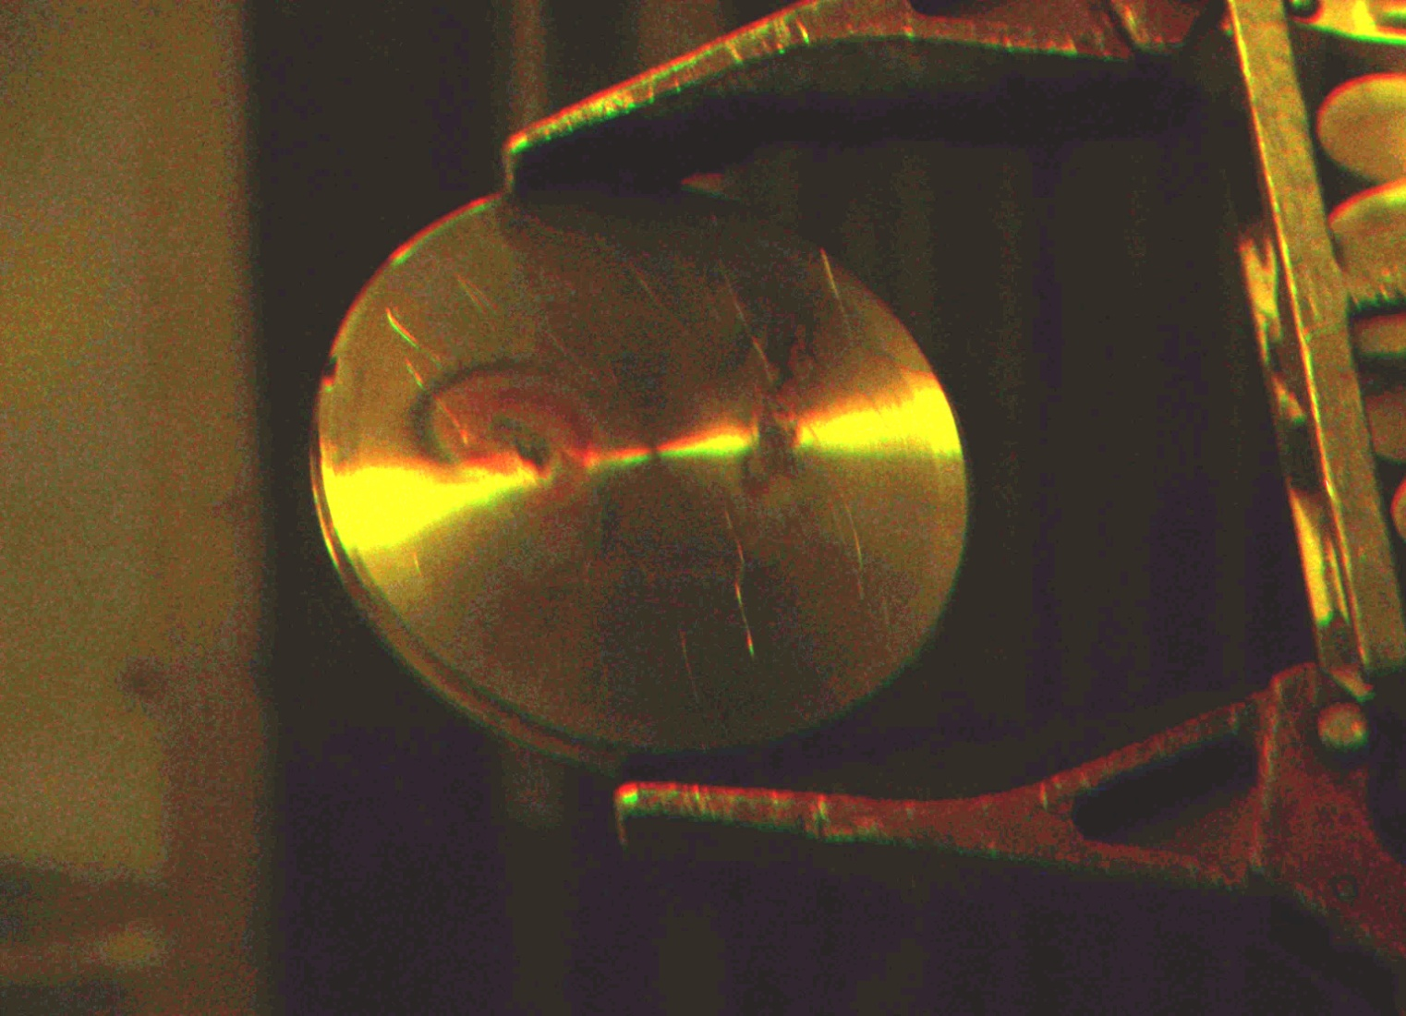
Leaking Ga target prepared by LANL
Burn marks on BNL fabricated targets are similar, and always off center.

