Slide 1
RHIC Status
Haixin Huang
Time Meeting
02/1/2011

Slide 2
Chronicle History of Last Week
Jan. 26 Ring access for six hours to fix jet and many other jobs. Difficulty to provide 28X28 store overnight.
Jan. 27 Rotator ramp development. All polarimeters are functioning. Difficulty to provide 56X56 store overnight.
Jan. 28 9MHz cavity development. Rebucketed with 28MHz. Difficulty to provide 56X56 store overnight.
Jan. 29 Provide 56X56 store overnight. Working on clean up the ramp and chromaticity feedback development.
Jan. 30 Provide 56X56 store overnight. 28x28 ramp with rotator ramp was a success.
Jan. 31 Provide 28X28 store overnight but ended due to P/S problem. Low polarization at store is understood. The ramp with gamma_tr quads on at a later time was a success, the tune glitch is largely gone. Pseudo-rotator ramp was commissioned.

Slide 3
Status as of 2/1/2011
56x56 with 0.9*10^11 ramp and collision.
Polarization between 40-50% at store.
Rotator ramp was tested with 28 bunches.
9MHz Cavity is ready for more bunches and intensity. Rebucketing with 28MHz is demonstrated.
Jet intensity recovered to normal level. Ready to take data.
We moved the gamma_tr quads off time to store. Cleaner ramp.
Issues:
  In every store, the IR steering is needed to generate collisions.
  Orbit feedback still sometimes causes large orbit excursion and beam dump.
  Many corrector P/S failures recently.

Slide 4
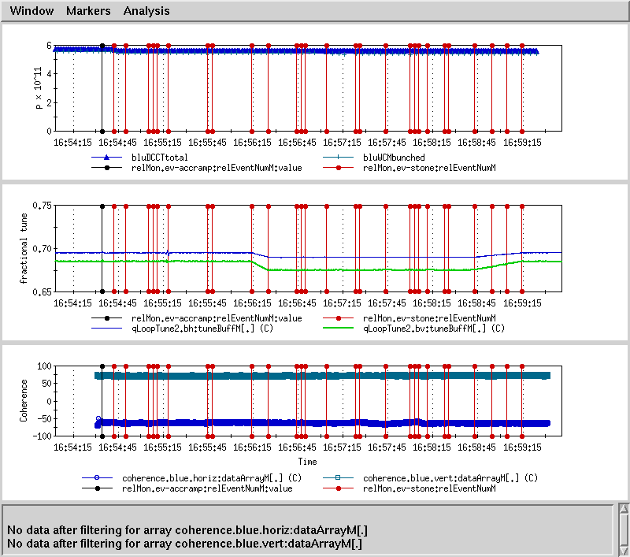
Later Tune Swing Moved Earlier (One Stone)

Slide 5
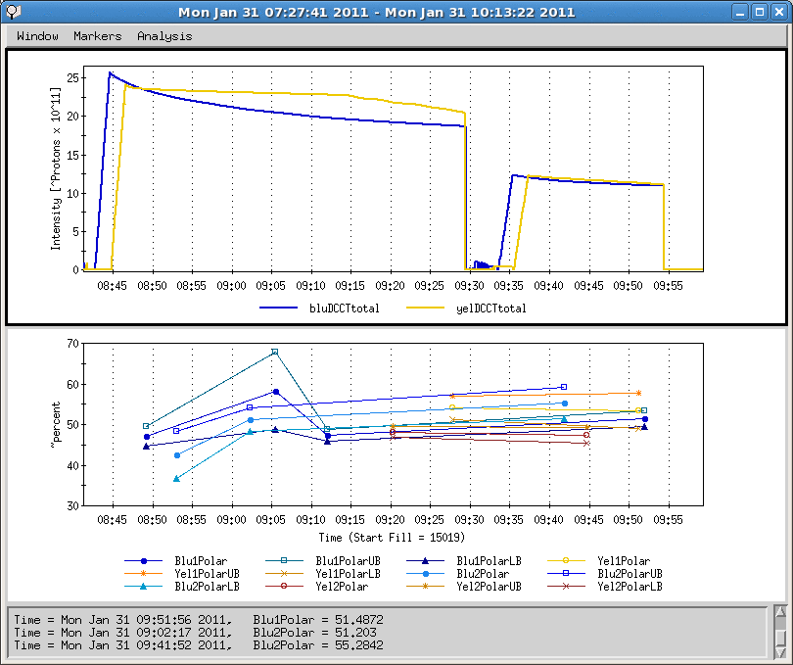
Polarization-Intensity Scan at Injection
Not enough statistics yet.

Slide 6
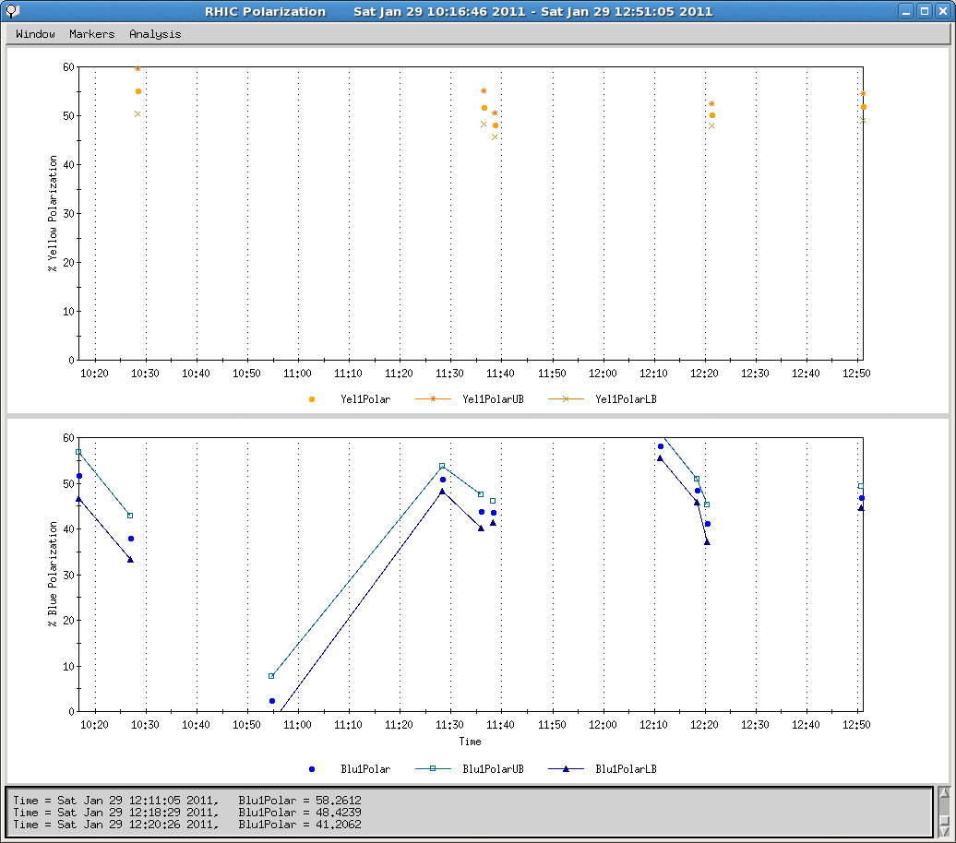
Examples of Transmission Efficiency in Blue

Slide 7
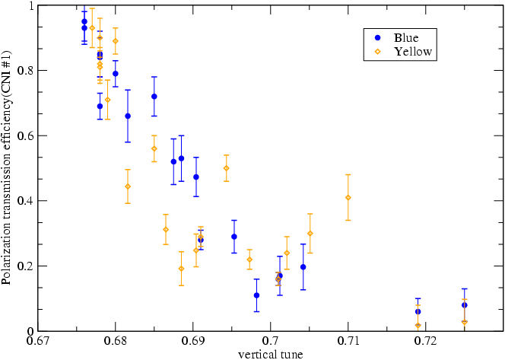
RHIC Polarization Transmission to 250GeV
Two new points compared to the tune scan from run9
94% in yellow and 85% in blue
70% in yellow and 65% in blue
From online polarization measurements
11/16 resonance
7/10 resonance
3/4 resonance
New Working pt 0.675
Working pt for 250GeV run

Slide 8
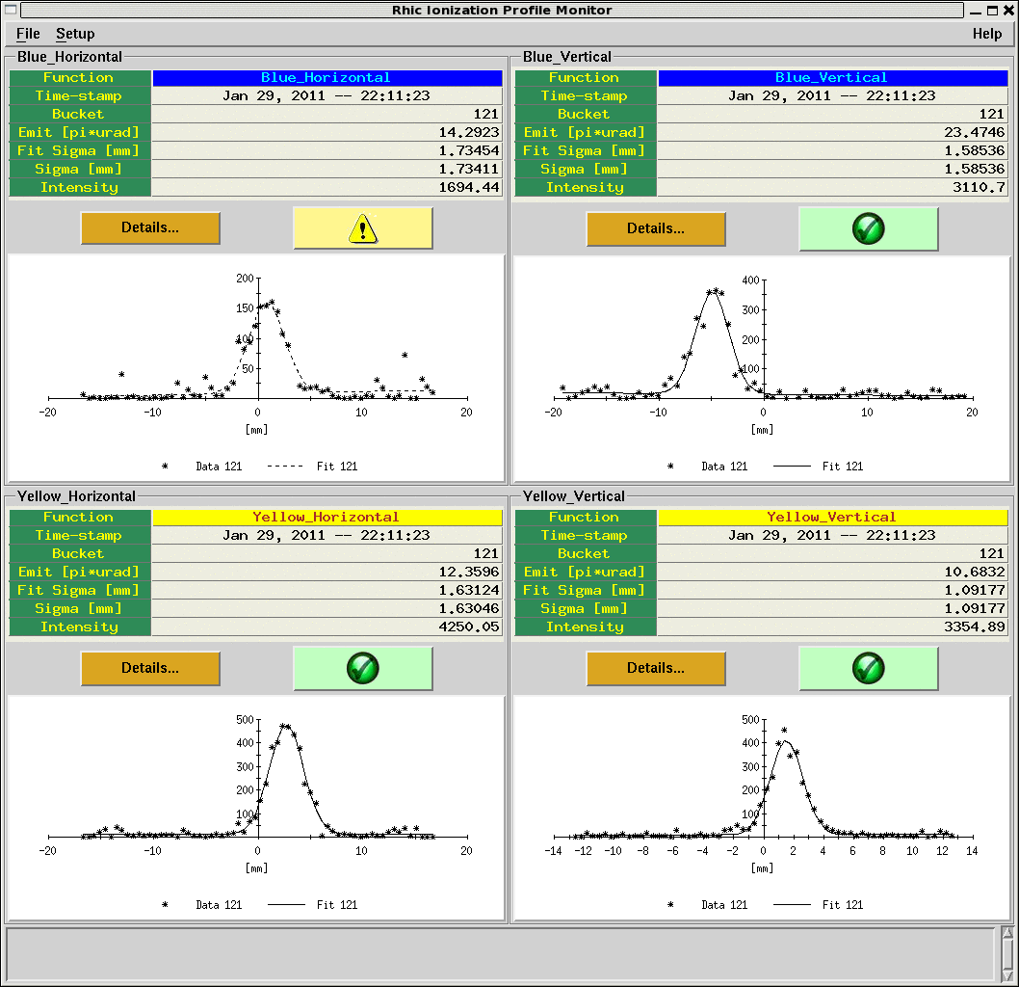
When IPM Behaved (Not Always)

Slide 9
Plan for Today and Tomorrow
  Increase bunch number.
  Commissioning D’ shift ramp when it’s ready (Steve), it is better to do it now when we still have big chunk of time for beam setup.
  Check collimator positions for rotator ramp.
  Check IR collision setup.
  9MHz cavity commissioning.
  Measure polarization at flattop when varying vertical tune on the ramp.
  Overnight store.
  Maintenance Day.

Slide 10
Overall Schedule
Cool-Down Mode : one week (01/03-01/09)
Injection setup (6 days: first 4 days are blue only) (01/10-01/15).
Ramp development (6 days) (01/16-01/21)
Commissioning 9MHz at injection and on the ramp (5 days) (01/19-01/23)
Store development (6 days) (01/22-01/27)
Ramp development with intense beam (7 days) (01/28-02/03).

