Slide 1
9 MHz Commissioning
Several successful ramps to store
No beam loss (thanks to well tuned ramp)
Power supply switch-over transient is not a problem
Developed llrf feedback algorithms for the bouncer cavities
Outstanding issue is getting average radius as good as with the 28 MHz ramps
We have been working with low intensity bunches
Proton bunches are unstable (no natural Landau damping) in RHIC
Low intensity separates feedback loop stability from single bunch stability
Last night we started adding a Landau cavity in Blue to stabilize high intensity bunches
This is standard practice but it comes at a price
It can cause longitudinal emittance growth which defeats the benefit of 9 MHz {here emittance = 0.7 eVs}
Requires running Landau cavity at low voltage > beam loading
Next steps are to apply Landau in Yellow and incrementally increase intensity
As we go we are trying to learn what it will take to stabilize very high intensity bunches (3e11) where the trade off between emittance and Landau voltage won’t be acceptable

Slide 2
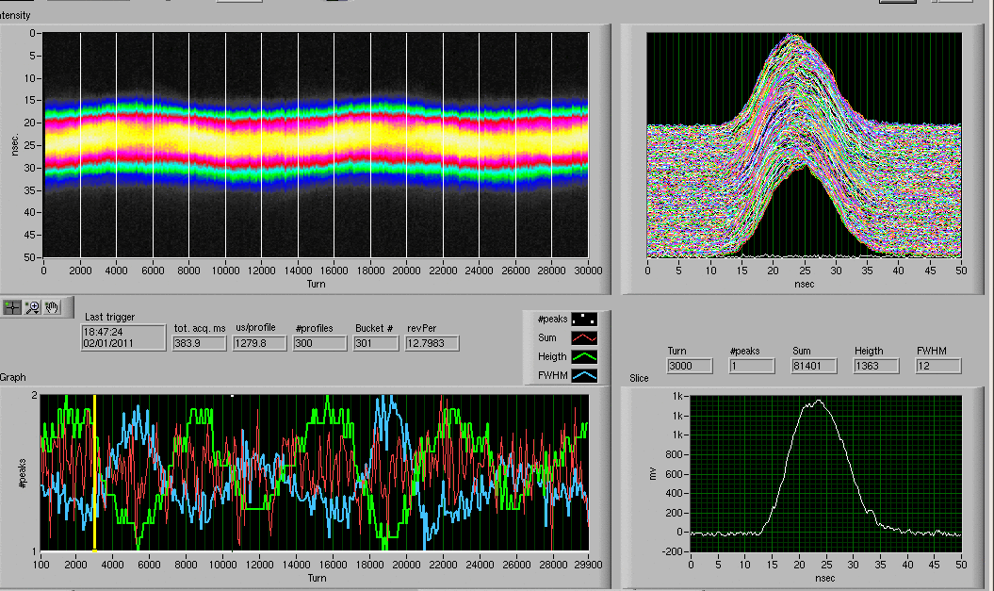
9 MHz Commissioning
Worked out configuration for the loops on the bouncers
Running on the “frequency program” only
No radial loop
Radial steering RTDL frame is still active
Will need to be tweaked to get same Xmean as with 28 MHz system
Outstanding mystery as to why the frequency program does not minimize Xmean
Tested injection with 100 1e11 bunches
Landau cavity provides sufficient damping with acceptable emittance growth
We increase Landau voltage to the same value used for 28 MHz during the ramp
Optimized injection matching to AGS bunch
Counter phase the bouncers to get 17 kV effective
voltage
Energy matching to the AGS requires matching
Blue then Yellow independently
Set up rebucketing into 28 MHz at store
Tweaked the bunch rotation gymnastic in 9 MHz
Have not yet got the correct phasing reproducibly
Ramping up the 197 MHz cavity give short bunches
Next step is to use the system and ramp up the intensity

