Slide 1
BLIP operations 02-15-11
Status – running at 117.5MeV
  BLIP weekly average beam increased to 101.5µA, highest this year. Reliability dropped to 154.0 hours due to failure of mod 5 on Friday. Isotope production of Sr-82, and Be-7 continued, along with LBNE targets downstream of the isotope targets.
Operations issues
  Investigation of cause of Ga targets leaks continues.
    Linac prepared a new tune that was very similar to last year’s operation. A fresh Ga target was installed but leaked after ~1.5 days, consistent with previous results. We now are trying to get octupole magnets working to create a much broader profile.
    We also have noted significant positional instability of the beam spot that seems to be correlated with EBIS activities. Cause unknown.
Research
  Fe-52 nanoparticles were fabricated, dispersed in solvent, injected into a mouse and imaged simultaneously by PET and MRI in a prototype combined scanner. This is the first time this feat has been achieved.

Slide 2
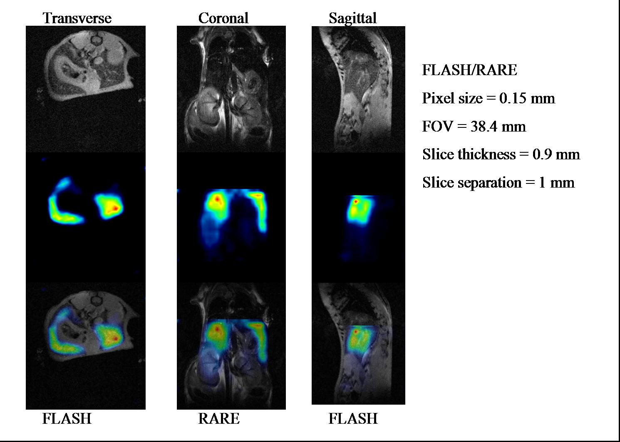
PET/MRI image of Fe-52 nanoparticles

