Slide 1
CRYOGENIC SYSTEM
TIMELINE MEETING
2-22-2011

Slide 2
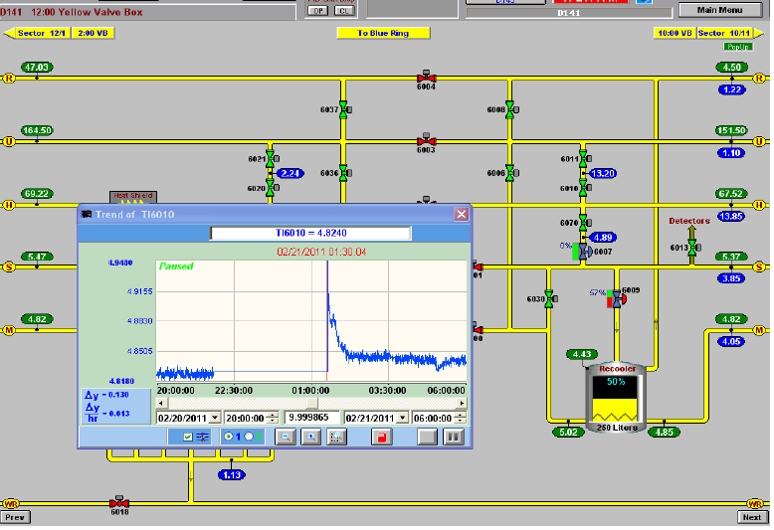
12 Oclock Cryo Control Rack Power:

Slide 3
12 Oclock Cryo Control Rack Power:
PLC alarm for 12 oclock racks
Sector 12, 1012B, Sector 11
Outage at 11:39 PM 2/20 Sunday
Power back at 1:30 AM 2/21 Monday
Recovery: Refill recoolers
Initial diagnosis: 480V power lost a phase
Subsequent: UPS failure, bypass switch not working

