Slide 1
RHIC Status
Haixin Huang
Time Meeting
02/22/2011

Slide 2
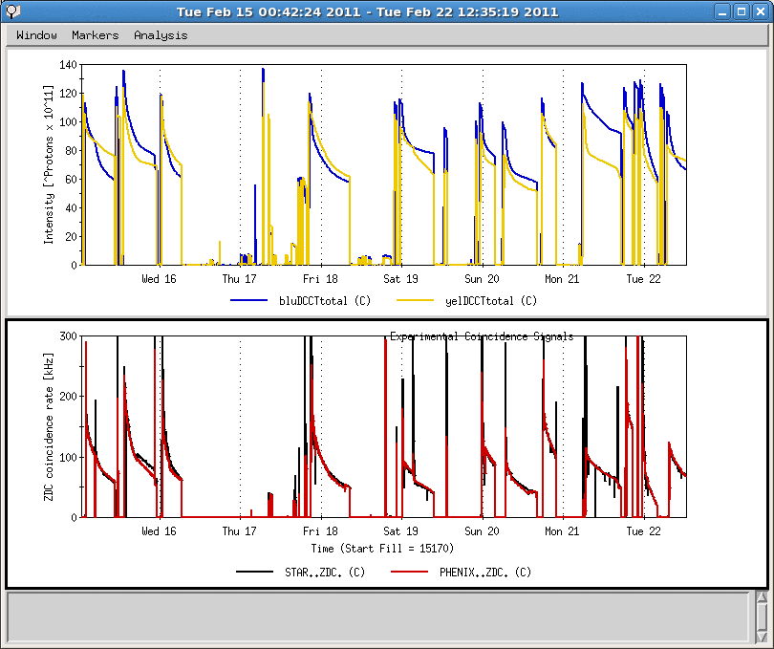
Last One Week
LLRF problem, setup with a patch
Bump closure measurement
PHENIX rotator setup
9B UPS failure
9MHz cavity commissioning
PASS system failure
IP12 cryo UPS failure

Slide 3
Status in Last One Week
10Hz orbit feedback turned on for physics stores. It improves luminosity lifetime.
All four polarimeters are working after moving half of them out of ring.
PHENIX rotators are on, but the currents are not correct for longitudinal polarization, after several iterations.
9MHz cavity commissioning did not went well due to LLRF problem. The PASS failure on the same day delayed the effort to restore the LLRF. The LLRF problem also affected physics run consequently.
Orbit feedback is in operation mode, including rotator ramp.
Existing issues:
  Quick beam loss at beginning of stores. It is not only beam-beam, as it happens for high and low bunch intensities.
  Injection efficiency is not stable, worse for yellow.
  Emittance growth in some ramps resulted lower collision rate.
  Some BPMs went bad, but we could not figure this out without beam.

Slide 4
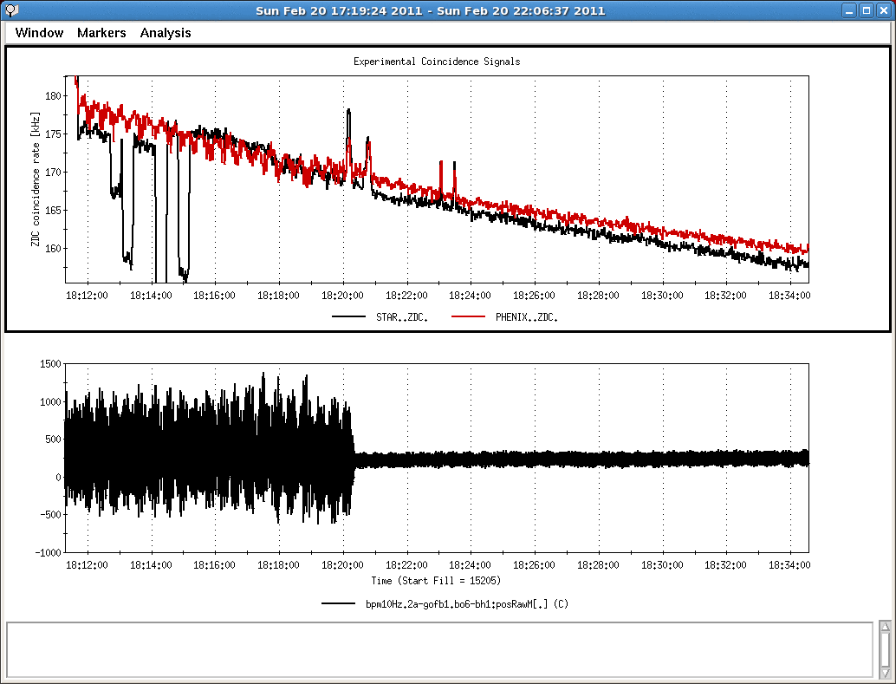
Benefit of 10Hz Feedback on Luminosity

Slide 5
Near Term Plan
  Change optics at beginning of store to improve beam lifetime.
  Improve injection efficiency.
  Put in nonlinear IR correction from last run.
  Increase bunch intensity.
  Need better tool to diagnose the BPM problems.
  Setup ramp with 9MHz cavity

